Slide 1
Lesson 7:
Logs Go Viral
Logarithmic Functions

Slide 2
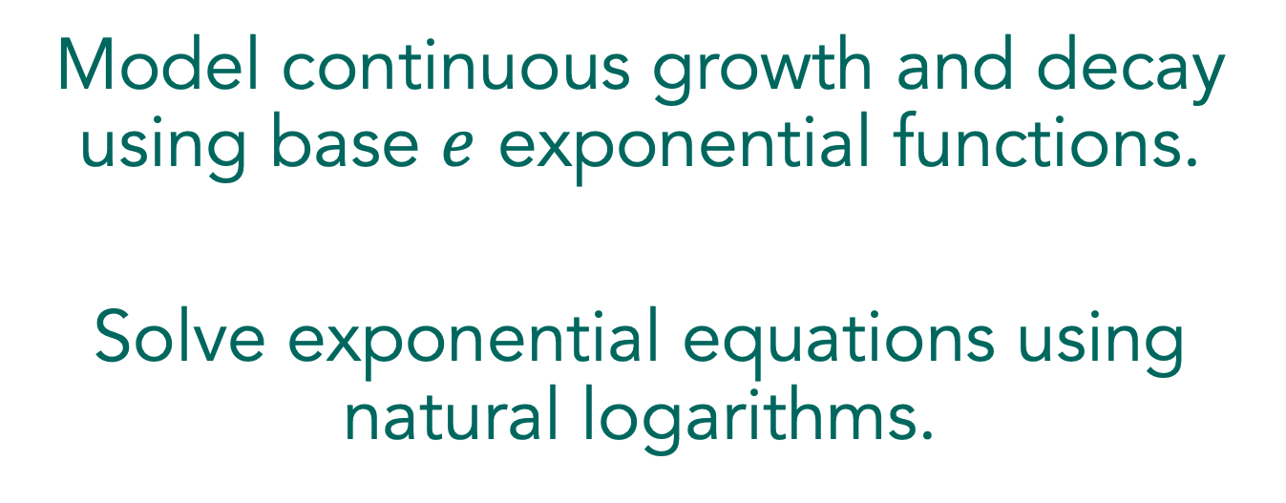
Model continuous growth and decay using base $e$ exponential functions.
Solve exponential equations using natural logarithms.

Slide 3

Logs Go Viral
Read the first paragraphs of the lesson and explain continuous growth and decay and the use of the base $e$ exponential.
Notes:
Using a Three Reads Routine might be helpful here to help students make sense of the situation.
Be sure students understand the variables in the formulas and that e is the constant they learned about in the previous lesson. (When students first learn about e, they often have to be reminded that it is not a variable.) Have students complete problem 1 individually. Have students use the formula to write and solve the equation for about three minutes, then discuss the solution with the class. Ask if the number of people infected is more or less than expected. Explain to students that in the first part of the task, they use representations to model the spread of the virus in the population.

Slide 4
Logs Go Viral
Independently, begin working through problems 2 and 3.
Notes:
Have students working independently for 2 minutes.

Slide 5
Logs Go Viral
With a partner, continue working through problems 2 and 3.
Notes:
As students work on problem 2, encourage them to use the formula and to use time for the independent variable. Encourage the use of technology for graphing the equation and for creating a table.
The two most common approaches students will use when working on problem 3 are using the graph and trying to solve the equation algebraically. Listen for how students are thinking about “undoing” the base e exponential. They should be talking about a base e logarithm, although they have not been introduced to natural log notation. When most students have talked about problem 3 with their partners, then move to the class discussion.

Slide 6

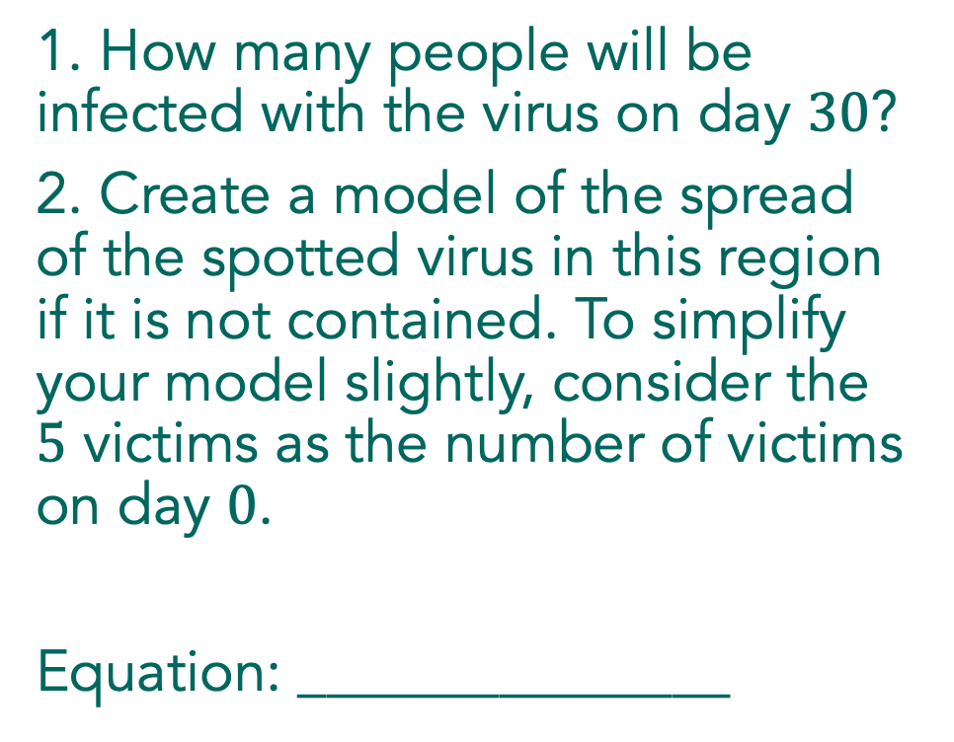
Logs Go Viral
1. How many people will be infected with the virus on day $30$?
2. Create a model of the spread of the spotted virus in this region if it is not contained. To simplify your model slightly, consider the $5$ victims as the number of victims on day $0$.
Equation: _______________
Notes:
Begin the discussion with a student who used the formula to make a table of values. Ask the class about the small number of people infected by the virus to show students the nature of an exponential function. Exponential growth initially grows slowly and has big increases as time goes on.

Slide 7

Logs Go Viral
3. When does your model predict there will be $50$ victims? Show how you arrived at your answer.
Notes:
Continue the discussion with problem 3, asking students to demonstrate solving the equation graphically and beginning to solve algebraically. The algebraic solution creates a need for base e logarithm. Introduce the natural logarithm and demonstrate how to find it on the calculator and how to use it to finish solving the equation in problem 3.

Slide 8
Logs Go Viral
Independently, continue working through problems 4 – 12.
Notes:
As students are working individually, do a quick check to see that they are thinking exponentially, not linearly, about the number of days necessary to double the number of victims. If students are using linear reasoning, support them in writing and solving an equation to find the number of days for the virus to claim 100 victims (problem 5) and then ask why the answer does not correspond to their reasoning. After most students have completed problem 6, ask students to share with a partner and then complete the task working in pairs or small groups.

Slide 9
Logs Go Viral
With a partner, continue working through problems 4 – 12.
Notes:
After most students have completed problem 6, ask students to share with a partner and then complete the task working in pairs or small groups.
To begin the discussion, identify a student who has solved problem 7 algebraically. Choose a student to share problem 8 who can describe how to solve the equation but may not use proper notation to communicate their steps. This will give the class an opportunity to examine and discuss notation for the natural log.

Slide 10
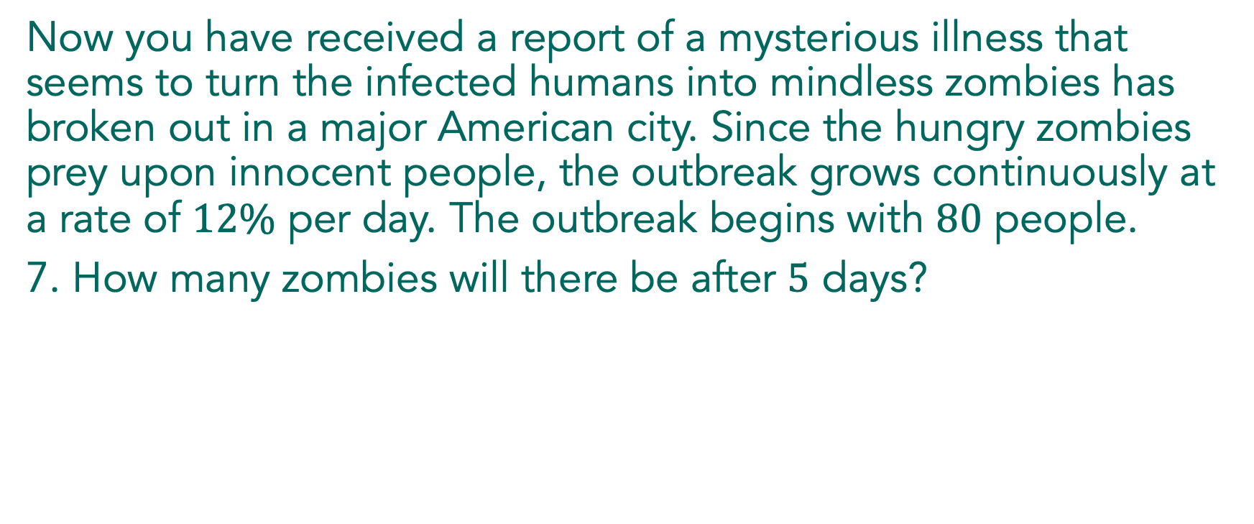
Logs Go Viral
Now you have received a report of a mysterious illness that seems to turn the infected humans into mindless zombies has broken out in a major American city. Since the hungry zombies prey upon innocent people, the outbreak grows continuously at a rate of $12\%$ per day. The outbreak begins with $80$ people.
7. How many zombies will there be after $5$ days?
Notes:
The focus of the discussion will be on solving equations in the context of exponential growth and decay. Students are ready to discuss when they have completed problem 9.
Begin the discussion with problem 7, by asking a student to describe how they used the formula and demonstrate how to use technology to find a value. Then ask a student to describe the steps they used to solve the equation in problem 8. Record the steps as they demonstrate their work and support their use of the natural log notation.

Slide 11
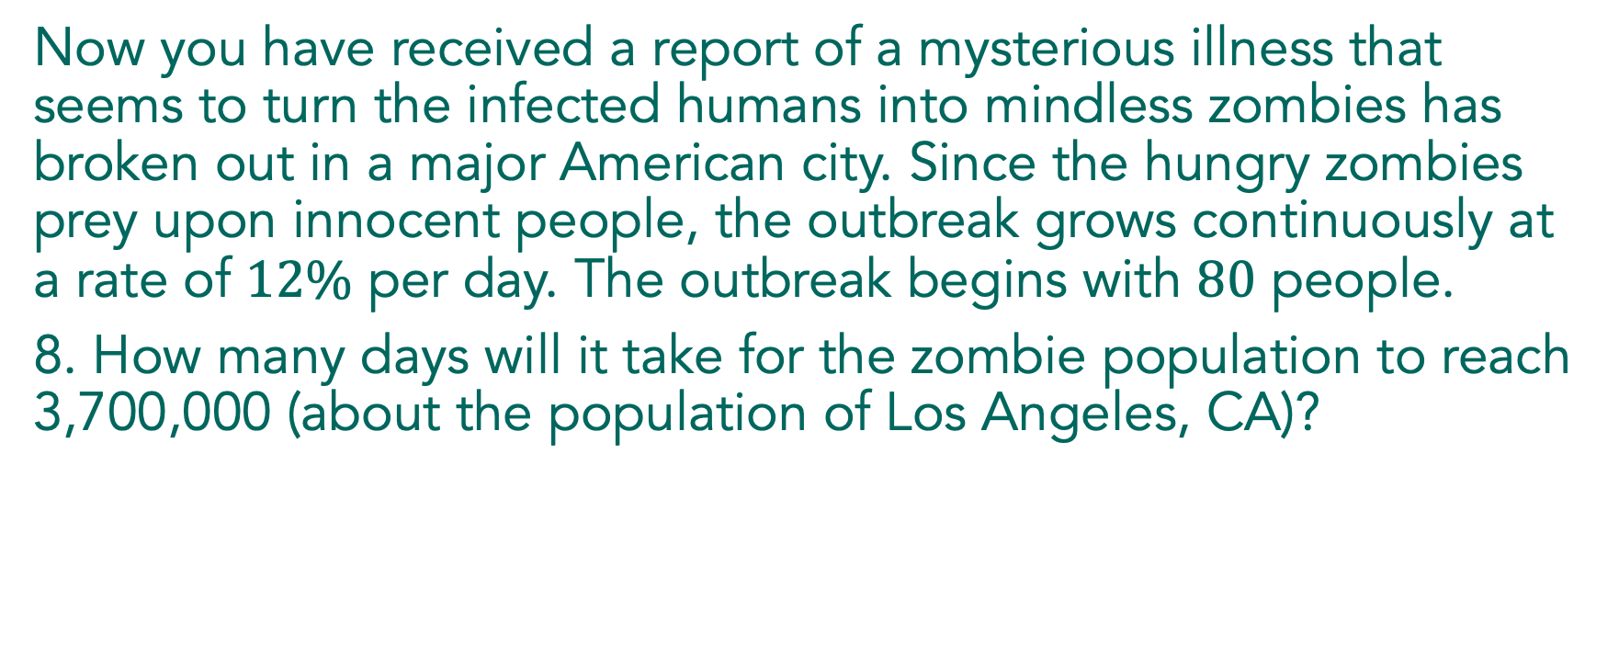
Logs Go Viral
Now you have received a report of a mysterious illness that seems to turn the infected humans into mindless zombies has broken out in a major American city. Since the hungry zombies prey upon innocent people, the outbreak grows continuously at a rate of $12\%$ per day. The outbreak begins with $80$ people.
8. How many days will it take for the zombie population to reach 3,700,000 (about the population of Los Angeles, CA)?
Notes:
The focus of the discussion will be on solving equations in the context of exponential growth and decay. Students are ready to discuss when they have completed problem 9.
Begin the discussion with problem 7, by asking a student to describe how they used the formula and demonstrate how to use technology to find a value. Then ask a student to describe the steps they used to solve the equation in problem 8. Record the steps as they demonstrate their work and support their use of the natural log notation.

Slide 12
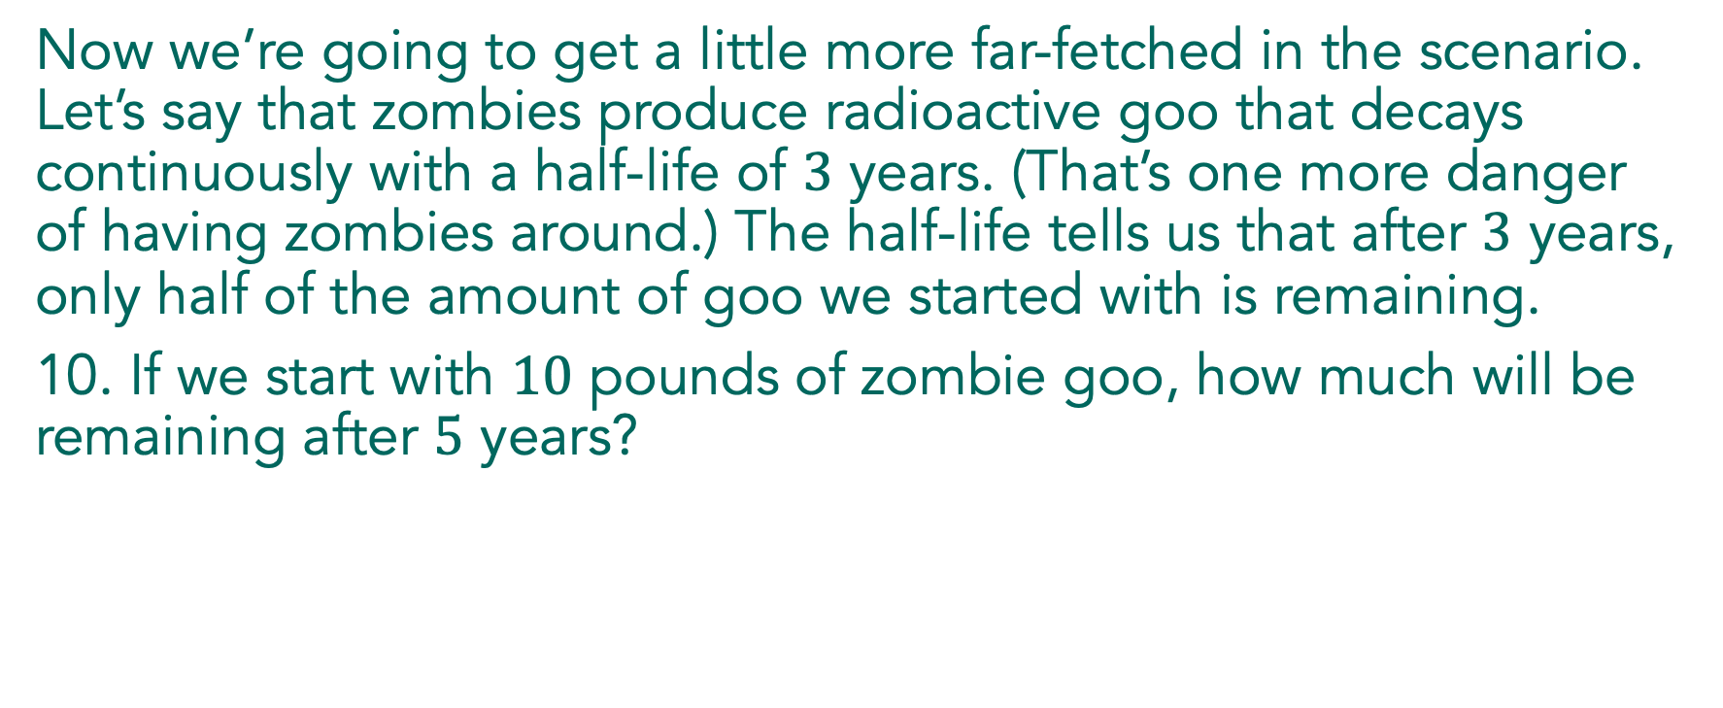
Logs Go Viral
Link to Graphing Calculator
Now we’re going to get a little more far-fetched in the scenario. Let’s say that zombies produce radioactive goo that decays continuously with a half-life of $3$ years. (That’s one more danger of having zombies around.) The half-life tells us that after $3$ years, only half of the amount of goo we started with is remaining.
10. If we start with $10$ pounds of zombie goo, how much will be remaining after $5$ years?
Notes:
Have a student show how they solved problem 10. If time permits, use technology to model the decay of the goo, and ask students how they could verify their solution to problem 10 graphically. Use the graph to discuss problems 11 and 12. Ask if the zombie goo will ever be entirely gone, using both the graph and an equation to support their answers.

Slide 13
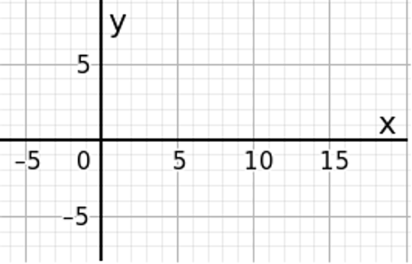

Graph $y=lnx$.

Slide 14
Solving an exponential equation with a variable in the exponent:

Slide 15
There are some nasty little bacteria hiding under that rotten banana peel in your bedroom. There are 20 bacteria now and they grow continuously at a rate of 5% every hour. How long will it take for the bacteria population to double?

Slide 16
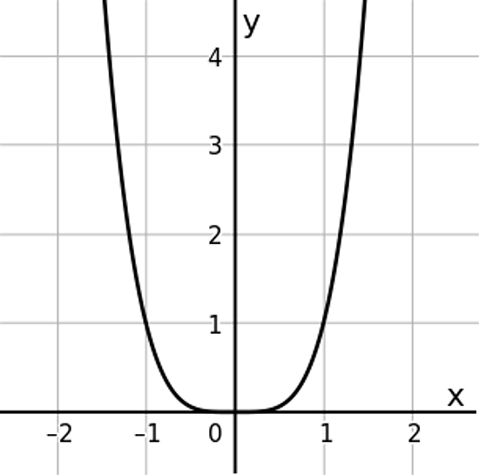

1. How do you know that the graph of $y=x^{4}$ it is NOT the graph of $y=x^{2}$?

Slide 17
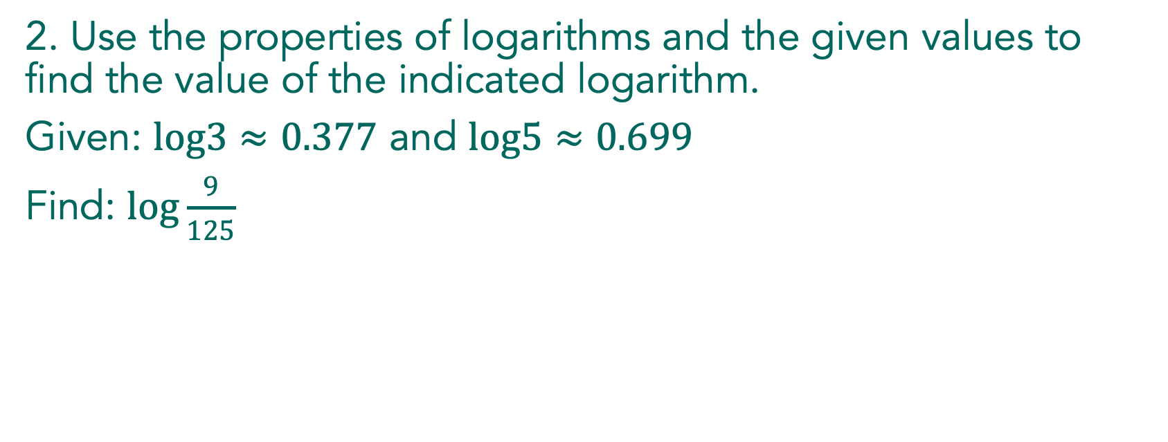
2. Use the properties of logarithms and the given values to find the value of the indicated logarithm.
Given: $log3≈0.377$ and $log5≈0.699$
Find: $log\frac{9}{125}$

