Slide 1
Lesson 6:
Compounding the Problem
Logarithmic Functions

Slide 2
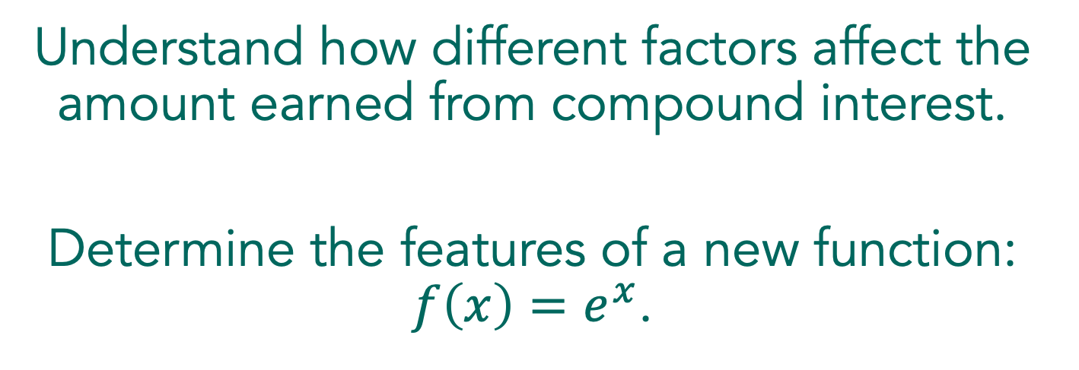
Understand how different factors affect the amount earned from compound interest.
Determine the features of a new function: $f\left(x\right)=e^{x}$.

Slide 3
Compounding the Problem
What does it means to earn compound interest on an investment?
Notes:
Routine: Pause and Record
Begin the lesson by asking students what it means to earn compound interest on an investment. Discuss with students that when an account pays compound interest, interest is earned on the entire amount in the account at the time, which includes the principal and any interest that was previously earned. Compound interest accounts have a specific compounding period, which is how often the interest is paid. Make sure that students understand what is being asked and the various parts of the compound interest formula explained in the task.

Slide 4
Compounding the Problem
Part I: As an enterprising young mathematician, you know that your superior knowledge of mathematics will help you make better decisions about all kinds of things in your life. One important area is money $$$. So, you’ve been contemplating the world and wondering how you could maximize the money that you make in your savings account.
You’re young and you haven’t saved much money yet. As a matter of fact, you only have $100, but you really want to make the best of it. You like the idea of compound interest, meaning that the bank pays you interest on all the money in your savings account, including whatever interest that they had previously paid you.
Notes:
Read text

Slide 5
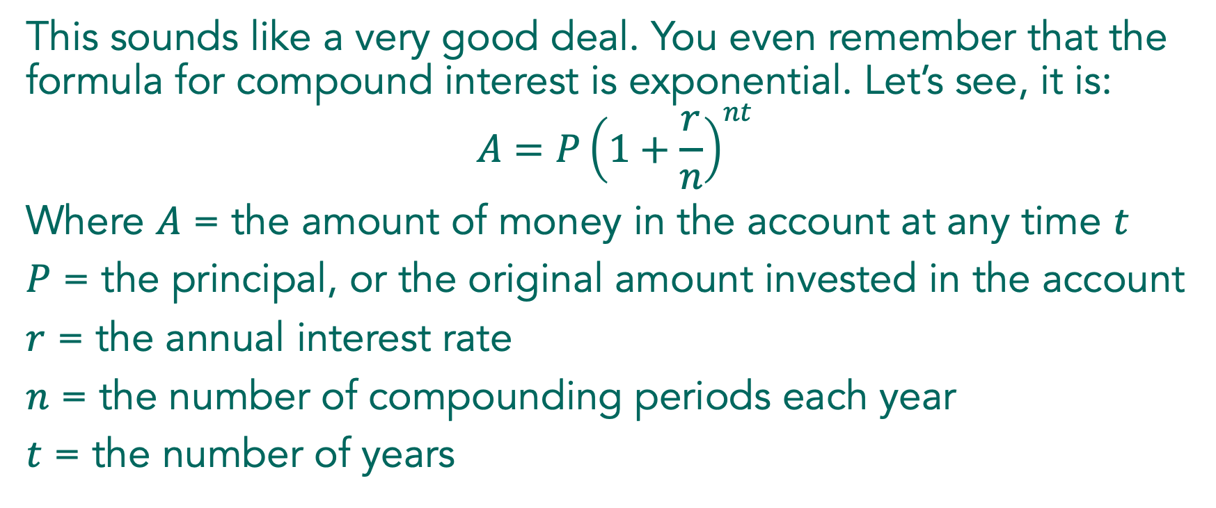
Compounding the Problem
This sounds like a very good deal. You even remember that the formula for compound interest is exponential. Let’s see, it is:
$$A=P{\left(1+\frac{r}{n}\right)}^{nt}$$
Where $A$ = the amount of money in the account at any time $t$
$P$ = the principal, or the original amount invested in the account
$r$ = the annual interest rate
$n$ = the number of compounding periods each year
$t$ = the number of years

Slide 6
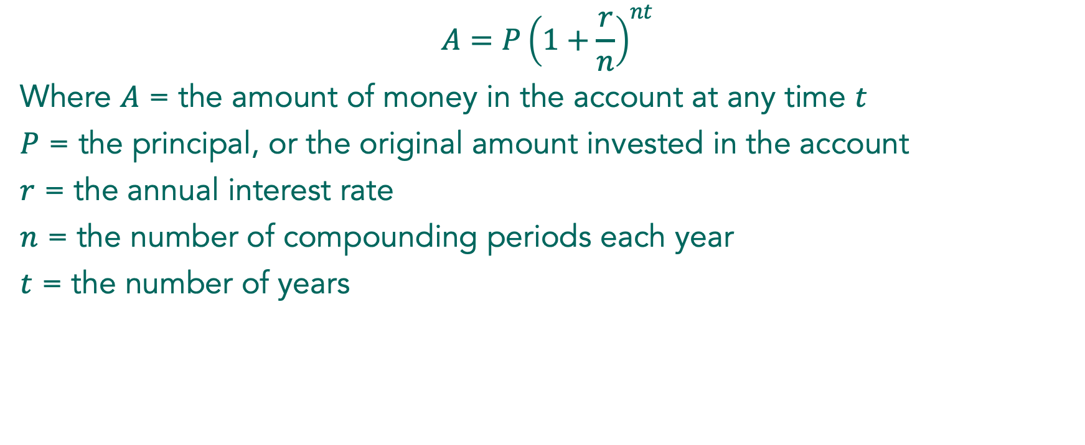
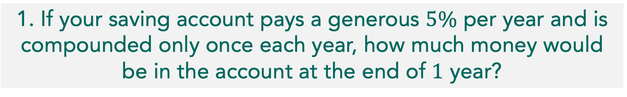
Compounding the Problem
$$A=P{\left(1+\frac{r}{n}\right)}^{nt}$$
Where $A$ = the amount of money in the account at any time $t$
$P$ = the principal, or the original amount invested in the account
$r$ = the annual interest rate
$n$ = the number of compounding periods each year
$t$ = the number of years
1. If your saving account pays a generous $5\%$ per year and is compounded only once each year, how much money would be in the account at the end of $1$ year?
Notes:
Model how to use the formula with problem 1 and then have students complete problem 2 individually, making sure students are able to use the formula and calculator to correctly answer.

Slide 7
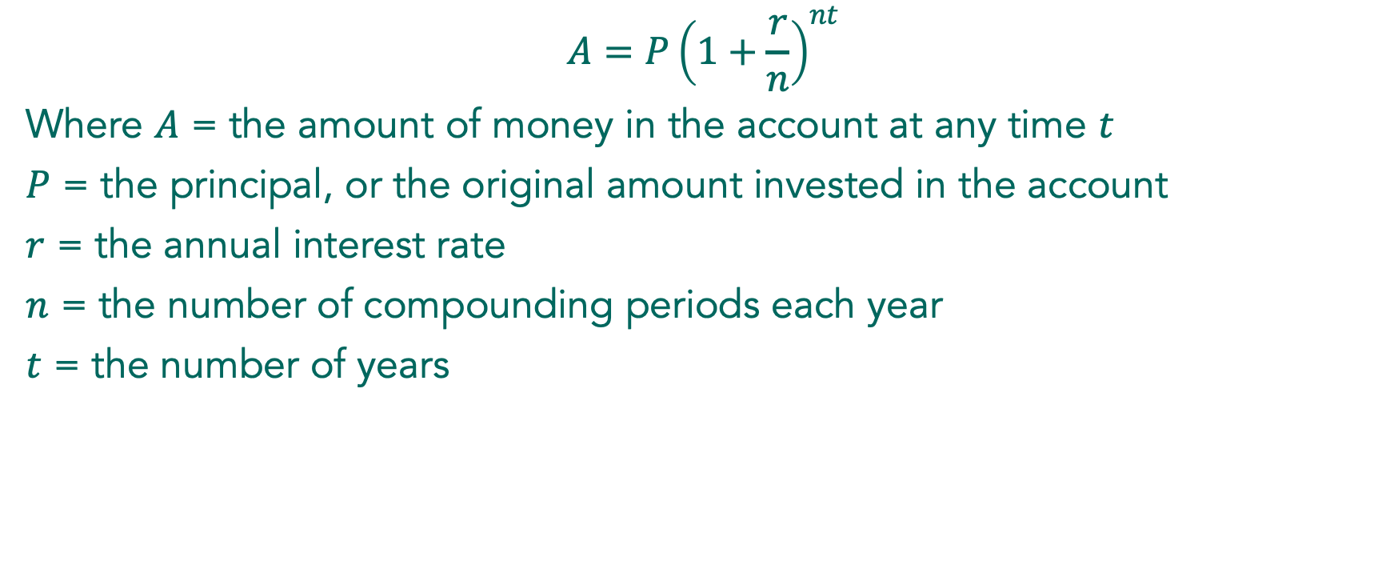

Compounding the Problem
$$A=P{\left(1+\frac{r}{n}\right)}^{nt}$$
Where $A$ = the amount of money in the account at any time $t$
$P$ = the principal, or the original amount invested in the account
$r$ = the annual interest rate
$n$ = the number of compounding periods each year
$t$ = the number of years
2. How much money would be in the account at the
end of $20$ years?
Notes:
Model how to use the formula with problem 1 and then have students complete problem 2 individually, making sure students are able to use the formula and calculator to correctly answer.
Ask students, Does increasing the number of compounding periods have a big effect on how much money is earned?

Slide 8
Compounding the Problem
Independently, begin working on problem 3.

Slide 9

Compounding the Problem
With a partner, continue working on problem 3.
Organize your results so they can be displayed
Use the formula: $A=P{\left(1+\frac{r}{n}\right)}^{nt}$

Slide 10
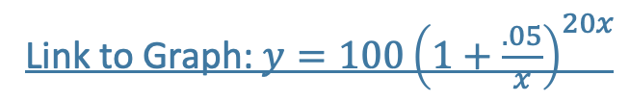
Compounding the Problem
Link to Graph: $y=100{\left(1+\frac{.05}{x}\right)}^{20x}$
Notes:
Begin the discussion of the first part of the task with a student created table.
Ask students what they notice about the table. What would the graph of this function look like based on the table? If students have tried to create a graph, ask them to show their work. If not, ask students how they could see the function graphically using the formula.
Use technology to graph: . It may be necessary to discuss how the work done to create the table leads to this function. Depending on the window selected, this graph may look like a horizontal line. Ask students to interpret what they see. Is the graph actually horizontal? Trace along the graph to show that it is actually increasing very slightly as it converges toward .
Tell students that the analysis they have done in problem 3 has led people to think about what would happen mathematically if money in an account were compounded continuously. Explain the formula given in the task, with all the variables being the same as the previous formula, but without the number of compounds per year. Make sure that students understand that in the formula is a constant that they can find on their calculators, not a variable.

Slide 11
Compounding the Problem
With a partner, work through problems 3-7.
Notes:
As students are working on problems 4 and 5 with their partners, check to see that they are able to use the compound interest formula. Problems 4 and 5 connect to work with problem 3 to show the effect of changing the number of compounding periods. Students may not recognize that t is the independent variable and the amount of money in the account is the dependent variable, partly because the graph they worked with previously had the number of compounding periods as the independent variable. If students are having trouble with this, ask them what parts of the formula they know and what they are looking for. They have been given values for everything but time and the amount of money in the account. For problem 5, students may need support in finding a viewing window and tracing the functions to recognize the difference between the functions over time. Encourage students to look past ten years because the differences become more noticeable over time.
Begin the second part of the discussion by selecting a student to share problem 4 who has correctly used the two formulas to compare the accounts. To discuss the problems in Part II, choose a student to share problem 7 who used technology to graph y=e^x and identify its mathematical features such as domain and range.

Slide 12
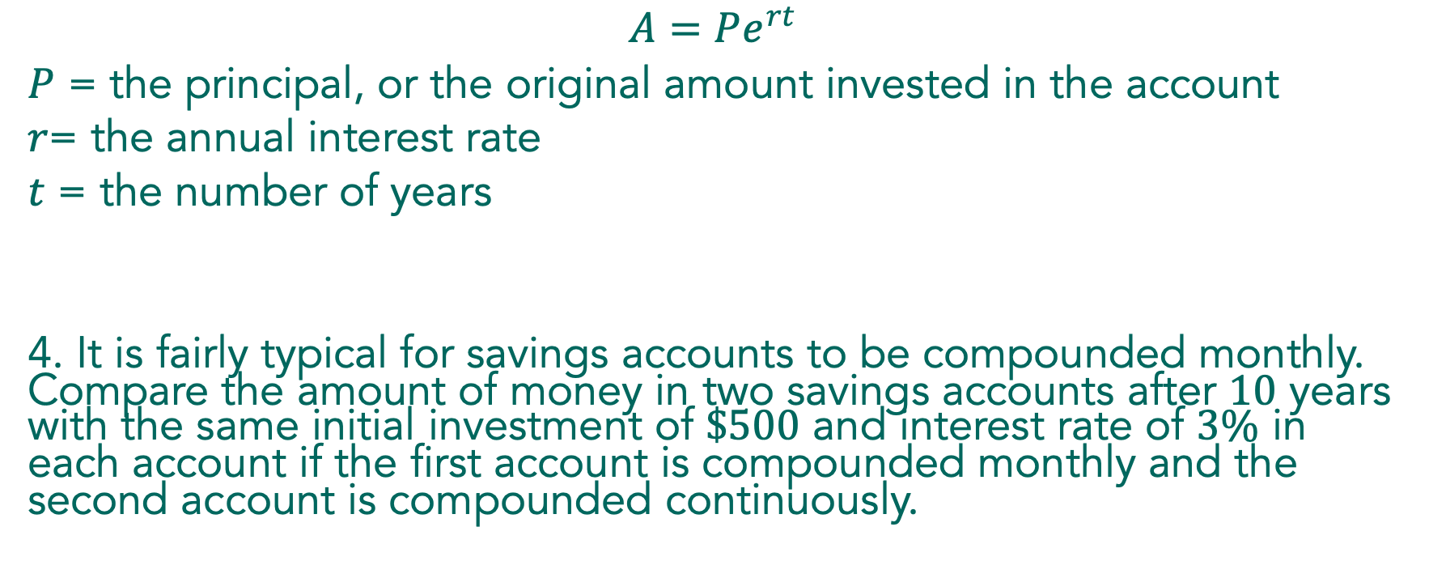
Compounding the Problem
$$A=Pe^{rt}$$
$P$ = the principal, or the original amount invested in the account
$r$= the annual interest rate
$t$ = the number of years
4. It is fairly typical for savings accounts to be compounded monthly. Compare the amount of money in two savings accounts after $10$ years with the same initial investment of $\$500$ and interest rate of $3\%$ in each account if the first account is compounded monthly and the second account is compounded continuously.

Slide 13
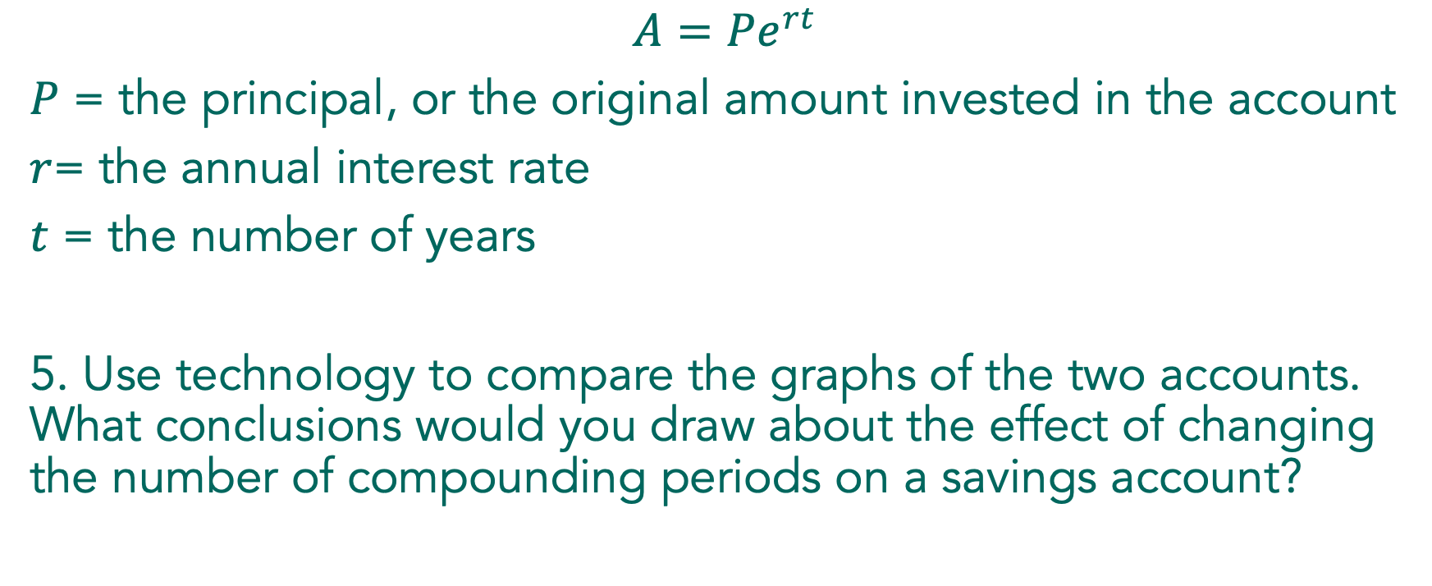
Compounding the Problem
$$A=Pe^{rt}$$
$P$ = the principal, or the original amount invested in the account
$r$= the annual interest rate
$t$ = the number of years
5. Use technology to compare the graphs of the two accounts. What conclusions would you draw about the effect of changing the number of compounding periods on a savings account?
Notes:
Notice that the two graphs in the solution for problem 5 are nearly the same. Trace along the curves so students can see the difference between the two functions. Ask students what conclusions they would draw about the importance of the number of compounding periods in the investment. If the number of compounding periods doesn’t make much difference, what variables do make a big difference for a given amount of principal? This is a good time for students to notice that since the amount in the account is growing exponentially, the amount doesn’t grow much in the first few years but takes off after a number of years.

Slide 14

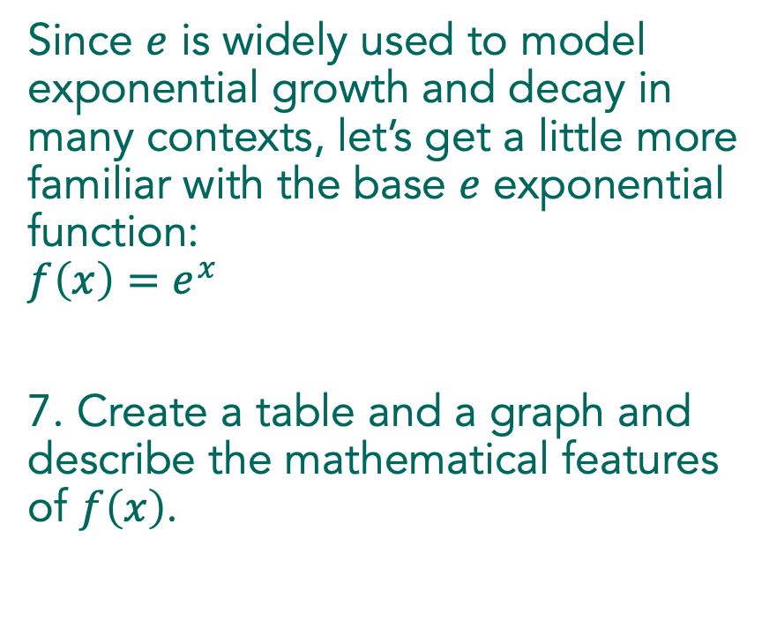
Compounding the Problem
Since $e$ is widely used to model exponential growth and decay in many contexts, let’s get a little more familiar with the base $e$ exponential function:
$$f\left(x\right)=e^{x}$$
7. Create a table and a graph and describe the mathematical features of $f\left(x\right)$.
Notes:
Wrap up the lesson with a discussion of the features of f(x)=e^x. Be sure to highlight how this function is similar to other exponential functions students have learned. Note the importance of e. Just as Pi occurs naturally as the ratio of the diameter to the circumference in a circle, e occurs naturally in continuous growth situations. The next task will provide more opportunities to work with continuous growth.

Slide 15
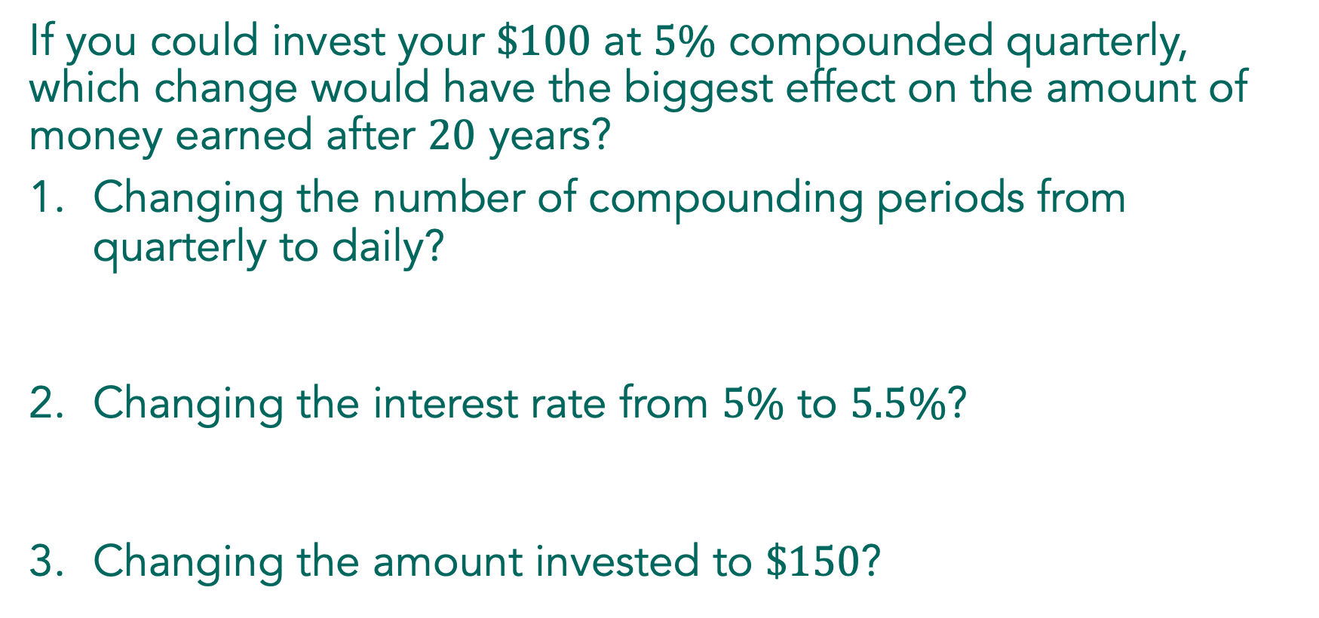
If you could invest your $\$100$ at $5\%$ compounded quarterly, which change would have the biggest effect on the amount of money earned after $20$ years?
Changing the number of compounding periods from quarterly to daily?
Changing the interest rate from $5\%$ to $5.5\%$?
Changing the amount invested to $\$150$?

Slide 16

Features of $f\left(x\right)=e^{x}$:

Slide 17

Use the formula $A=Pe^{rt}$ to find the amount of money in a savings account after 10 years if $250 is invested at 2% per year, compounded continuously.
Notes:
This is a quick check to see that students understand how to use the number e in a formula. There will be more opportunities to work with the continuous growth formula in the next lesson. If there are common misconceptions or errors in student work, use the work in the next lesson to address the misconceptions.

Slide 18
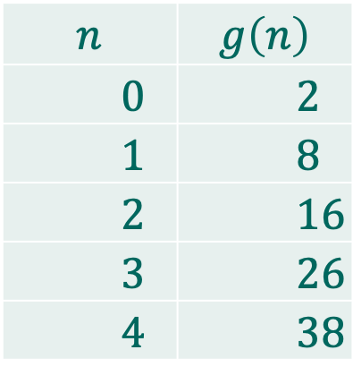
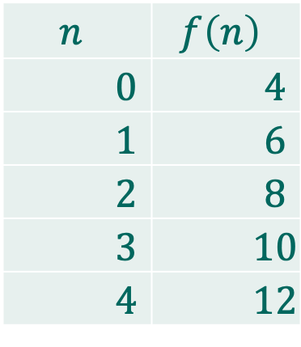
1. Use first and second differences to identify the type of function represented by the pattern in each table. If the pattern in the table is linear, write both the explicit and the recursive equations. If the pattern is quadratic, write only the recursive equation.
a. Table 1: b. Table 2:
$$n$$ | $$f\left(n\right)$$
$0$ | $4$
$1$ | $6$
$2$ | $8$
$3$ | $10$
$4$ | $12$
$$n$$ | $$g\left(n\right)$$
$0$ | $2$
$1$ | $8$
$2$ | $16$
$3$ | $26$
$4$ | $38$

Slide 19
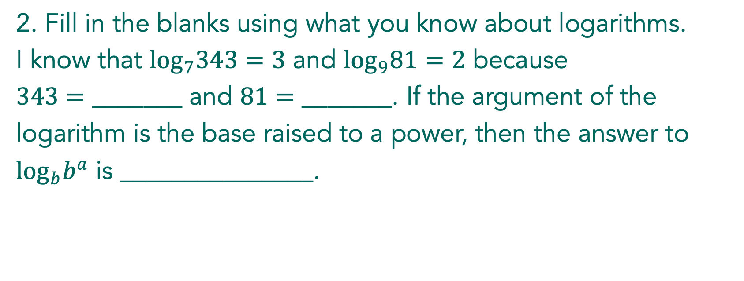
2. Fill in the blanks using what you know about logarithms.
I know that $\log_{7}343=3$ and $\log_{9}81=2$ because
$343=$ _______ and $81=$ _______. If the argument of the
logarithm is the base raised to a power, then the answer to
$\log_{b}b^{a}$ is _______________.

