Slide 1
Lesson 5:
Common Sense
Logarithmic Functions

Slide 2
Use logarithms to solve exponential equations.
Solve systems of equations that contain exponential functions.

Slide 3
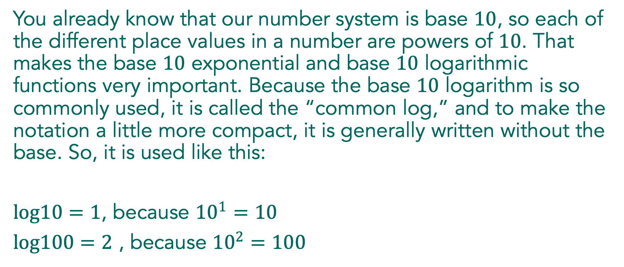
Common Sense
You already know that our number system is base $10$, so each of the different place values in a number are powers of $10$. That makes the base $10$ exponential and base $10$ logarithmic functions very important. Because the base $10$ logarithm is so commonly used, it is called the “common log,” and to make the notation a little more compact, it is generally written without the base. So, it is used like this:
$log10=1$, because ${10}^{1}=10$
$log100=2$ , because ${10}^{2}=100$
Notes:
Begin the Launch with reading and discussing base 10 logarithms, as detailed in the narrative at the beginning of the task. Be sure that students are clear on the meaning of a term like log16.

Slide 4
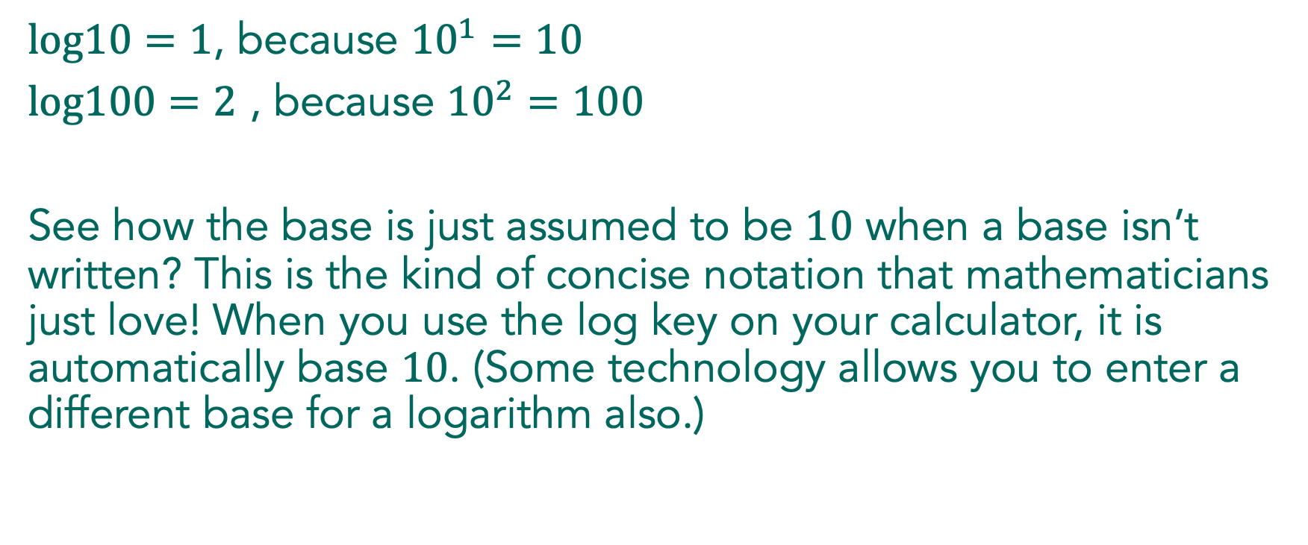
Common Sense
$log10=1$, because ${10}^{1}=10$
$log100=2$ , because ${10}^{2}=100$
See how the base is just assumed to be $10$ when a base isn’t written? This is the kind of concise notation that mathematicians just love! When you use the log key on your calculator, it is automatically base $10$. (Some technology allows you to enter a different base for a logarithm also.)
Notes:
Begin the Launch with reading and discussing base 10 logarithms, as detailed in the narrative at the beginning of the task. Be sure that students are clear on the meaning of a term like log16.

Slide 5
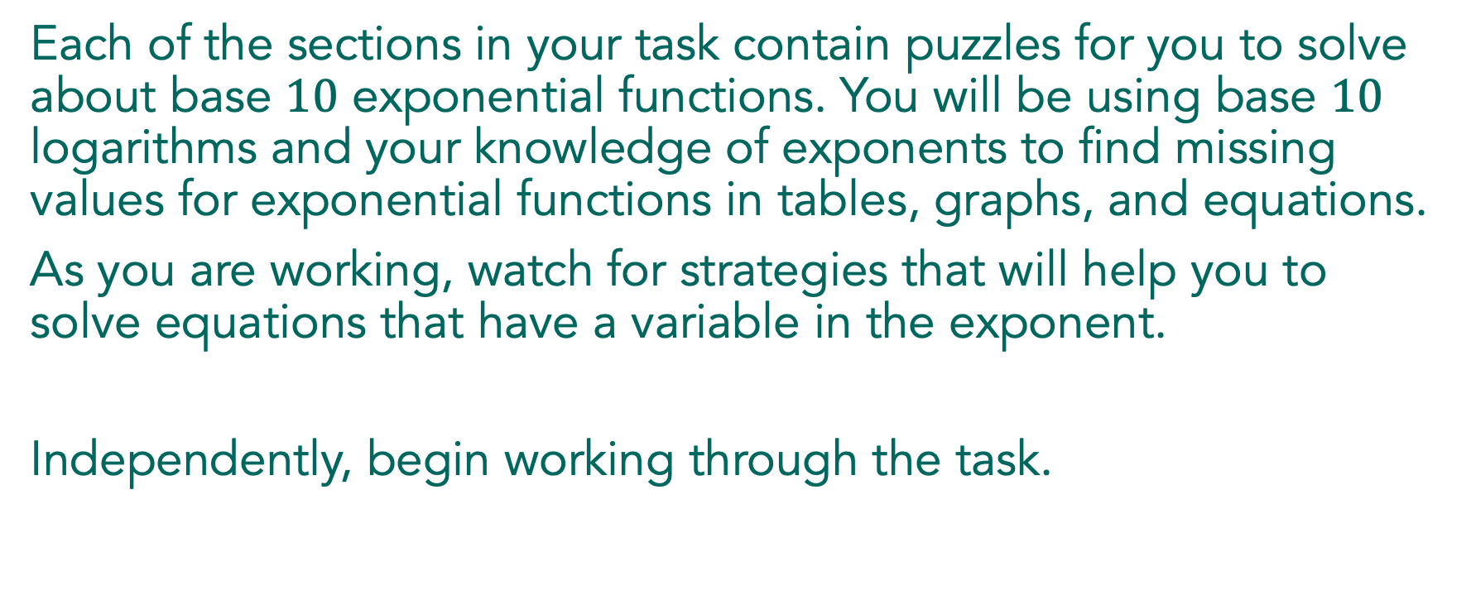
Common Sense
Each of the sections in your task contain puzzles for you to solve about base $10$ exponential functions. You will be using base $10$ logarithms and your knowledge of exponents to find missing values for exponential functions in tables, graphs, and equations.
As you are working, watch for strategies that will help you to solve equations that have a variable in the exponent.
Independently, begin working through the task.
Notes:
As students are working individually, do a quick check to see that they are finding the missing values of x. The first table puzzle is designed for students to think about what a solution to an exponential equation really means. As they are working on the table puzzles, encourage them to consider writing equations as a way to track their strategies. This will help them to think about using a logarithm to undo the exponential function.

Slide 6
Common Sense
With a partner, continue working through the remainder of the task.
Notes:
After most students have completed problem 1, have them share their work with a partner and then finish the task working with a partner or small group.
To build the discussion, begin by selecting a student for problem 1a who has written the solution for y=50 as log50. Choose a student for 3a who has annotated the graph and can demonstrate how they used it to find a solution. For problem 7, select a student to share who can show the algebraic steps and connect their work to the table in 1b. Problem 10 provides an opportunity to address a common algebraic issue. Select a student who mistakenly used logarithmic properties to separate the argument after taking a logarithm of both sides of the equation. Finally, for problem 16, choose a student to share who solved the system of equations graphically.

Slide 7

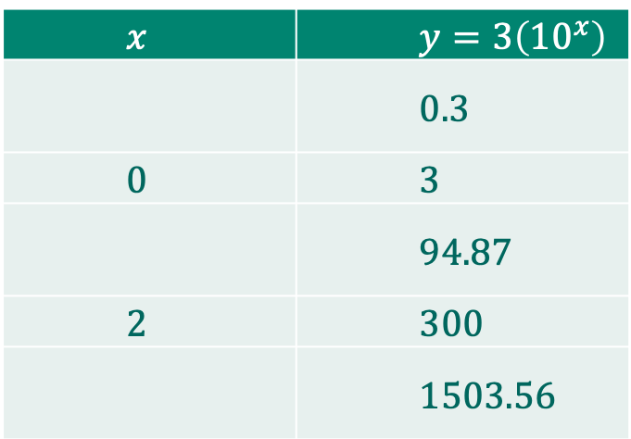
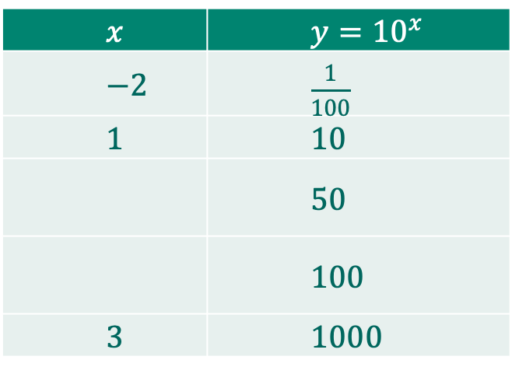
Common Sense
Find the missing values of $x$ in the tables.
a. b.
$x$ | $y={10}^{x}$
$−2$ | $\frac{1}{100}$
$1$ | $10$
 | $50$
 | $100$
$3$ | $1000$
$x$ | $y=3\left({10}^{x}\right)$
 | $0.3$
$0$ | $3$
 | $94.87$
$2$ | $300$
 | $1503.56$
Link to Graph
Notes:
The goal of the discussion is for students to be able to understand how to solve an exponential equation using a logarithm. Students are ready for the discussion when they have completed problem 14.
Begin the discussion with a student who has estimated a value for the third row in table a, where y=50. Encourage the logic that x must be between 1 and 2, but not exactly at x=1.5. Share the idea that the exact value is log50, which they can approximate using technology. If a student has written and solved this as an equation, have them share their work and connect it to the estimated value.
Next, select a student who has used an equation to find the third row of table b, where y=94.87.
The equation written should be: 94.87=3(10^x)
Have them describe how they wrote the equation and then their strategy for solving it. Be sure to have students describe their thinking about how to unwind the function as the steps are tracked on the equation. Ask the class where this point would be on a graph of the function. Ask students what the graph of the function would look like, and; they should be able to describe a base 10 exponential function with a vertical stretch of 3. Display the graph of the function and ask students how it could be used to find the solution of the equation.

Slide 8
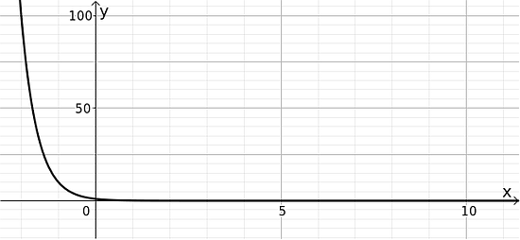

Common Sense
3. The graph of ${10}^{−x}$ is given below. Use the graph to solve the equations for $x$ and label the solutions.
${10}^{−x}=40$
                $x=$ _____________
Notes:
Move the discussion to the graph of y=10^-X. Ask students to describe how they used the graph to find the solution to A, and how they could check the solution in the equation. Does the solution they found with the graph make sense? How would they solve this equation without a graph? Track the steps algebraically.
Make sure students can explain the third step, both using the calculator and writing equivalent expressions on the right side of the equation.
Next, ask students to show their strategies for solving as many of the equation puzzles that time will allow. In every case, be sure students can describe how they use logarithms to undo the exponential and that their notation matches their thinking.

Slide 9
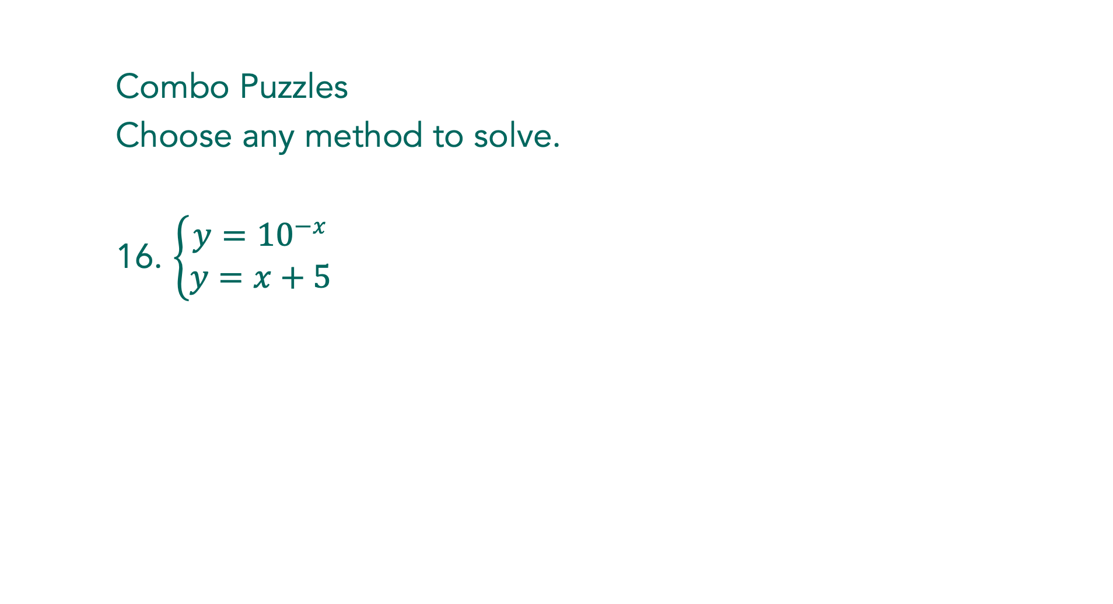
Common Sense
Combo Puzzles
Choose any method to solve.
16. $\left\{\begin{matrix}y={10}^{−x} \\ y=x+5\end{matrix}\right.$
Notes:
Wrap up the discussion with problem 16, one of the systems of equations. Have a student share who has graphed the system and found the intersection and another student who has used a table or inspection to find a solution. If there are any students who tried to get a solution to the system using algebraic methods, have them share their strategy and how far they were able to get using the strategy. Ask the class to explain why algebraic methods won’t lead to a solution in this case.

Slide 10
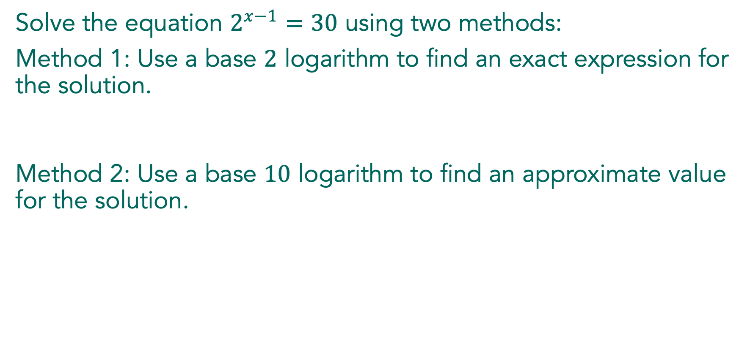
Solve the equation $2^{x−1}=30$ using two methods:
Method 1: Use a base $2$ logarithm to find an exact expression for the solution.
Method 2: Use a base $10$ logarithm to find an approximate value for the solution.

Slide 11
Strategies for solving exponential equations and systems:

Slide 12

Find the solution to each equation:
$50=5\left({10}^{x−1}\right)$
${10}^{2x+1}=1,255$
Notes:
This is a quick check to see that students understood how to use logarithms in solving exponential equations. If the results show students may need some additional help in understanding and showing the steps for solving exponential equations, then work the following problems or use the Set problems to review at the beginning of the next class period. After working the problems together, discuss the answers and why they are reasonable, based on an understanding of exponential and log relationships. Make connections with tables and graphs, if possible.

Slide 13
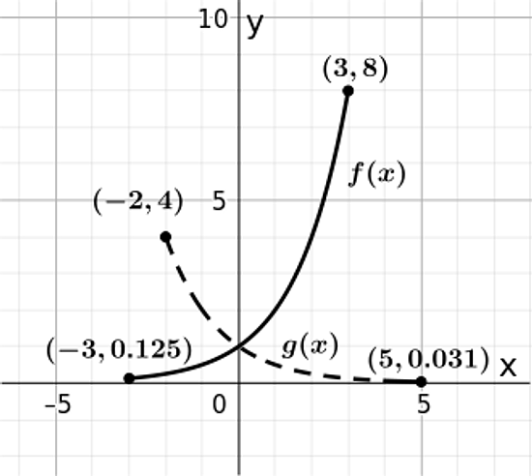
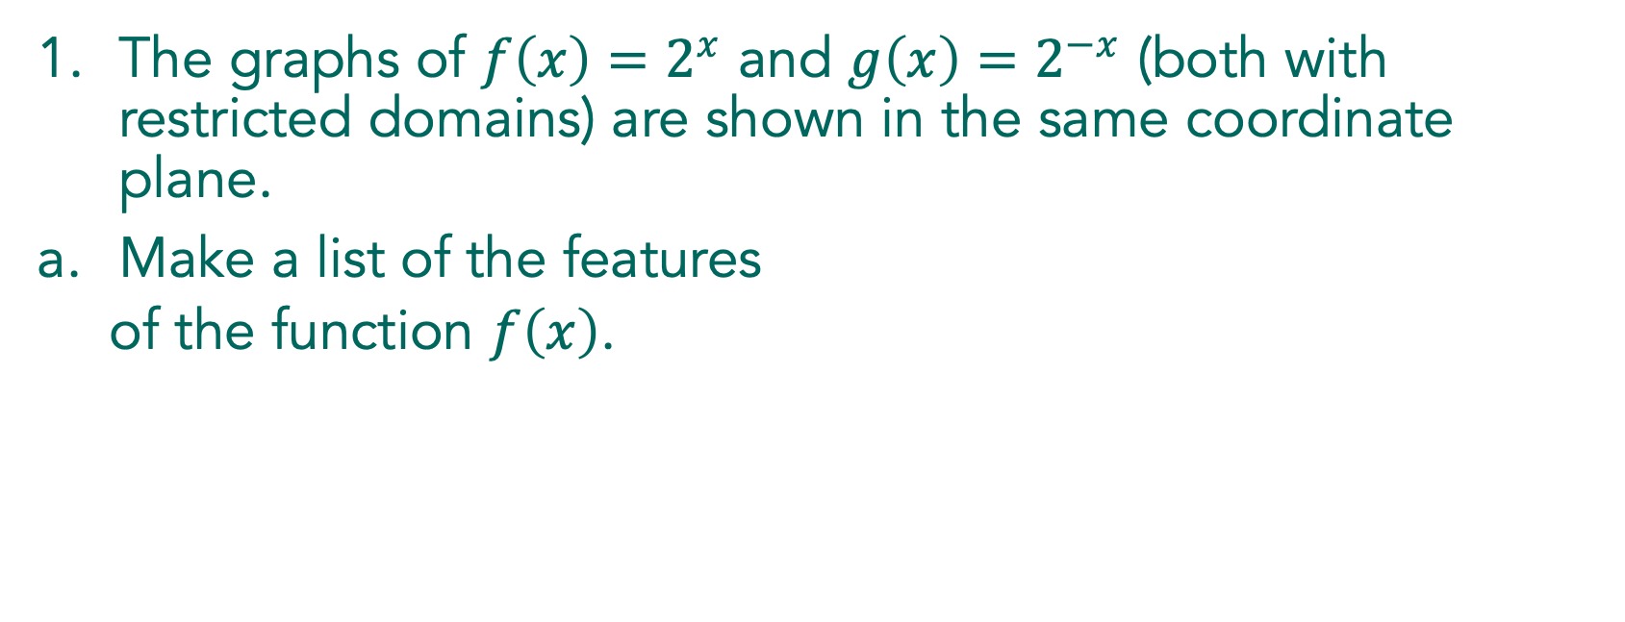
The graphs of $f\left(x\right)=2^{x}$ and $g\left(x\right)=2^{−x}$ (both with restricted domains) are shown in the same coordinate plane.
Make a list of the features
  of the function $f\left(x\right)$.

Slide 14
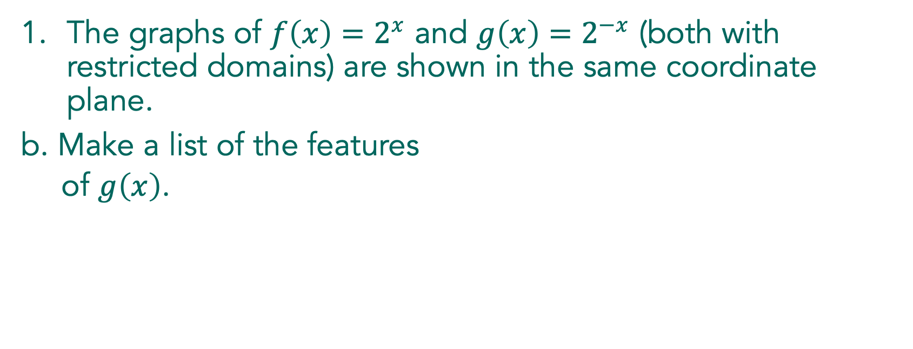
The graphs of $f\left(x\right)=2^{x}$ and $g\left(x\right)=2^{−x}$ (both with restricted domains) are shown in the same coordinate plane.
b. Make a list of the features
  of $g\left(x\right)$.

Slide 15

2. Use long division to calculate $\left(1,568÷13\right)$. Show each step.
Write your answer as a quotient and a remainder.

