Slide 1
Lesson 4:
Log-Arithm-etic
Logarithmic Functions

Slide 2
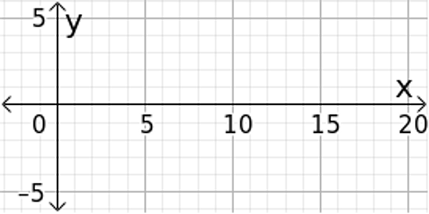

Log-Arithm-etic
Graph each of the following functions:
1. $f\left(x\right)=\log_{2}\left(x+1\right)$ 2. $g\left(x\right)=2\log_{2}\left(x+1\right)$
Notes:
The purpose of the Jump Start is to build fluency in graphing logarithmic functions.

Slide 3
Use logarithm properties to find equivalent algebraic expressions.
Use logarithm properties to find values for logarithmic expressions using other known values.

Slide 4
Log-Arithm-etic
Abe and Mary are feeling good about their log rules and bragging about their mathematical prowess to all their friends when this exchange occurs:
Stephen: I guess you think you’re pretty smart because you figured out some log rules, but I want to know what they’re good for.
Abe: Well, we’ve seen a lot of times when equivalent expressions are handy. Sometimes when you write an expression with a variable in it in a different way, it means something different.
1. What are some examples from your previous experience where equivalent expressions were useful?
Notes:
Launch the lesson by reading through the scenario and having students work on problem 1. Have students share their answers, pointing out that equivalent forms often have different meanings in a story context and can be helpful in solving equations and graphing. Follow this brief discussion by having students work problems 2 and 3, then discussing them as a class.

Slide 5
Log-Arithm-etic
Independently, think through problems 1 and 2.
Notes:
1 minute independent think time.

Slide 6
Log-Arithm-etic
With a partner, continue thinking through problems 1 and 2.
Notes:
2 minutes partner exploration

Slide 7
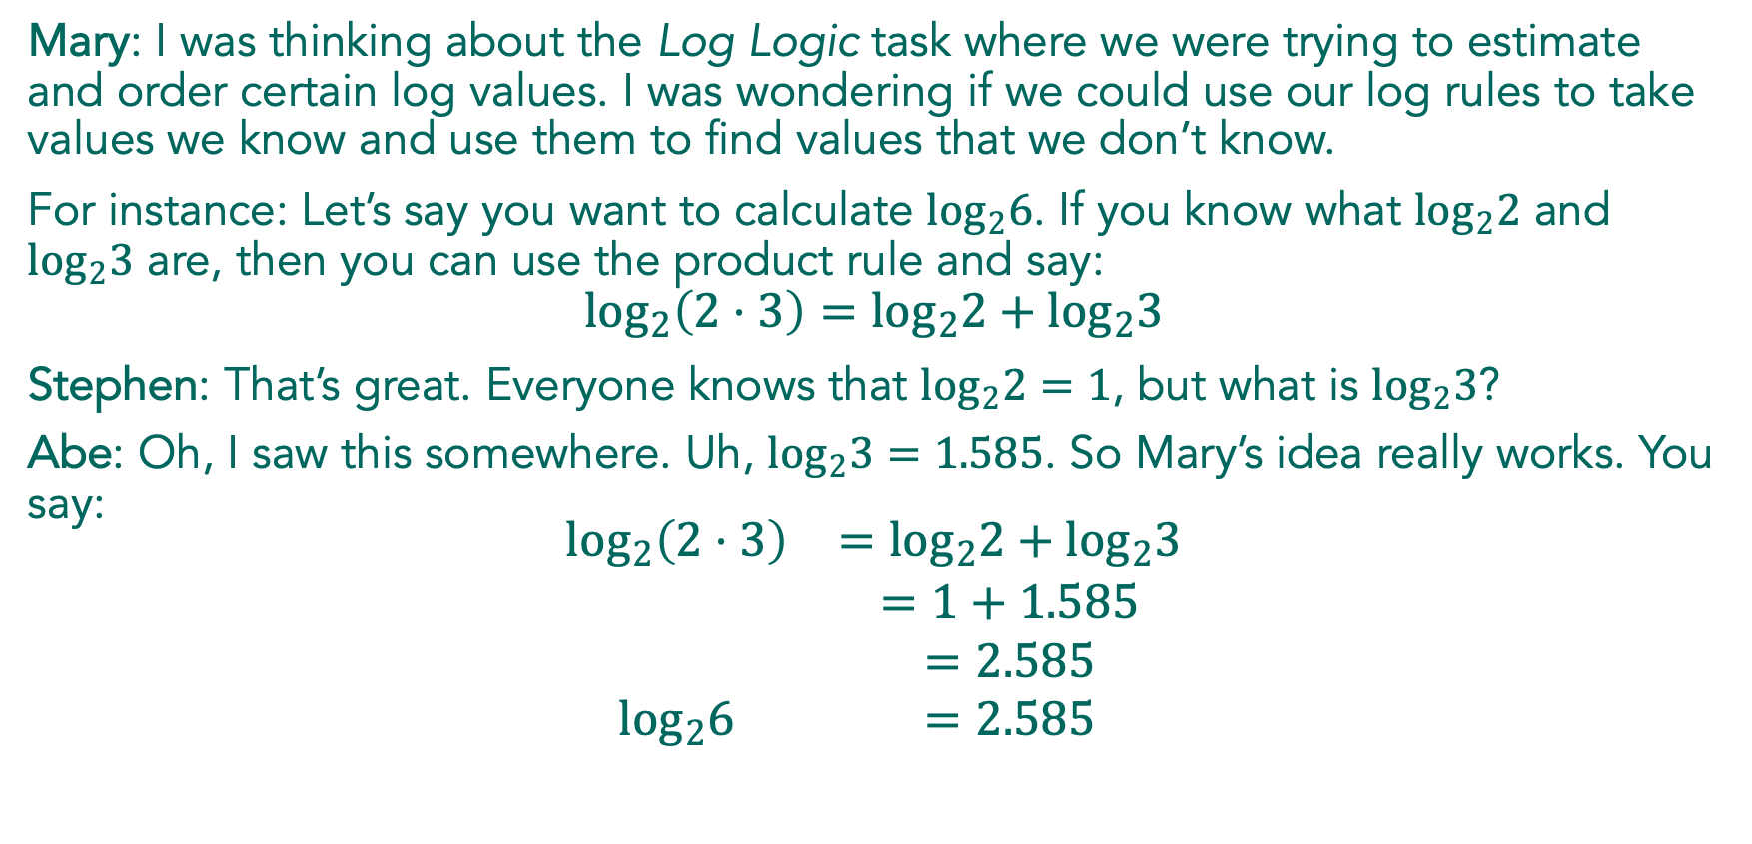
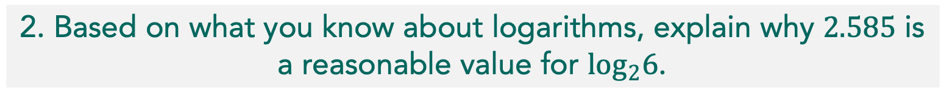
Mary: I was thinking about the Log Logic task where we were trying to estimate and order certain log values. I was wondering if we could use our log rules to take values we know and use them to find values that we don’t know.
For instance: Let’s say you want to calculate $\log_{2}6$. If you know what $\log_{2}2$ and $\log_{2}3$ are, then you can use the product rule and say:
$$\log_{2}\left(2⋅3\right)=\log_{2}2+\log_{2}3$$
Stephen: That’s great. Everyone knows that $\log_{2}2=1$, but what is $\log_{2}3$?
Abe: Oh, I saw this somewhere. Uh, $\log_{2}3=1.585$. So Mary’s idea really works. You say:
$$\begin{matrix}\begin{matrix}\log_{2}\left(2⋅3\right) & =\log_{2}2+\log_{2}3 \\ & =1+1.585 \\ & =2.585 \\ \log_{2}6 & =2.585\end{matrix}\end{matrix}$$
2. Based on what you know about logarithms, explain why $2.585$ is a reasonable value for $\log_{2}6$.

Slide 8

Stephen: Oh, oh! I’ve got one. I can figure out $\log_{2}5$ like this:
$$\begin{matrix}\begin{matrix}\log_{2}\left(2+3\right) & =\log_{2}2+\log_{2}3 \\ & =1+1.585 \\ & =2.585 \\ \log_{2}5 & =2.585\end{matrix}\end{matrix}$$
3. Can Stephen and Mary both be correct? Explain who’s right, who’s wrong (if anyone) and why.
Notes:
After discussing these two problems, students are ready to use the properties to find values of logarithms. Once students understand the expectations of the lesson, ask them to begin working individually to complete the lesson.

Slide 9
Log-Arithm-etic
Independently, think through problems 4-10.
Notes:
Monitor for when most students have finished problem 6.

Slide 10
Pause and Reflect
How are you rewriting the number inside the argument so you can use the logarithmic rules?
How can you determine if your answer is reasonable?
Notes:
Pause and Reflect
When most students have completed problem 6, ask students to pause and respond to the following questions:
How are you rewriting the number inside the argument so you can use the logarithmic rules?
How can you determine if your answer is reasonable?
Give students about a minute to write down a response to the questions, and then have them share with a partner.
When both partners have finished sharing, have students complete the task, working in pairs or small groups.

Slide 11
Log-Arithm-etic
With your partner, complete problems 11-17.
Notes:
In problems 11–17, support students as they work in making sense of the statements and verifying them.
There are several possible strategies for verifying these equations but the two most common strategies are:
1. Using the logarithmic properties to manipulate one side of the equation to match the other.
2. Trying to put in numbers to check the statement.
Begin by selecting two students for problem 6, one who rewrote the argument as 6x2 and the other who rewrote the argument as 4x3, to demonstrate that it is useful to use powers of the base when possible. For problem 8, identify a student who can demonstrate the steps in the problem with proper notation. Select a student for problem 12 who believes that the equivalent expression should be log3-logx^2. Choose a student for problem 13 who can demonstrate graphing both sides of the equation as functions to show that the statement is not true. Find a student who claims that problem 15 is true because the power rule was applied correctly. Round out the discussion plan with a student who shows that the statement in problem 16 is true because they recognized that the square root is the same as the 1/2 power.

Slide 12

Log-Arithm-etic
6. $\log_{2}12=$ 8. $\log_{2}\left(\frac{30}{7}\right)=$
Notes:
Begin the discussion with problem 6, having two students share different strategies. Ask the class to compare strategies to notice that using powers of the base is always a useful strategy when working with logarithms. Proceed with a more complicated expression like problem 8 and a student who can demonstrate each step using correct notation.

Slide 13

Log-Arithm-etic
12. $log3−logx−logx=log\left(\frac{3}{x^{2}}\right)$
13. $logx−log5=\frac{logx}{log5}$
Notes:
Ask students to share their claims and reasoning for problems 11–17. Provide students with an opportunity to respond to the claims so that possible misconceptions are discussed openly. Bring in the strategy of comparing the graphs of the two sides of the equation to see if they coincide, to verify if the equation is true for all values of x. When students determine a statement is not true, ask the class how it could be corrected to make it true. This will be a valuable strategy in the next three units.

Slide 14

Log-Arithm-etic
15. $2logx+log5=log\left(x^{2}+5\right)$
16. $\frac{1}{2}logx=log\sqrt{x}$

Slide 15
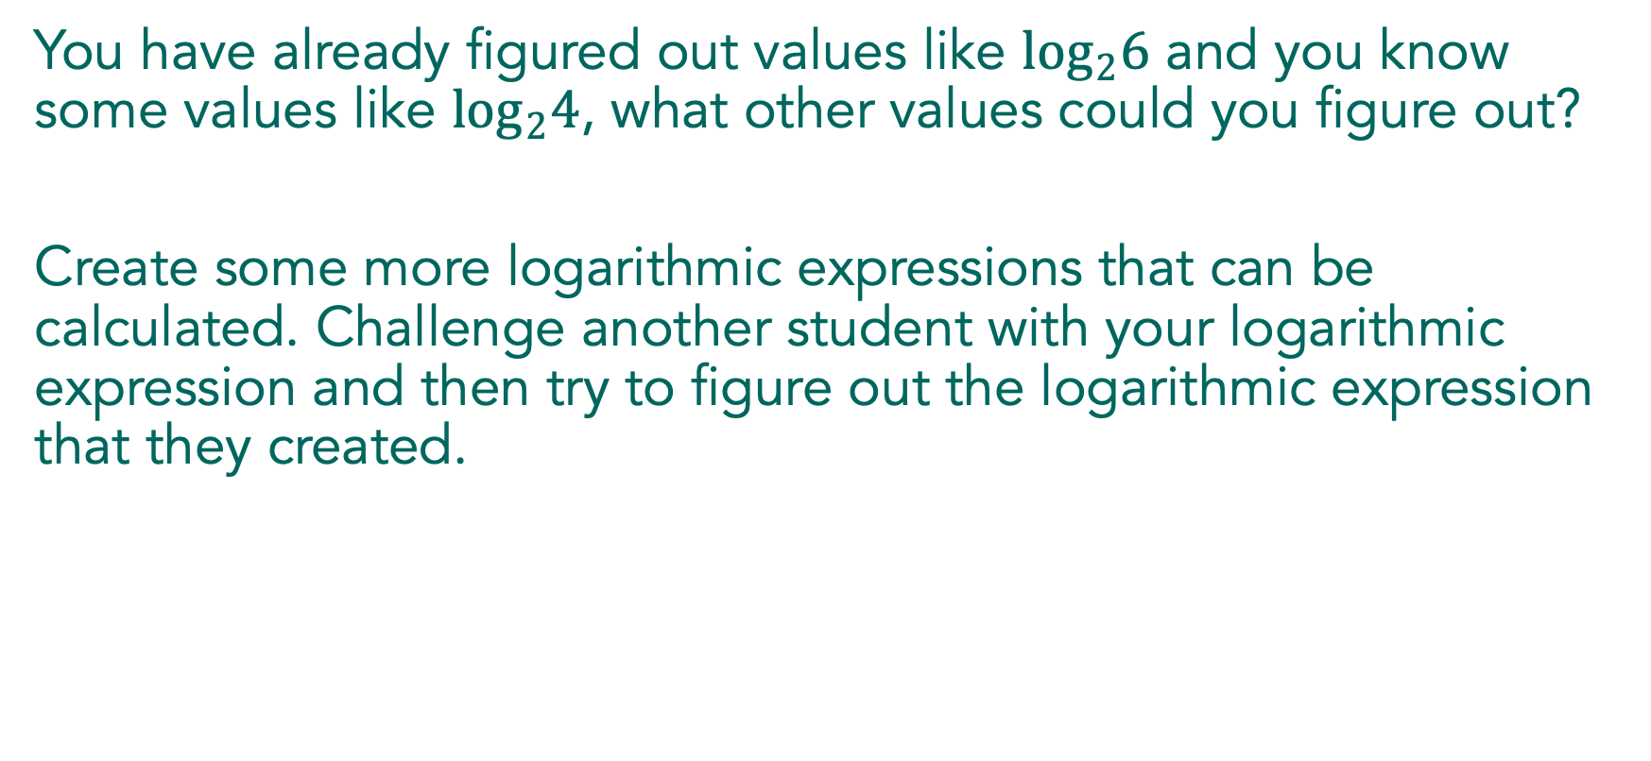
You have already figured out values like $\log_{2}6$ and you know some values like $\log_{2}4$, what other values could you figure out?
Create some more logarithmic expressions that can be calculated. Challenge another student with your logarithmic expression and then try to figure out the logarithmic expression that they created.

Slide 16
Strategies for working with logarithmic expressions and using properties of logarithms:
Notes:
Wrap up the discussion with a Think-Pair-Share, asking students to share strategies for working with logarithmic properties and logarithmic expressions.

Slide 17

Write equivalent expressions for each of the following:
$Log20$
$log\frac{100}{x}$
$logx^{5}$
Notes:
If students are not successful with the Exit Ticket, review these problems as part of the next lesson.

Slide 18
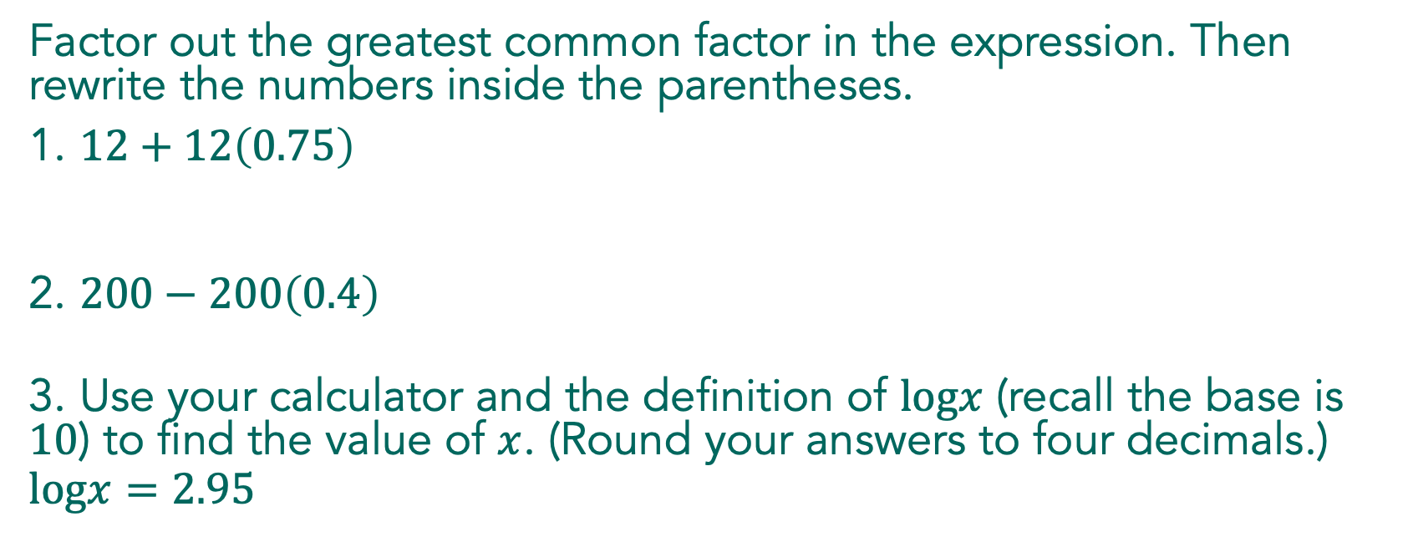
Factor out the greatest common factor in the expression. Then rewrite the numbers inside the parentheses.
1. $12+12\left(0.75\right)$
2. $200−200\left(0.4\right)$
3. Use your calculator and the definition of $logx$ (recall the base is $10$) to find the value of $x$. (Round your answers to four decimals.)
$$logx=2.95$$

