Slide 1
Lesson 3: Chopping Logs
Logarithmic Functions

Slide 2
Chopping Logs
1. Graph the equation:
$$y=2+\log_{2}\left(x+3\right)$$
2. Write the equation for the base $2$ logarithmic function with the given graph:
Notes:
Ask students to work the Jump Start problems. After students have completed the problems, ask a student to share their method for graphing the function. Reinforce their explanation by drawing in the transformed axes and counting the points as described in Unit 2 Lesson 2. Have a student also share how to work the second problem by identifying the vertical asymptote and then using the point that is 1 unit to the right to identify the transformed x-axis. Verify that the graph has only been translated by counting the anchor points marked on the graph.

Slide 3
Use graphs to discover properties of logarithms.
Justify conjectures about logarithms.

Slide 4
Chopping Logs
Abe and Mary are working on their math homework together when Abe has a brilliant idea.
Abe: I was just looking at this log function that we graphed in Falling Off A Log: $y=\log_{2}\left(x+b\right)$.
I started to think that maybe I could just “distribute” the log so that I get: $y=\log_{2}x+\log_{2}b$.

Slide 5
Chopping Logs
I guess I’m saying that I think these are equivalent expressions, so I could write it this way:
$\log_{2}\left(x+b\right)=\log_{2}x+\log_{2}b$.
Mary: I don’t know about that. Logs are tricky and I don’t think that you’re really doing the same thing here as when you distribute a number.
What do you think?
How can you verify if Abe’s idea works?
Notes:
Instructional Routine: Think-pair-share, give 1 minute independent think time, 2 minutes with a partner and then discuss whole group
Begin the lesson by introducing the equation and asking the students why this might make sense. Students may say they could “distribute” the log. Ask students how they could test their claim. Students should come up with the idea that they can test the statement with particular numbers, which they need to do to work on problems 1 and 2. These questions address the common misconception that .
The purpose of this question in the launch is to:
get students thinking about the possibility of equivalent expressions for logarithms,
to demonstrate how to test an algebraic expression with numbers,
to understand that although a statement like this is tempting to believe, it is not true.
The product, quotient, and power rules for logarithms will be introduced as the lesson progresses.

Slide 6
Chopping Logs
I guess I’m saying that I think these are equivalent expressions, so I could write it this way:
$\log_{2}\left(x+b\right)=\log_{2}x+\log_{2}b$.
Mary: I don’t know about that. Logs are tricky and I don’t think that you’re really doing the same thing here as when you distribute a number.
2. If Abe’s idea works, give some examples that illustrate why it works. If Abe’s idea doesn’t work, give a counterexample.
Notes:
Once students have a chance to work on problem 2, have a student share their example showing the statement to be untrue. Students will use this strategy throughout the task. If necessary, support them in rewriting their work so the statements are clear.

Slide 7
Chopping Logs
Independently, begin thinking through problems 3 and 4.
Notes:
Have students begin working on problems 3 and 4 independently for 3 minutes before moving into partner work.

Slide 8
Chopping Logs
With your partner, continue thinking through problems 3 - 7.
Notes:
If students struggle with problems 3 and 4. Pause and have a short discussion before moving them to work on problems 5-7.

Slide 9
Chopping Logs
5. Try to write an equivalent equation for each of these graphs that is a vertical shift of $y=\log_{2}x$.
a. $y=\log_{2}\left(8x\right)$ b. $y=\log_{2}\left(16x\right)$
Equivalent Equation: Equivalent Equation

Slide 10
Mary: Oh my gosh! I think I know what is happening here! Here’s what we see from the graphs:
$$\begin{matrix}\begin{matrix}\log_{2}\left(4x\right) & =2+\log_{2}x \\ \log_{2}\left(8x\right) & =3+\log_{2}x \\ \log_{2}\left(16x\right) & =4+\log_{2}x\end{matrix}\end{matrix}$$
Here’s the brilliant part: We know that $\log_{2}4=2$, $\log_{2}8=3$, and $\log_{2}16=4$. So:
$$\begin{matrix}\begin{matrix}\log_{2}\left(4x\right) & =\log_{2}4+\log_{2}x \\ \log_{2}\left(8x\right) & =\log_{2}8+\log_{2}x \\ \log_{2}\left(16x\right) & =\log_{2}16+\log_{2}x\end{matrix}\end{matrix}$$
I think it looks like the “distributive” thing that you were trying to do, but since you can’t really distribute a function, it’s really just a log multiplication rule. I guess my rule would be: $\log_{2}\left(ab\right)=\log_{2}a+\log_{2}b$
6. How can you express Mary’s rule in words?
Notes:
After these equations have been discussed, have a student who can explain Mary’s reasoning behind the Log of a Product Rule. Have a student share an example of the Logarithm of a Product Rule and ask the class for an explanation of the rule. End the discussion by asking students to write the following in their Takeaways notes:

Slide 11
Logarithm of a Product Rule: $\log_{2}\left(ab\right)=\log_{2}a+\log_{2}b$ means that the logarithm of a product $(ab)$ is the same as the sum of the logarithms of the two factors $a$ and $b$.

Slide 12
Chopping Logs
Independently, working through problem 8.
Notes:
As students are working individually, check to see that they are finding methods for identifying the transformations of the parent function. After students have completed problem 8, ask them to share their work with a partner and then complete the task working in pairs or small groups.

Slide 13
Chopping Logs
With a partner, share your thinking on problem 8 and then begin working on problems 8-12.
Notes:
As students are working individually, check to see that they are finding methods for identifying the transformations of the parent function. After students have completed problem 8, ask them to share their work with a partner and then complete the task working in pairs or small groups.
Problem 10 may pose a challenge for students in finding numbers that they can evaluate to determine if the statement is true. Refer them back to the example given during the discussion of problem 7. Students should recognize that using powers of will make the statement easier to evaluate.
Once students complete problems 8–10, read Abe and Mary’s discussion aloud. Presenting the task both visually and auditorily improves comprehension and clarity of the argument. Encourage students to follow along as you read, and to pay particular attention to the equations written in the task.
For the discussion of the second part of the task, identify a student for 8a and 8b who can show how they found the transformations of the graphs and wrote equations. For problem 9, select a student who has written a statement of the Logarithm of a Quotient Rule that expresses the right idea but does not use notation that is precise, so that the class can discuss how it can be revised.

Slide 14
Chopping Log
8. Here are Mary’s examples and their graphs. Test Mary’s theory by trying to write an equivalent equation for each of these graphs that is a vertical shift of $y=\log_{2}x$.
a. $y=\log_{2}\left(\frac{x}{4}\right)$ b. $y=\log_{2}\left(\frac{x}{8}\right)$
Equivalent Equation: Equivalent Equation:
Notes:
The focus of this part of the discussion will be on the Logarithm of a Quotient Rule and the Logarithm of a Power Rule. Students are ready to discuss when they have completed problem 11.

Slide 15
Chopping Logs
9. Use these examples to write a rule for division inside the argument of a logarithm that is like the rule that Mary wrote for multiplication inside a logarithm.
10. Is this statement true? If it is, give some examples that illustrate why it works. If it is not true provide a counterexample.

Slide 16
Chopping Logs
Abe: Before we win the Nobel Prize for mathematics, I suppose that we need to think about whether or not these rules work for any base.
12. The three rules, written for any base $b>1$ are:
Logarithm of a Product Rule: $\log_{b}xy=\log_{b}x+\log_{b}y$
Logarithm of a Quotient Rule: $\log_{b}\frac{x}{y}=\log_{b}x−\log_{b}y$
Logarithm of a Power Rule: $\log_{b}x^{k}=k\log_{b}x$
Make an argument for why these rules will work in any base
$b>1$ if they work for base 2.

Slide 17
Find an example that demonstrates the logarithm rules in bases other than base $2$. For instance, an illustration of the Logarithm of a Product Rule in base $3$ might be:
$\log_{3}27=3$ and $\log_{3}\left(3⋅9\right)=\log_{3}3+\log_{3}9=1+2=3$

Slide 18
Properties of Logarithms:

Slide 19
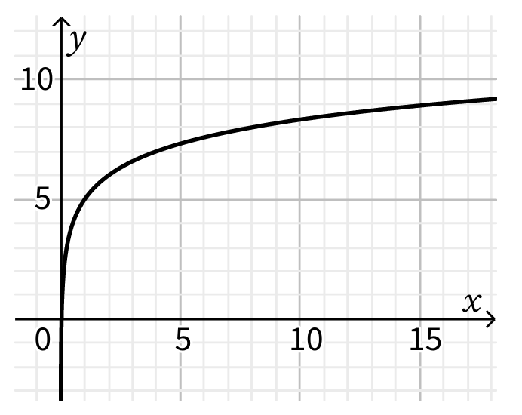
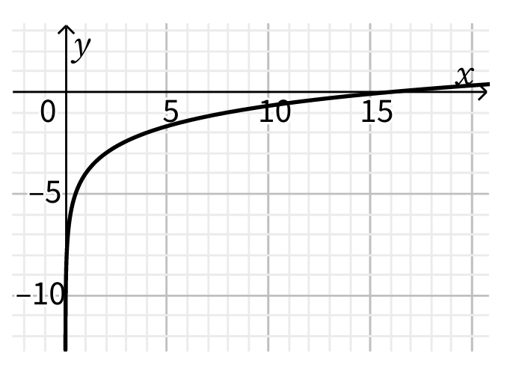
Use the graph to write an equivalent equation for each of the following:
a. $f\left(x\right)=\log_{2}(32x)$ b. g$\left(x\right)=\log_{2}\left(\frac{x}{16}\right)$

Slide 20
1. Rewrite the expression using exponents. $\sqrt[3]{\left(54x^{6}\right)}$
2. Rewrite $\log_{2}\sqrt[3]{8}$ with a fractional exponent.
3. Rewrite the equation $6^{5}=$7,776 in logarithmic form.

