Slide 1
Lesson 2:
Falling off a Log
Logarithmic Functions

Slide 2
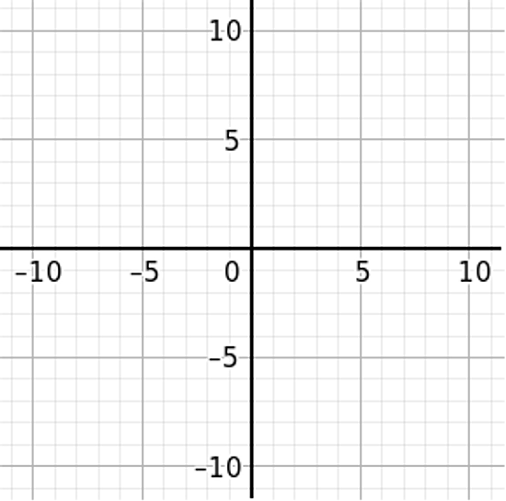

Graph each pair of functions on the same graph.
1. $y=x^{2}$ and $y=−{\left(x+1\right)}^{2}+3$ 2. $y=2^{x}$ and $y=2^{x}−3$
Notes:
Ask the class to identify each of the transformations from problem 1.
Repeat the process with the second problem, beginning with identifying the transformations.
After demonstrating the quick-graph method, ask students what similarities and differences they see in transforming these two functions.
In both cases, the axes are redrawn.
In both cases, the vertical shift is a number added or subtracted to the function output. A number added or subtracted to the input, x, causes a horizontal shift.
The quadratic function is symmetric and the exponential function is not.
The anchor point on a quadratic function is the vertex, (0, 0) on the parent function. On an exponential function, the anchor point is (0, 1).

Slide 3
Identify common features of the graphs of logarithmic functions.
Transform the graph of a logarithmic function.

Slide 4
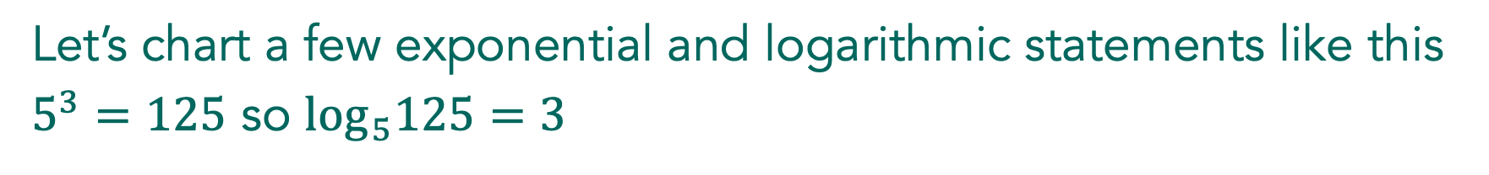
Falling off a Log
Let’s chart a few exponential and logarithmic statements like this
$5^{3}=125$ so $\log_{5}125=3$

Slide 5
Falling off a Log
Independently, work through problems 1-6.
Notes:
Begin by asking students to work individually until most students have completed 1a. Then, ask students to share and work together to complete problems 1–6.

Slide 6
Falling off a Log
With a partner, continue working through problems 1-6.
Notes:
Begin by asking students to work individually until most students have completed 1a. Then, ask students to share and work together to complete problems 1–6.

Slide 7
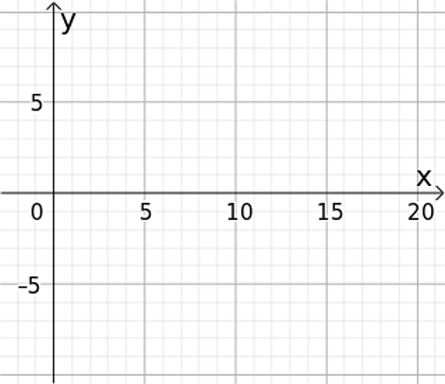

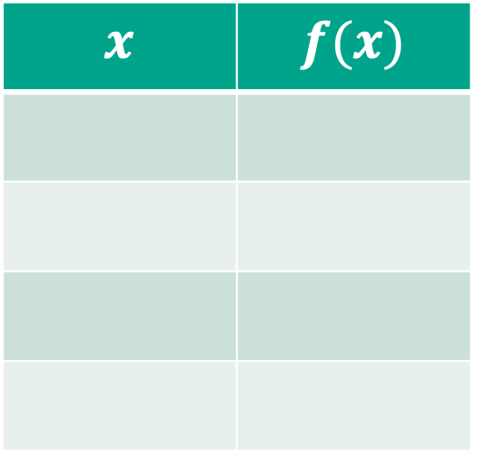
Construct a table of values and a graph for each of the following functions. Be sure to select at least two values in the interval
$0<x<1$.
$$f\left(x\right)=\log_{2}x$$
$$x$$ | $$f(x)$$
Notes:
Discuss each of the graphs of the three functions by asking a different student to present each function. Ask students about how they constructed the table of values and how the graphs compare to the exponential function of the same base.

Slide 8

Construct a table of values and a graph for each of the following functions. Be sure to select at least two values in the interval
$0<x<1$.
  $$g\left(x\right)=\log_{3}x$$
$$x$$ | $$f(x)$$
Notes:
Discuss each of the graphs of the three functions by asking a different student to present each function. Ask students about how they constructed the table of values and how the graphs compare to the exponential function of the same base.

Slide 9

Construct a table of values and a graph for each of the following functions. Be sure to select at least two values in the interval
$0<x<1$.
  $$k\left(x\right)=\log_{10}x$$
$$x$$ | $$f(x)$$
Notes:
Discuss each of the graphs of the three functions by asking a different student to present each function. Ask students about how they constructed the table of values and how the graphs compare to the exponential function of the same base.

Slide 10
What are the mathematical features that are common to logarithmic functions, b > 1?
Notes:
Ask the class to work individually for one minute and then with a partner to find the mathematical features that are common to logarithmic functions, b>1. Discuss and record the features in the Takeaways notes.

Slide 11

Falling off a Log
Base 10 logarithmic functions are written without the base as:
$$k\left(x\right)=logx$$
Let’s graph this function: link to Desmos calculator
Notes:
At the end of this short teaching cycle, relaunch the remaining problems in the lesson by explaining to students how the base 10 logarithmic function is written.
Students will work more with base logarithms to solve equations later in the unit. At this point, they only need to understand that if a base is not written on the logarithmic function, it is assumed to be 10.

Slide 12
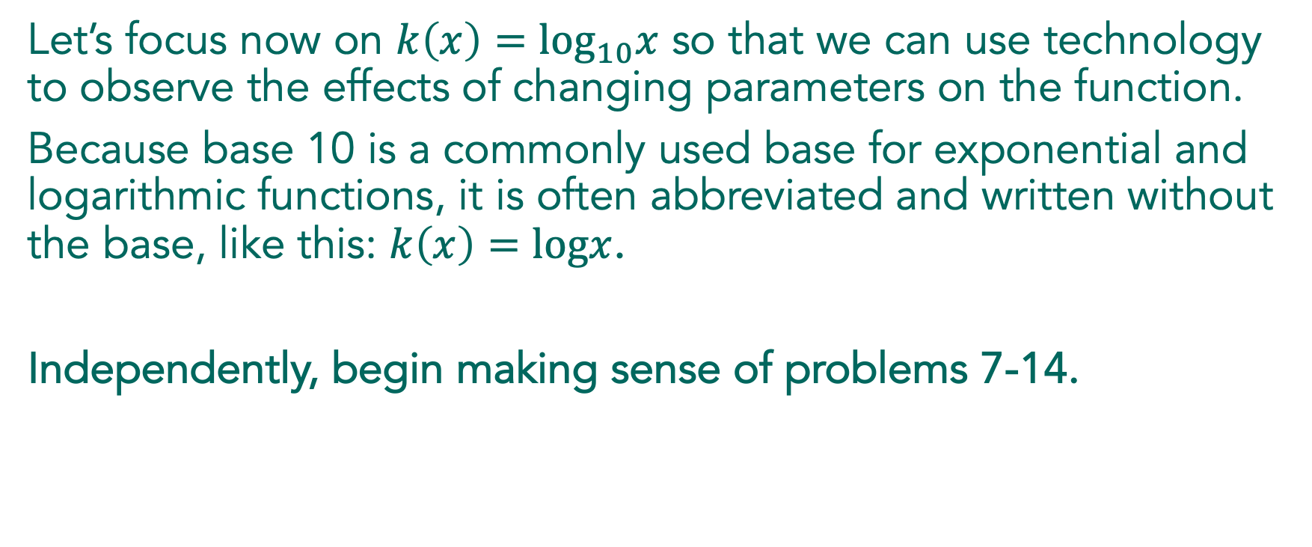
Falling off a Log
Let’s focus now on $k\left(x\right)=\log_{10}x$ so that we can use technology to observe the effects of changing parameters on the function.
Because base 10 is a commonly used base for exponential and logarithmic functions, it is often abbreviated and written without the base, like this: $k\left(x\right)=logx$.
Independently, begin making sense of problems 7-14.

Slide 13
Falling off the Log
With a partner, continue making sense of problems 7-14.

Slide 14

Falling off a Log
What is the effect of $a$ and the graph $y=logx$?
$$y=a+logx$$
Notes:
Students are ready to discuss when they have completed problem 12b.
Begin by asking a student who has identified the effect of a on the graph.
Help the class to connect to their prior experience with quadratics and other functions and recognize that the transformations of logarithmic functions are the same. Ask questions to ensure that students understand that vertical and horizontal shifts are translations that maintain the shape of the curve because they are rigid transformations.

Slide 15

Falling off a Log
What is the effect of $b$ and the graph $y=logx$?
$$y=log(x+b)$$
Notes:
Students are ready to discuss when they have completed problem 12b.
Begin by asking a student who has identified the effect of b on the graph.
Help the class to connect to their prior experience with quadratics and other functions and recognize that the transformations of logarithmic functions are the same. Ask questions to ensure that students understand that vertical and horizontal shifts are translations that maintain the shape of the curve because they are rigid transformations.

Slide 16
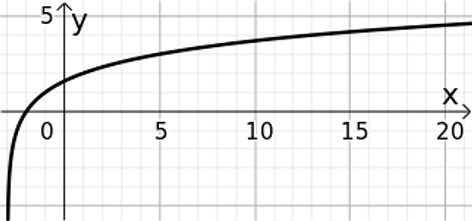
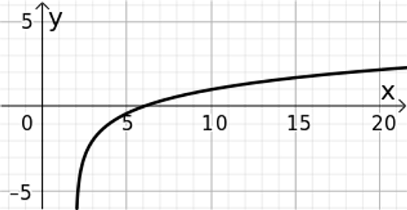

Falling of a Log
Write an equation for each of the following functions that are transformations of $f\left(x\right)=\log_{2}x$.
a. b.
Notes:
Proceed to problem 12, with a student sharing how they identified the transformations in the graph and wrote the equation. It will be especially useful if the student who shares shows the parent function for students to compare to. Ask the student to draw in the transformed axes, because this is an important strategy for identifying transformations and using the quick graph method.

Slide 17

Falling off a Log
Graph each of the following functions:
a. $f\left(x\right)=2+\log_{2}\left(x−1\right)$ b. $g\left(x\right)=−1+\log_{2}\left(x+2\right)$
Notes:
Continue the discussion with problem 13 and ask a student to share their graph and how they identified the transformations. Again, ask for the transformed axes to be shown and identify corresponding points on the parent function. End the discussion by demonstrating the quick graph method for graphing with an additional example in the Takeaways.

Slide 18

Graph: $y=3\log_{2}x$.
What is the effect on the graph of the $3$ in the equation?

Slide 19

Features of logarithmic functions, $b>1$:
Quick Graphs for Logarithmic Functions:

Slide 20
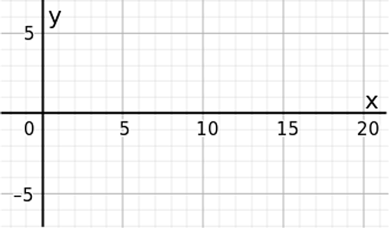

Demonstrating with the function: $y=−2+\log_{2}\left(x−1\right)$.
_______________________
_______________________
_______________________

Slide 21
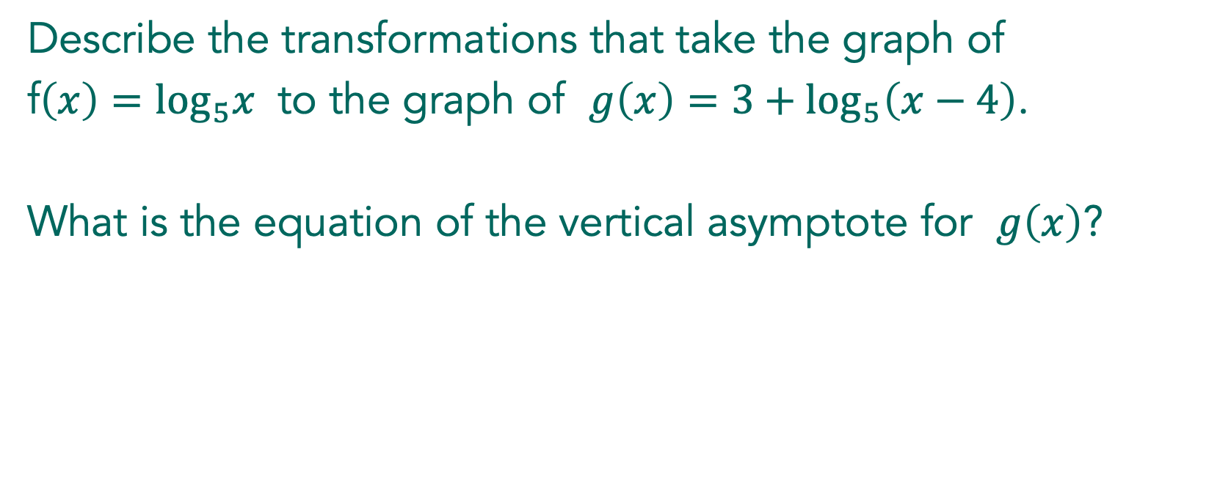
Describe the transformations that take the graph of
f$\left(x\right)=\log_{5}x$ to the graph of $g\left(x\right)=3+\log_{5}\left(x−4\right)$.
What is the equation of the vertical asymptote for $g\left(x\right)$?

Slide 22
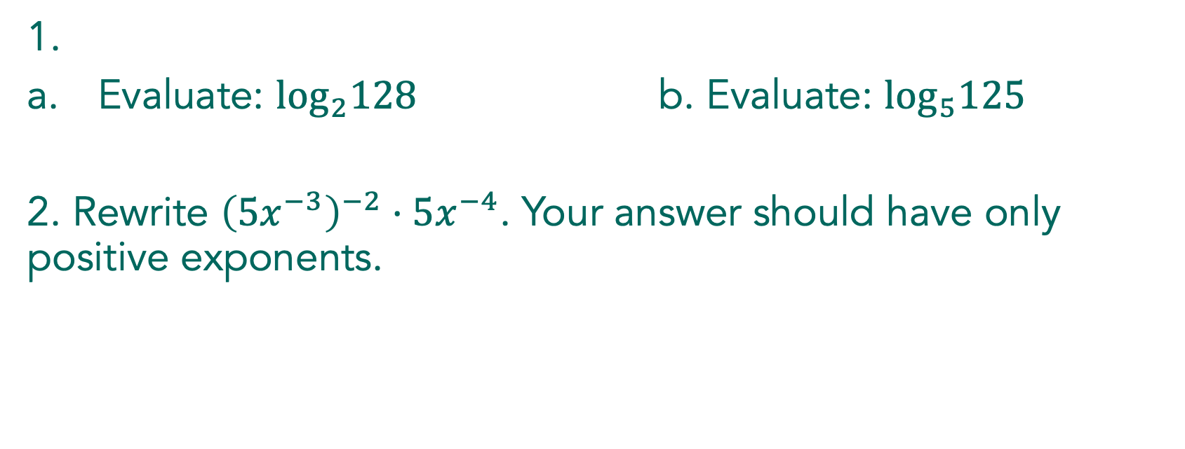
1.
Evaluate: $\log_{2}128$ b. Evaluate: $\log_{5}125$
2. Rewrite ${\left(5x^{−3}\right)}^{−2}⋅5x^{−4}$. Your answer should have only positive exponents.

Slide 23
Lesson 7:
Logs Go Viral
Logarithmic Functions

Slide 24
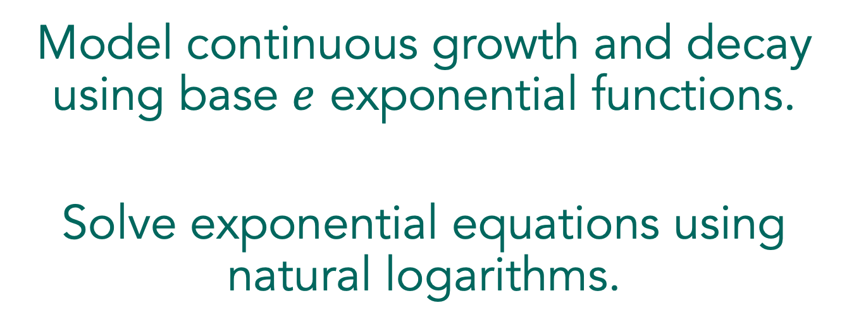
Model continuous growth and decay using base $e$ exponential functions.
Solve exponential equations using natural logarithms.

Slide 25

Logs Go Viral
Read the first paragraphs of the lesson and explain continuous growth and decay and the use of the base $e$ exponential.
Notes:
Using a Three Reads Routine might be helpful here to help students make sense of the situation.
Be sure students understand the variables in the formulas and that e is the constant they learned about in the previous lesson. (When students first learn about e, they often have to be reminded that it is not a variable.) Have students complete problem 1 individually. Have students use the formula to write and solve the equation for about three minutes, then discuss the solution with the class. Ask if the number of people infected is more or less than expected. Explain to students that in the first part of the task, they use representations to model the spread of the virus in the population.

Slide 26
Logs Go Viral
Independently, begin working through problems 2 and 3.
Notes:
Have students working independently for 2 minutes.

Slide 27
Logs Go Viral
With a partner, continue working through problems 2 and 3.
Notes:
As students work on problem 2, encourage them to use the formula and to use time for the independent variable. Encourage the use of technology for graphing the equation and for creating a table.
The two most common approaches students will use when working on problem 3 are using the graph and trying to solve the equation algebraically. Listen for how students are thinking about “undoing” the base e exponential. They should be talking about a base e logarithm, although they have not been introduced to natural log notation. When most students have talked about problem 3 with their partners, then move to the class discussion.

Slide 28

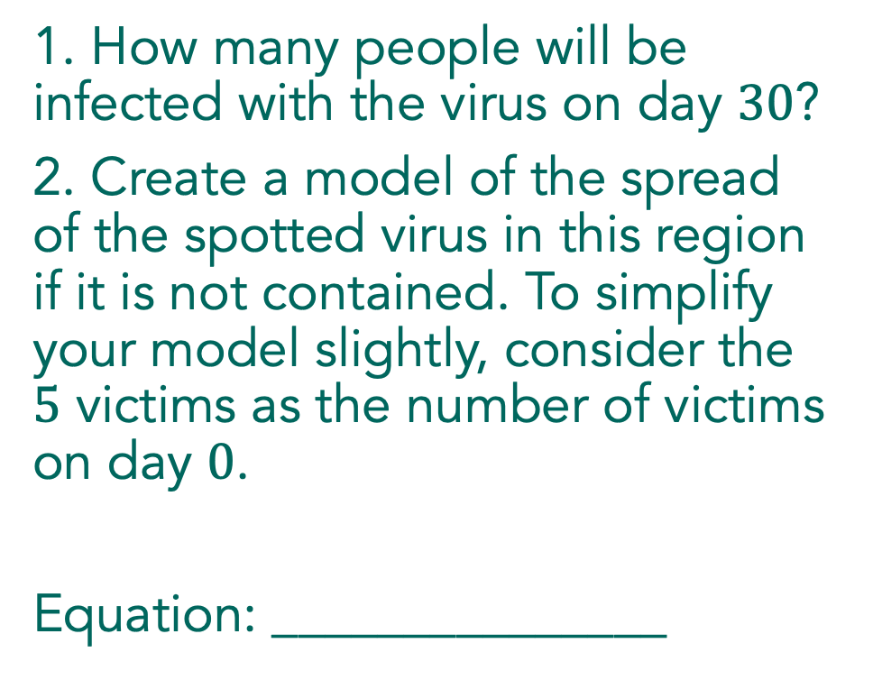
Logs Go Viral
1. How many people will be infected with the virus on day $30$?
2. Create a model of the spread of the spotted virus in this region if it is not contained. To simplify your model slightly, consider the $5$ victims as the number of victims on day $0$.
Equation: _______________
Notes:
Begin the discussion with a student who used the formula to make a table of values. Ask the class about the small number of people infected by the virus to show students the nature of an exponential function. Exponential growth initially grows slowly and has big increases as time goes on.

Slide 29

Logs Go Viral
3. When does your model predict there will be $50$ victims? Show how you arrived at your answer.
Notes:
Continue the discussion with problem 3, asking students to demonstrate solving the equation graphically and beginning to solve algebraically. The algebraic solution creates a need for base e logarithm. Introduce the natural logarithm and demonstrate how to find it on the calculator and how to use it to finish solving the equation in problem 3.

Slide 30
Logs Go Viral
Independently, continue working through problems 4 – 12.
Notes:
As students are working individually, do a quick check to see that they are thinking exponentially, not linearly, about the number of days necessary to double the number of victims. If students are using linear reasoning, support them in writing and solving an equation to find the number of days for the virus to claim 100 victims (problem 5) and then ask why the answer does not correspond to their reasoning. After most students have completed problem 6, ask students to share with a partner and then complete the task working in pairs or small groups.

Slide 31
Logs Go Viral
With a partner, continue working through problems 4 – 12.
Notes:
After most students have completed problem 6, ask students to share with a partner and then complete the task working in pairs or small groups.
To begin the discussion, identify a student who has solved problem 7 algebraically. Choose a student to share problem 8 who can describe how to solve the equation but may not use proper notation to communicate their steps. This will give the class an opportunity to examine and discuss notation for the natural log.

Slide 32
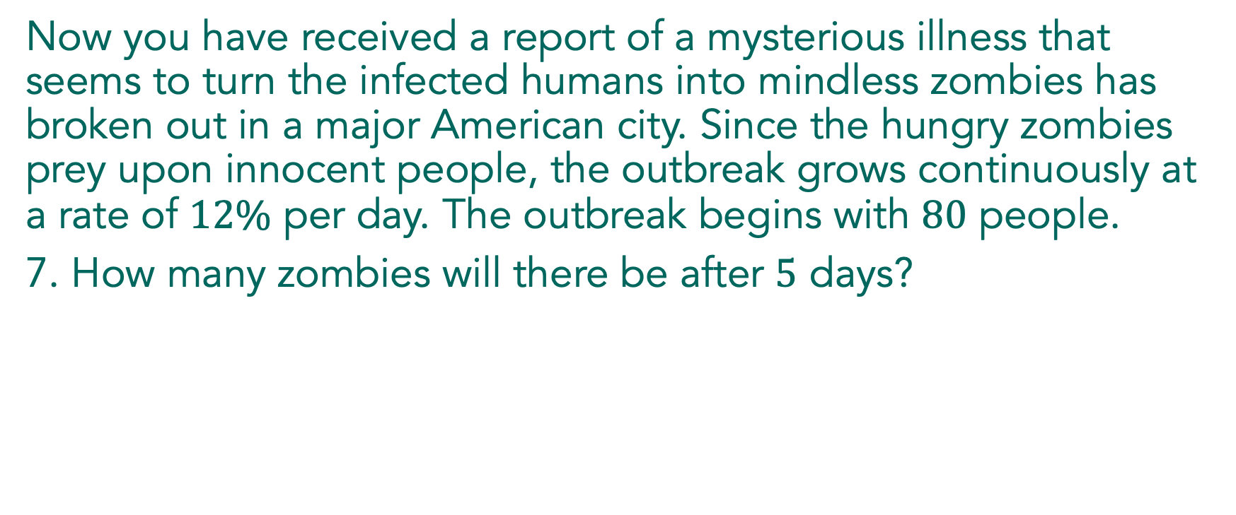
Logs Go Viral
Now you have received a report of a mysterious illness that seems to turn the infected humans into mindless zombies has broken out in a major American city. Since the hungry zombies prey upon innocent people, the outbreak grows continuously at a rate of $12\%$ per day. The outbreak begins with $80$ people.
7. How many zombies will there be after $5$ days?
Notes:
The focus of the discussion will be on solving equations in the context of exponential growth and decay. Students are ready to discuss when they have completed problem 9.
Begin the discussion with problem 7, by asking a student to describe how they used the formula and demonstrate how to use technology to find a value. Then ask a student to describe the steps they used to solve the equation in problem 8. Record the steps as they demonstrate their work and support their use of the natural log notation.

Slide 33
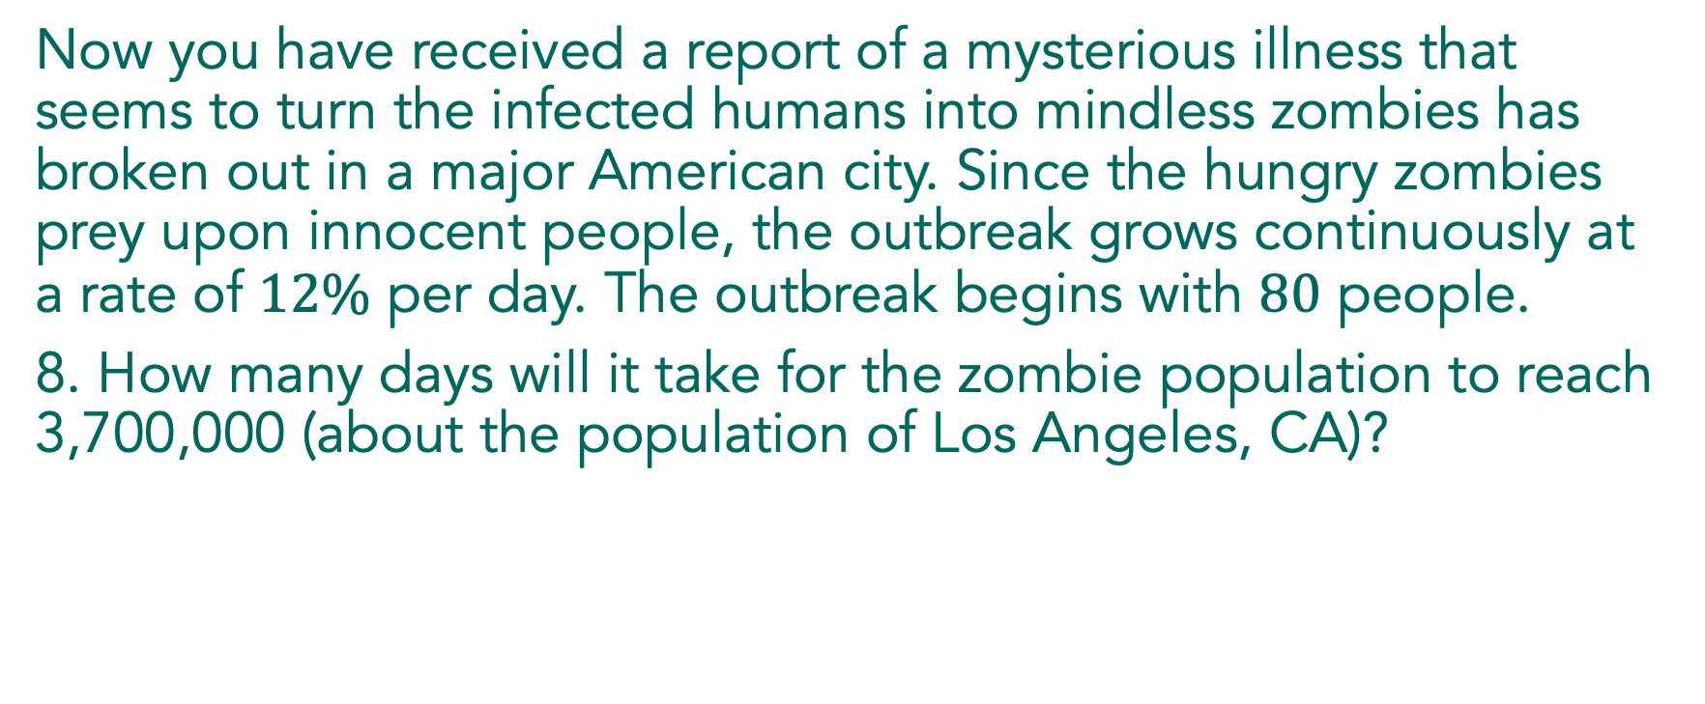
Logs Go Viral
Now you have received a report of a mysterious illness that seems to turn the infected humans into mindless zombies has broken out in a major American city. Since the hungry zombies prey upon innocent people, the outbreak grows continuously at a rate of $12\%$ per day. The outbreak begins with $80$ people.
8. How many days will it take for the zombie population to reach 3,700,000 (about the population of Los Angeles, CA)?
Notes:
The focus of the discussion will be on solving equations in the context of exponential growth and decay. Students are ready to discuss when they have completed problem 9.
Begin the discussion with problem 7, by asking a student to describe how they used the formula and demonstrate how to use technology to find a value. Then ask a student to describe the steps they used to solve the equation in problem 8. Record the steps as they demonstrate their work and support their use of the natural log notation.

Slide 34
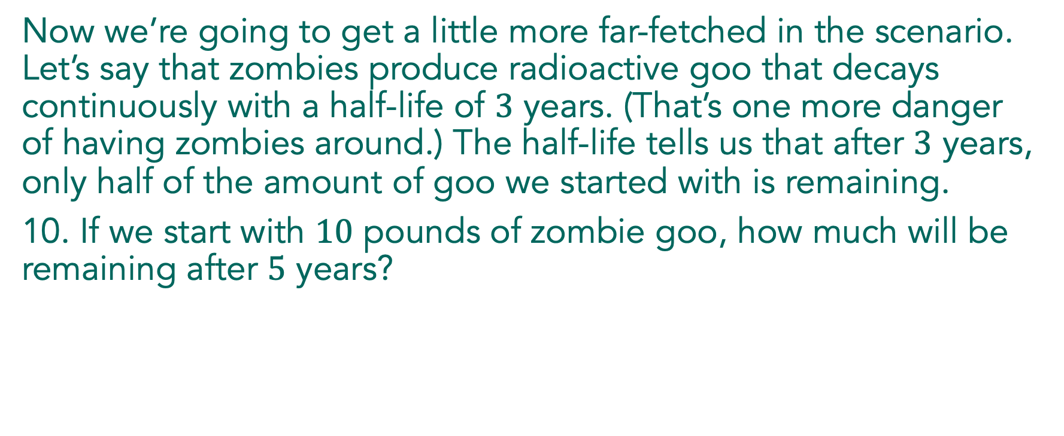
Logs Go Viral
Link to Graphing Calculator
Now we’re going to get a little more far-fetched in the scenario. Let’s say that zombies produce radioactive goo that decays continuously with a half-life of $3$ years. (That’s one more danger of having zombies around.) The half-life tells us that after $3$ years, only half of the amount of goo we started with is remaining.
10. If we start with $10$ pounds of zombie goo, how much will be remaining after $5$ years?
Notes:
Have a student show how they solved problem 10. If time permits, use technology to model the decay of the goo, and ask students how they could verify their solution to problem 10 graphically. Use the graph to discuss problems 11 and 12. Ask if the zombie goo will ever be entirely gone, using both the graph and an equation to support their answers.

Slide 35
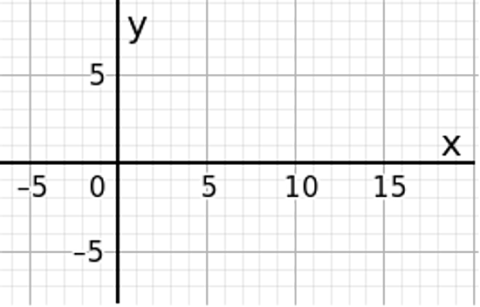

Graph $y=lnx$.

Slide 36
Solving an exponential equation with a variable in the exponent:

Slide 37
There are some nasty little bacteria hiding under that rotten banana peel in your bedroom. There are 20 bacteria now and they grow continuously at a rate of 5% every hour. How long will it take for the bacteria population to double?

Slide 38
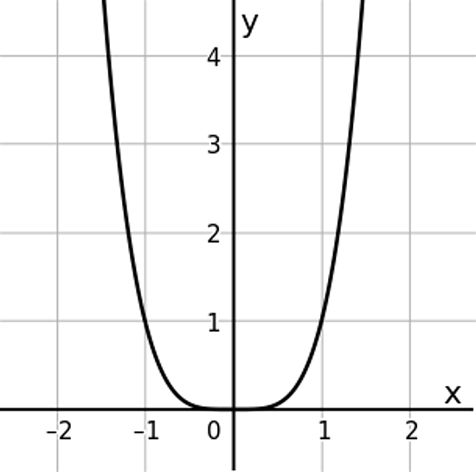

1. How do you know that the graph of $y=x^{4}$ it is NOT the graph of $y=x^{2}$?

Slide 39
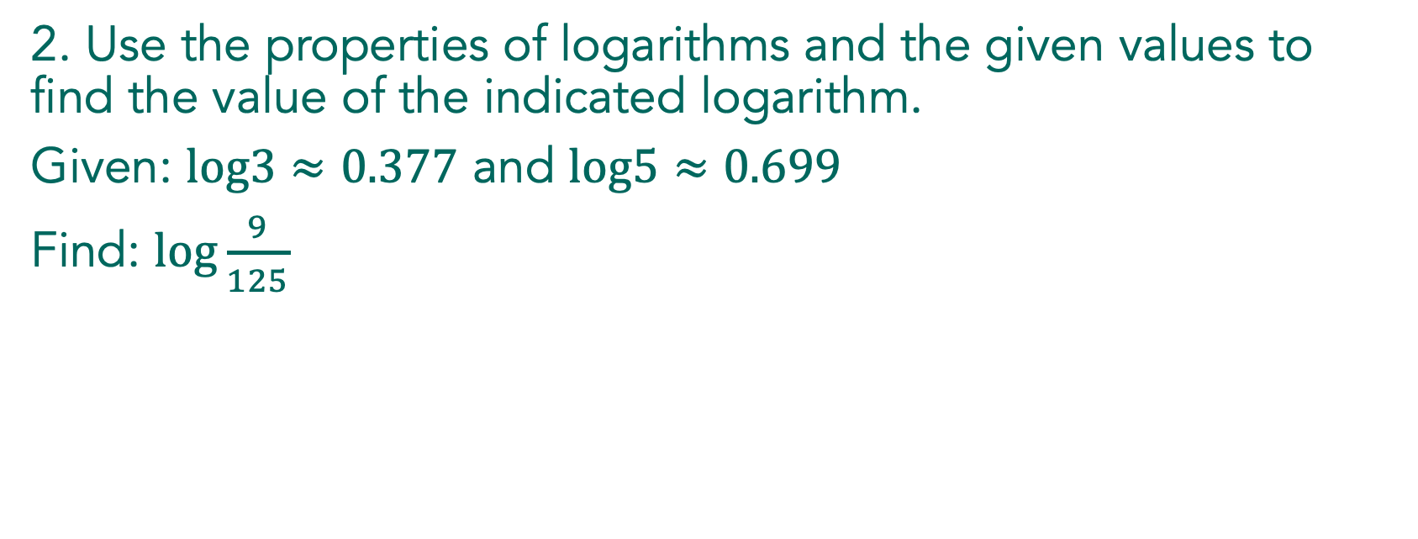
2. Use the properties of logarithms and the given values to find the value of the indicated logarithm.
Given: $log3≈0.377$ and $log5≈0.699$
Find: $log\frac{9}{125}$

