Slide 1
Lesson 4
Pulling a Rabbit Out of the Hat
Functions and Their Inverses
Notes:
The purpose of this lesson is to solidify students’ understanding of the relationship between functions and their inverses and to formalize a method for writing inverse functions. In this lesson, students are given a function and an input value z, and then asked to describe and write the function that will produce an output that is the original x value. The lesson relies on students’ prior experiences in solving equations using inverse operations, such as subtraction “undoing” addition or square roots “undoing” squaring. There are two exponential problems where students can describe “undoing” an exponential function and the teacher can support the writing of the inverse function using logarithmic notation. The definition of inverse functions is extended to include composition so students can verify inverses algebraically in the next lesson.

Slide 2
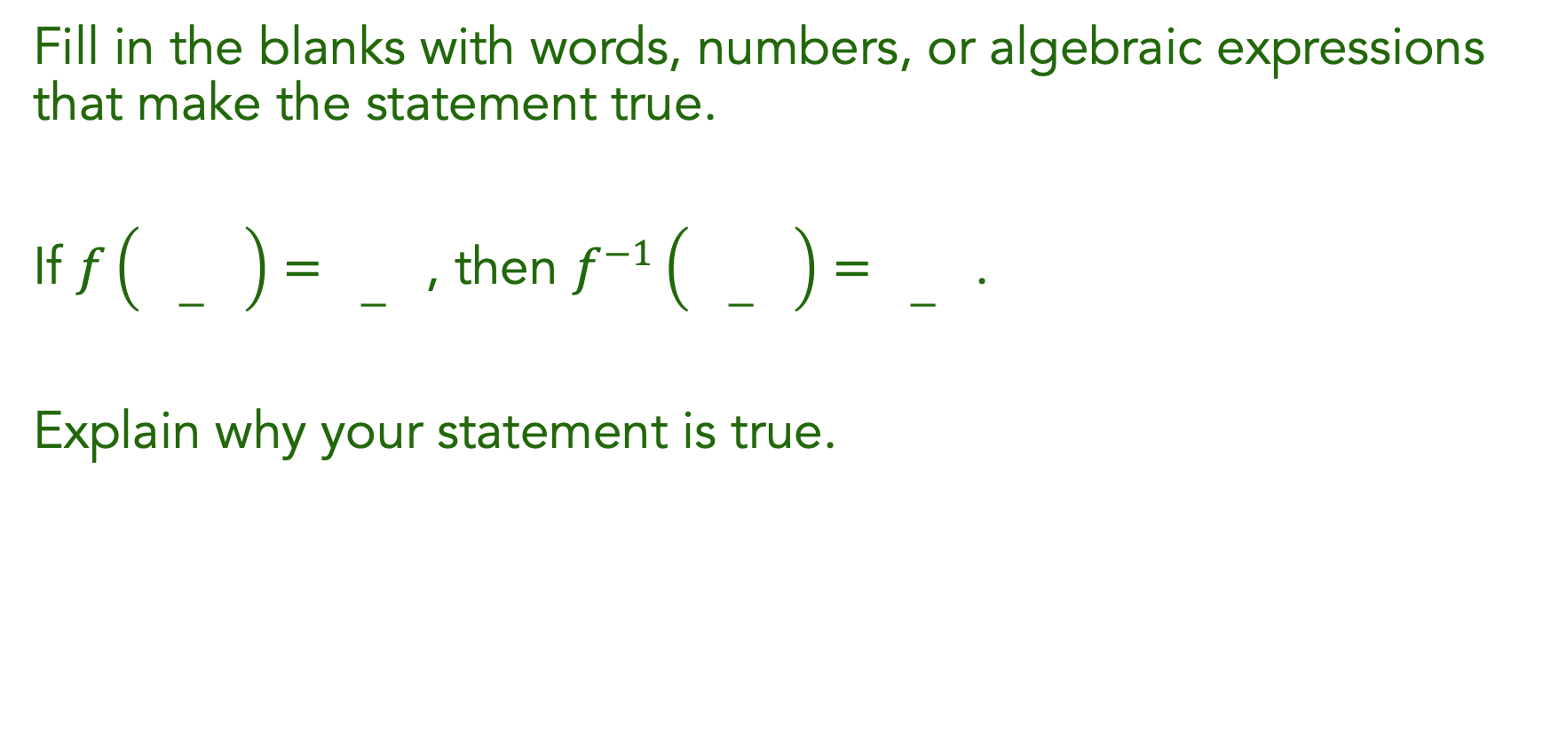
Fill in the blanks with words, numbers, or algebraic expressions that make the statement true.
If $f\left(\underset{―}{}\right)=\underset{―}{}$, then $f^{−1}\left(\underset{―}{}\right)=\underset{―}{}$.
Explain why your statement is true.

Slide 3
Understand the input-output relationship between a function and its inverse.
Find the inverse of a function.

Slide 4

Pulling a Rabbit Out of the Hat
I have a magic trick for you:
  Pick a number, any number
  Add $6$
  Multiply the result by $2$
  Subtract $12$
  Divide by $2$
Notes:
Begin class by having students try the number trick at the beginning of the task. After they try it with their own numbers, help them to track through the operations to show why it works.
This highlights the idea that inverse operations “undo” each other. A function may involve more than one operation, so if the inverse function is to “undo” the function, it may have more than one operation and those operations may need to be performed in a particular order. Students will be finding inverse functions, which will be described in words and then in symbols. Like the magic trick, the output of the inverse needs to be the same input as the original function. Work through the example with the class, and then have them begin working individually on the rest of the task.

Slide 5
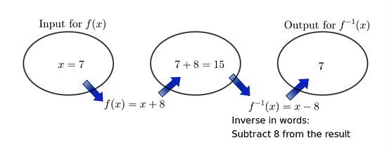
Pulling a Rabbit Out of the Hat
People are often mystified by such tricks, but those of us who have studied inverse operations and inverse functions can easily figure out how they work and even create our own number tricks. Let’s get started by figuring out how inverse functions work together.

Slide 6
Pulling a Rabbit Out of the Hat
Independently, begin working on problem 1 and 2.
Notes:
As students are working individually on problem 1, do a quick check to see whether students are recognizing the inverse operation needed and writing an equation.
Pause and Reflect: After most students have completed problem 2, stop work to pause and reflect.
Ask students to work with partners, with one partner focused on problem 1 and the other partner focused on problem 2.

Slide 7
Pulling a Rabbit Out of the Hat
With a partner, continue working on problems 1-11.
Notes:
After both partners have a chance to share, have students complete the task working with their partners or small groups.
Monitor Student Thinking
Monitor students as they work to see that they are making sense of the inverse operations and considering the order that is needed on the functions that require two steps. (MP7) Encourage them to describe the operations in the correct order before they write the inverse function symbolically. (MP6) Because the notation for logarithmic functions has barely been introduced in the previous lesson, students may not know how to write the inverse function for problems 3 and 8. Tell them that it is acceptable as long as they have described the operation for the inverse in words. Accept informal expressions such as, “undo the exponential,” but challenge students who may say that the inverse of the exponential is some kind of root, such as an “xth root.”
Select and Sequence Student Thinking
Plan to begin the discussion with a student who found the inverse equation for problem 4. Identify a student for problem 6 who found the inverse by solving for x in terms of y in much the same way as they did in Lesson 2, and left the equation as x=sqrty +3, so the class can discuss a method for writing f^-1(x) from this form. For problem 3, select a student who has correctly written the inverse. If none are available, choose a student who has described the inverse without writing an equation with logarithmic notation. Choose a student for problem 8 who has tried to write the steps for creating the inverse as a logarithm, even if their notation is not quite correct.

Slide 8
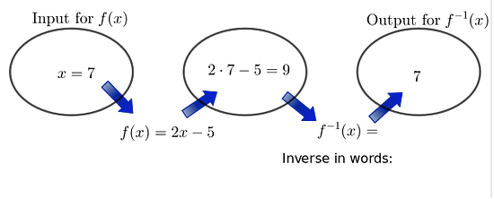
Pulling a Rabbit Out of the Hat
4. Complete:
Notes:
The focus of the discussion will be on finding the inverse of a function. Students are ready to discuss when they have completed problem 8.

Slide 9
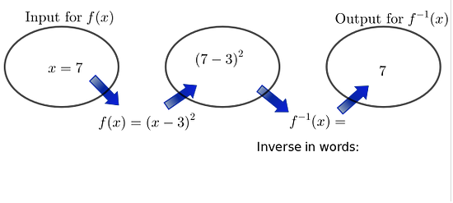
Pulling a Rabbit Out of the Hat
6. Complete:

Slide 10
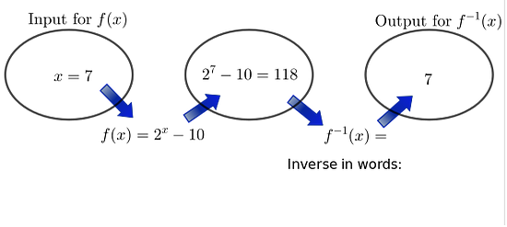
Pulling a Rabbit Out of the Hat
8. Complete:
Notes:
Problems 8 should be discussed so students are familiar with log notation and know that the logarithmic function is the inverse of an exponential function. Finding values for log expressions, graphing logarithmic functions, and using log properties are all topics for Unit 2.

Slide 11
The task began with a magic number trick. Impress your friends by writing your own magic number trick that includes as many operations as you can. Write the trick in words, and then use symbols to show why it works algebraically.

Slide 12
The definition of inverse functions:

Slide 13

Find the inverses of each function:
$f\left(x\right)=\frac{2}{3}x−7$
$g\left(x\right)=2{(x−1)}^{2}+3$
$h\left(x\right)={10}^{x}$

Slide 14
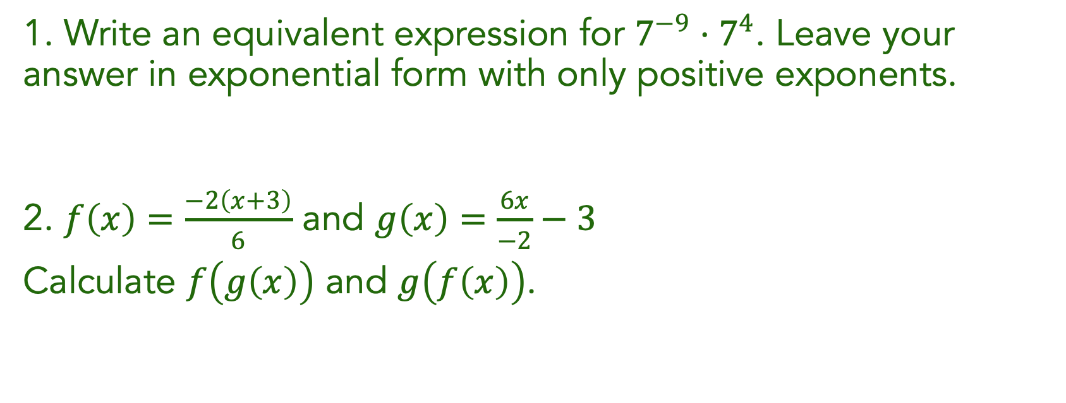
1. Write an equivalent expression for $7^{−9}⋅7^{4}$. Leave your answer in exponential form with only positive exponents.
2. $f\left(x\right)=\frac{−2\left(x+3\right)}{6}$ and $g\left(x\right)=\frac{6x}{−2}−3$
Calculate $f\left(g\left(x\right)\right)$ and $g\left(f\left(x\right)\right)$.

