Slide 1
Lesson 3:
Tracking the Tortoise
Functions and Their Inverses

Slide 2
Represent the inverse of an exponential function.
Compare the inverse relationship for an exponential function with the inverses of linear and quadratic functions.
Determine if a function is invertible.

Slide 3
Tracking the Tortoise
Read the first part of the task, through problems 1 and 2.
What is this situation about?
Notes:
Begin the task using the Three Reads routine. Tell students that they will be reading the first part of the task, up to and including problems 1 and 2, three times. The first time they read the problem, they will read just to tell the story without mathematical details and to describe the problem situation. Give students time to read and ask students to turn to their partners and tell the story. Ask the class to share the story, one aspect at a time until the following are shared and recorded:
Read 1–The Story:
The tortoise and hare are in a race.
The hare thinks he will win.
The tortoise gets a head start.
The tortoise’s family is watching the race.

Slide 4
Tracking the Tortoise
Read the first part of the task, through problems 1 and 2.
Notes:
Next, ask the students to read the task again for the mathematical features of the task, both what they know and what they want to know. After students have some time to read the task, ask the class to share the details, one at a time. Record what is shared, including the following details:
In the second read, students will read with the purpose of identifying both the implicit and explicit mathematical features of the story by naming quantities (numbers and their relationships) and determining the mathematical question.
Read 2–What do they know, what do they want to know?
The tortoise’s head start is 1 meter.
The equation of the distance traveled by the tortoise is: d(t)=2^t.
The distance is in meters and the time is in seconds.
Looking for the distance traveled at 5 seconds and 10 seconds.
Want to know what the graph looks like.

Slide 5
Tracking the Tortoise
Read the first part of the task, through problems 1 and 2.
How might you get started?
Notes:
The third read is for ideas about how to get started. Ask students to read the problem again and share a few ideas for getting started.
Read 3–How to get started:
Use the equation to find values.
Make a table.

Slide 6
Tracking the Tortoise
Independently begin working on problems 1 and 2.

Slide 7
Tracking the Tortoise
With a partner, continue working through problems 1-11.
Notes:
As students are working individually, see that they have a good idea of how to get started with problems 1 and 2 after the Launch. Problem 2 asks for a description of the graph, which could be accomplished by a quick sketch. If students do not know the shape of an exponential graph, encourage them to use graphing technology to see the graph of the function and then sketch it on their papers. After they have the shape in mind, they should write a few features, such as the graph is always increasing, it has no -intercept, and it contains the point (0, 1). Once most students have completed problem 2, ask them to share their work with their partners and then complete the task working with partners or small groups.
Begin by selecting a student for problems 1 and 2 who has calculated some values and created a sketch of the graph of d(t). For problem 5, pick a student who has graphed the inverse by switching the inputs and outputs in the table of d(t) to obtain d(t). Identify a student to share problem 8 who has accurately graphed both functions. Choose a student for problems 9 and 10 who has an explanation for why if f(3)=8, then f^-1(8)=3.

Slide 8
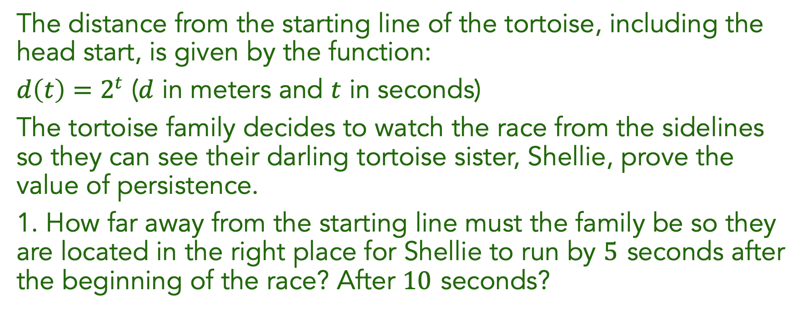
Tracking the Tortoise
The distance from the starting line of the tortoise, including the head start, is given by the function:
$d\left(t\right)=2^{t}$ ($d$ in meters and $t$ in seconds)
The tortoise family decides to watch the race from the sidelines so they can see their darling tortoise sister, Shellie, prove the value of persistence.
1. How far away from the starting line must the family be so they are located in the right place for Shellie to run by $5$seconds after the beginning of the race? After $10$seconds?
Notes:
The focus of the discussion will be exploring the inverse of an exponential function. Students are ready to discuss when they have completed problem 9.
Begin the discussion by asking a student to present a table of values for the graph of d(t). Ask students to describe how they selected the values of d to elicit the idea that they chose powers of 2 because they made it easy to think about the time. This strategy will become increasingly valuable in the next unit, so it is important to make it explicit here. Ask a student to share the graph of the inverse function t(d), and ask the class how it compares to the graph of d(t). They should again notice the reflection over y=x. Ask students to compare the domain and range of d(t) with the domain and range of . As students discuss the graphs and conclude that is the inverse function of t(d), ask them to begin to generalize the patterns they see about inverses to all functions. Some questions to ask are:
Will a function and its inverse always be reflections over the y=x line? Why?
Will the domain of the function always be the range of the inverse function? Why or why not?

Slide 9

Tracking the Tortoise
2. Describe the graph of $d\left(t\right)$, Shellie’s distance at time $t$. What are the important features of $d\left(t\right)$?

Slide 10

Tracking the Tortoise
8. Consider the function $f\left(x\right)=2^{x}$.
  What are the domain and range of $f\left(x\right)$? Is $f\left(x\right)$ invertible?
  Graph $f\left(x\right)$ and $f^{−1}\left(x\right)$ on the grid.
Notes:
Move the discussion to problem 8. It is important in this early exposure to the ideas of logarithms that students consider the part of a logarithmic graph between x=0 and x=1.

Slide 11

Tracking the Tortoise
9. If $f\left(3\right)=8$, what is $f^{−1}\left(8\right)$? How do you know?
10. If $f\left(\frac{1}{2}\right)=1.414$, what is $f^{−1}\left(1.414\right)$? How do you know?
Notes:
Complete the discussion with problems 9–10. Ask students to show how they can use the graphs of f(x) and f^-1(x) to justify their answers.

Slide 12

Tracking the Tortoise
11. If $f\left(a\right)=b$, what is $f^{−1}\left(b\right)$? Will your answer change if $f\left(x\right)$ is a different function? Explain.
Notes:
Emphasize problem 11, and ask students to make a general argument based on the three tasks and their knowledge of inverses so far. End the discussion by introducing a more formal definition of inverse functions as follows:
In mathematics, an inverse function is a function that “reverses” or “undoes” another function. To describe this relationship in symbols, it can be said, The function g is the inverse of function f if and only if f(a)=b and g(b)=a. Using x and y, one would write f(x)=y and g(y)=x.

Slide 13

Find the graph of the inverse of $f\left(x\right)={10}^{x}$.
What features does this graph have in common with the graph of the inverse of $f\left(x\right)=2^{x}$?

Slide 14
Exponential functions and their inverses:

Slide 15
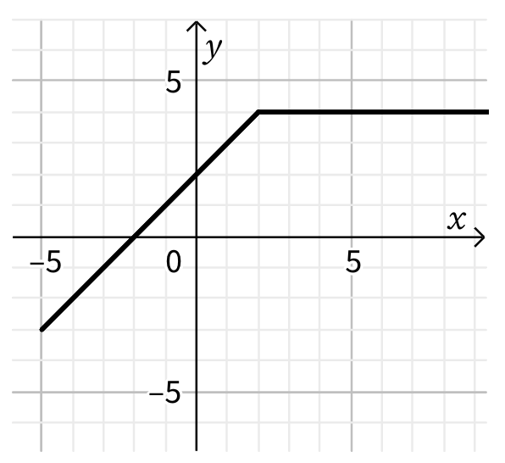
Graph the inverse of the function given:
Is the inverse a function? Why or why not?
.

Slide 16

1. Solve for the value of $x$.
$$3^{4x+5}=3^{7x−13}$$
2. Calculate $f\left(a+b\right)$, given that $f\left(x\right)=x^{2}+4x−3$.

