Slide 1
Lesson 4: Square Deal
Structures of Quadratic Expressions

Slide 2
Find a process for completing the square that works on all quadratic functions.
Adapt diagrams to become more efficient in completing the square.

Slide 3
Square Deal
Remember Optima’s quilt shop? She bases her designs on quilt squares that can vary in size, so she calls the length of the side for the basic square $x$, and the area of the basic square is the function $A\left(x\right)=x^{2}$. In this way, she can customize the designs by making bigger squares or smaller squares.

Slide 4
Square Deal
Sometimes a customer orders more than one quilt block of a given size. For instance, when a customer orders $4$ blocks of the basic size, the customer service representatives write up an order for $A\left(x\right)=4x^{2}$. Model this area expression with a diagram.
One of the customer service representatives finds an envelope that contains the blocks pictured below. Write the order that shows two equivalent equations for the area of the blocks.

Slide 5
Notes:
Use this routine when students present their strategies for creating expressions that represent the area models. Ask students to consider what is the same and what is different about the strategies. Draw students’ attention to the different ways students reasoned to connect the expression to the area models. Listen for and amplify language students use to describe the connection between the algebraic expression and the model, such as factors, terms, distributive property, and sum. This will foster meta-awareness and support constructive conversations as they move towards an algebraic approach supported with diagrams.

Slide 6
Square Deal
What equations for the area could customer service write if they received an order for $2$ square blocks that have both dimensions increased by $1$ inch in comparison to the basic block? Write the area equations in two equivalent forms. Verify your algebra using a diagram.

Slide 7
Square Deal
What if customer service receives an order for $3$ square blocks with both dimensions increased by $2$ inches in comparison to the basic block? Again, show two different equations for the area and verify your work with a model.

Slide 8
Square Deal
Clementine is at it again! When is that dog going to learn not to chew up the orders? (She also chews Optima’s shoes, but that’s a story for another day.) Here are some of the orders that have been chewed up so they are missing the last term. Help Optima by completing each of the following expressions for the area so that they describe a perfect square. Then, write the two equivalent equations for the area of the square.
a. $2x^{2}+8x$
b. $3x^{2}+24x$

Slide 9
Square Deal
Sometimes the quilt shop gets an order that turns out to be more or less than a perfect square. Customer service always tries to fill orders with perfect squares, or at least, they start there and then adjust as needed. They always write their equations in a way that relates the area to the closest perfect square.
Now here’s a real mess! Customer service received an order for an area $A\left(x\right)=2x^{2}+12x+13$. Help them to figure out an equivalent expression for the area using the diagram.

Slide 10
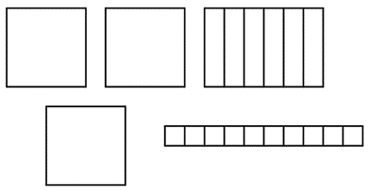
Square Deal
Optima really needs to get organized. Here’s another scrambled diagram. Write two equivalent equations for the area of this diagram.

Slide 11
Square Deal
Optima realized that not everyone needs perfect squares and not all orders are coming in as expressions that are perfect squares. Determine whether each expression below is a perfect square and why the expression is or is not a perfect square. If it is not a perfect square, find the perfect square that seems “closest” to the given expression, and show how the perfect square can be adjusted to be equivalent to the given expression.

Slide 12
Square Deal
Determine whether each expression below is a perfect square and why the expression is or is not a perfect square.
$A\left(x\right)=x^{2}+6x+13$
$A\left(x\right)=x^{2}−8x+16$
$A\left(x\right)=x^{2}−10x−3$
$A\left(x\right)=2x^{2}+8x+14$
$A\left(x\right)={3x}^{2}−30x+75$
$A\left(x\right)=2x^{2}−22x+11$

Slide 13
Square Deal
Now let’s generalize. Given an expression in the form $ax^{2}+bx+c \left(a≠0\right)$, describe a step-by-step process for completing the square.

Slide 14
Use the completing the square process on the following expression:
$$\frac{1}{2}x^{2}+4x+8$$

Slide 15
Completing the square for $y=ax^{2}+bx+c$ when $a=1$
Example: __________ | Diagram

Slide 16
Completing the square for $y=ax^{2}+bx+c$ when $a≠1$
Example: __________ | Diagram

Slide 17
Complete the square to find an equivalent expression:
$x^{2}+4x+10$
$2x^{2}+8x+3$

Slide 18
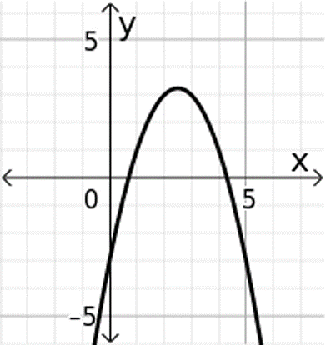
State the $y$-intercept for each of the graphs. Then match the graph with its equation.
$f\left(x\right)=x^{2}+5x+3$
$g\left(x\right)=−x^{2}+5x−3$
$h\left(x\right)=x^{2}+5x−3$
$y$-intercept: _______
Equation: _______
$y$-intercept: _______
Equation: _______
$y$-intercept: _______
Equation: _______

Slide 19
Find the indicated values for $g\left(x\right)=−x^{2}+5x−3$
4. $g\left(2\right)$
5. $g\left(5\right)$
6. $g(−3)$

