Slide 1
Lesson 3:
Building the Perfect Square
Structures of Quadratic Expressions

Slide 2
Find the square of a binomial expression.
Recognize a perfect square trinomial.
Create perfect squares from partial areas.
Find relationships between terms in a perfect square trinomial.

Slide 3


Building the Perfect Square
Graph each function.
1. $y=−x^{2}+5$

Slide 4

Building the Perfect Square
Graph each function.
2. $y={(x−1)}^{2}−3$

Slide 5

Building the Perfect Square
Graph each function.
3. $y=2x^{2}−5$

Slide 6
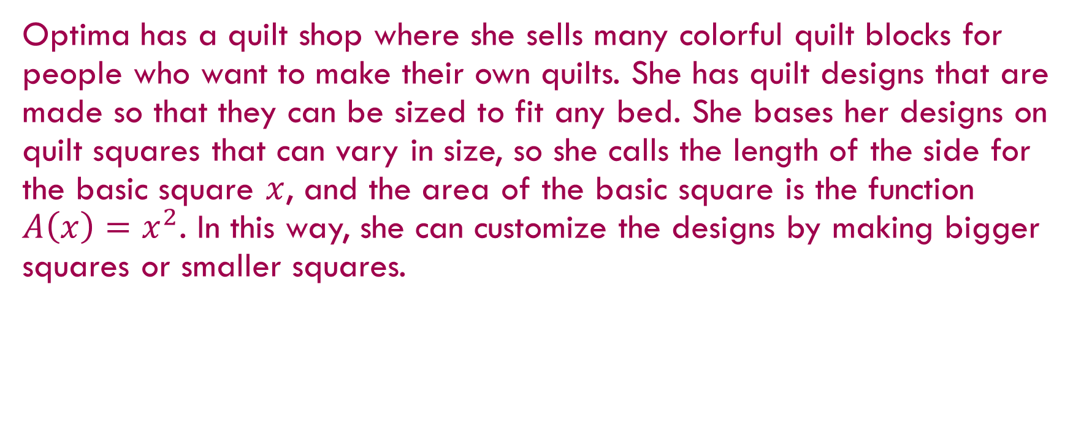
Building the Perfect Square
Optima has a quilt shop where she sells many colorful quilt blocks for people who want to make their own quilts. She has quilt designs that are made so that they can be sized to fit any bed. She bases her designs on quilt squares that can vary in size, so she calls the length of the side for the basic square $x$, and the area of the basic square is the function $A\left(x\right)=x^{2}$. In this way, she can customize the designs by making bigger squares or smaller squares.

Slide 7

Notice and Wonder
If Optima adds $3$ inches to the side of the square, what is the area of the square?

Slide 8
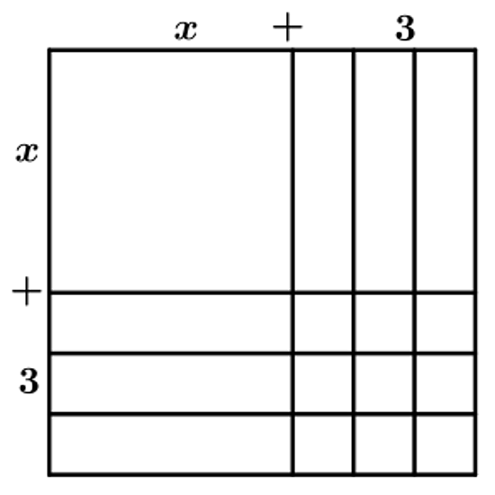
Notice and Wonder
When Optima draws a pattern for the square in problem 1, it looks like this:

Slide 9

Notice and Wonder
Use both the diagram and the equation $A\left(x\right)={\left(x+3\right)}^{2}$ to explain why the area of the quilt block square, $A\left(x\right),$ is also equal to ${ x}^{2}+6x+9$.

Slide 10
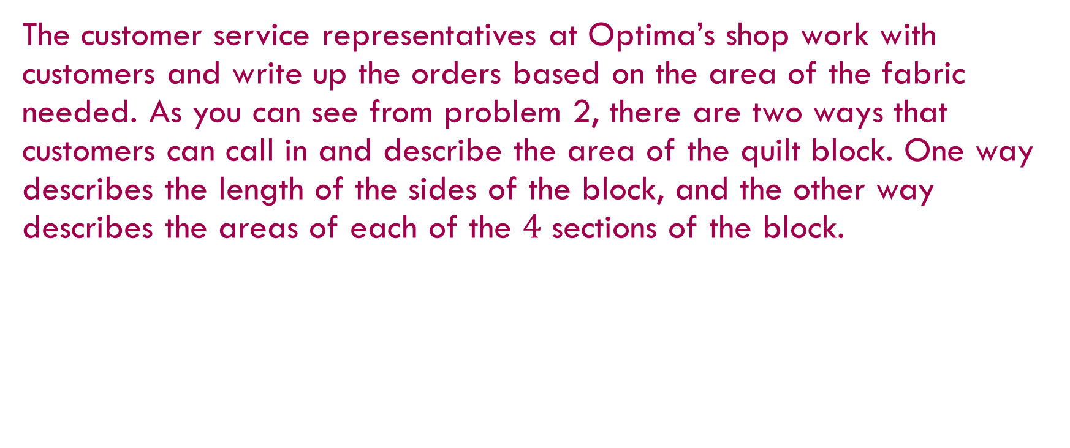
Building the Perfect Square
The customer service representatives at Optima’s shop work with customers and write up the orders based on the area of the fabric needed. As you can see from problem 2, there are two ways that customers can call in and describe the area of the quilt block. One way describes the length of the sides of the block, and the other way describes the areas of each of the $4$ sections of the block.

Slide 11

Building the Perfect Square
For each of the following quilt blocks, draw the diagram of the block and write two equivalent equations for the area of the block.
Block with side length $x+2$.

Slide 12

Building the Perfect Square
For each of the following quilt blocks, draw the diagram of the block and write two equivalent equations for the area of the block.
4. Block with side length $x+1$.

Slide 13
Building the Perfect Square
What patterns do you notice when you relate the diagrams to the two expressions for the area?

Slide 14
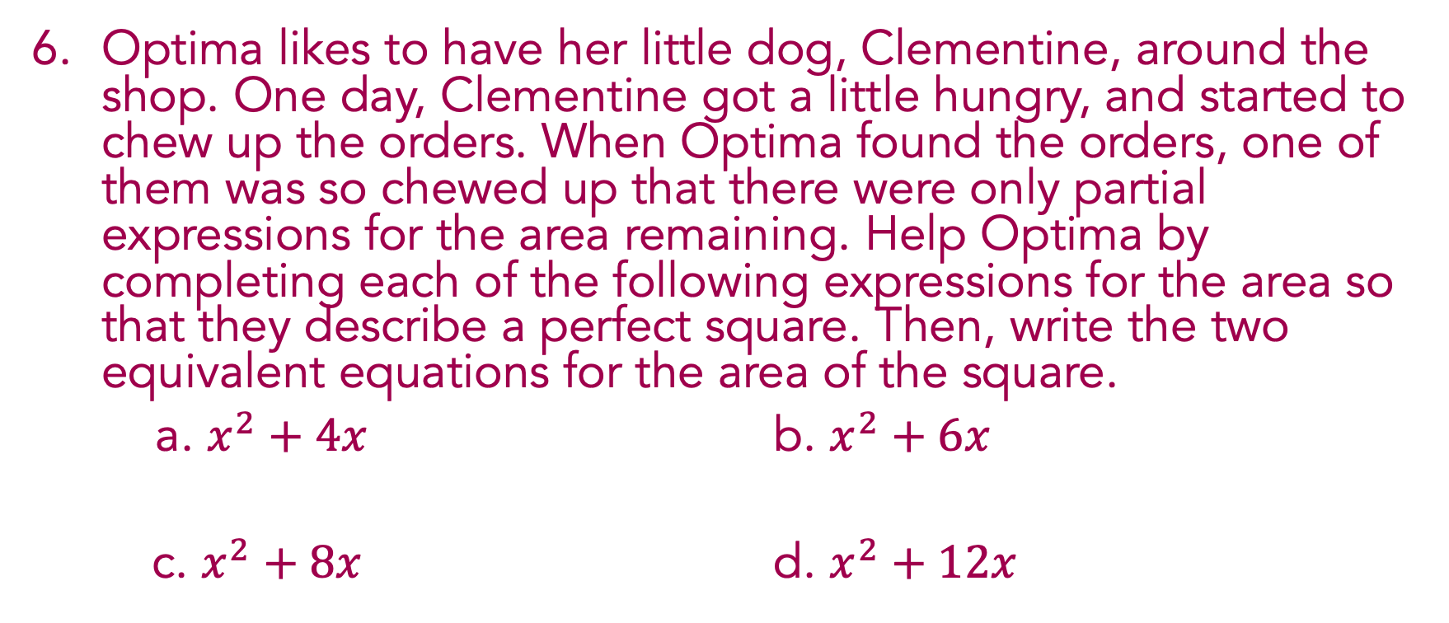
Building the Perfect Square
Optima likes to have her little dog, Clementine, around the shop. One day, Clementine got a little hungry, and started to chew up the orders. When Optima found the orders, one of them was so chewed up that there were only partial expressions for the area remaining. Help Optima by completing each of the following expressions for the area so that they describe a perfect square. Then, write the two equivalent equations for the area of the square.
a. $x^{2}+4x$ b. $x^{2}+6x$
c. $x^{2}+8x$ d. $x^{2}+12x$

Slide 15
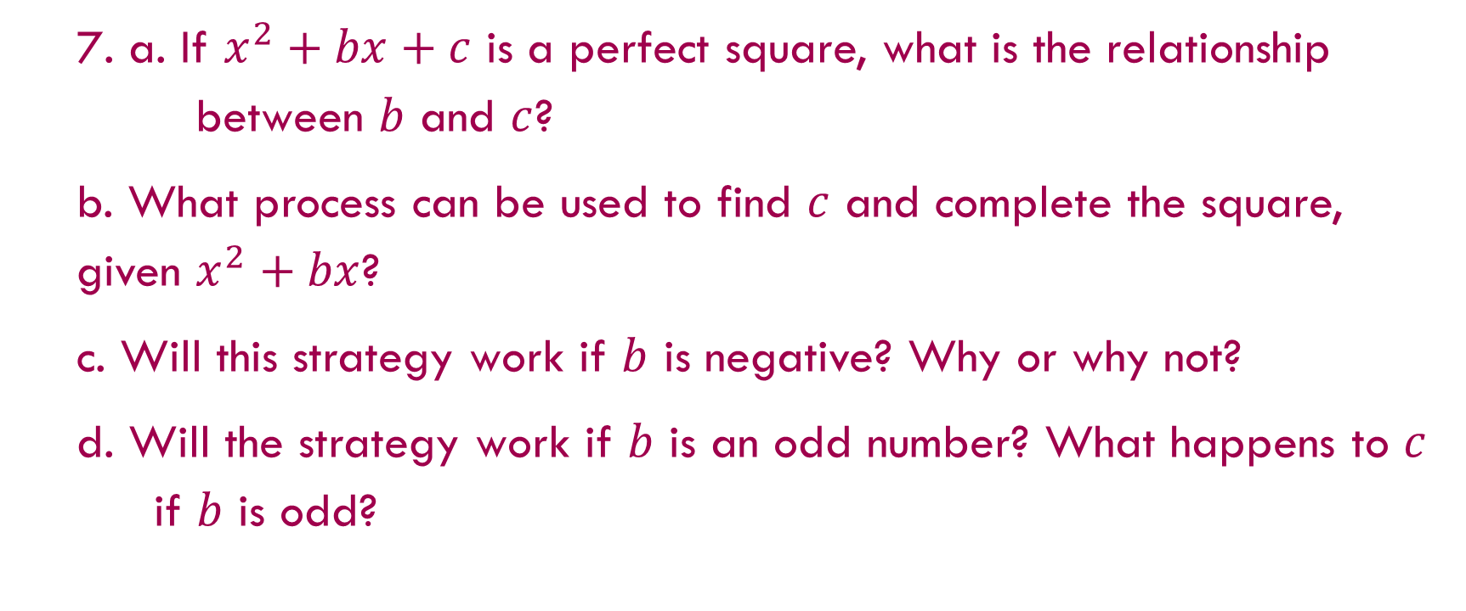
Building the Perfect Square
  7. a. If $x^{2}+bx+c$ is a perfect square, what is the relationship between $b$ and $c$?
  b. What process can be used to find $c$ and complete the square, given $x^{2}+bx$?
  c. Will this strategy work if $b$ is negative? Why or why not?
  d. Will the strategy work if $b$ is an odd number? What happens to $c$ if $b$ is odd?

Slide 16

Building the Perfect Square
One of the new customer service representatives thinks she doesn’t need to draw diagrams anymore because she found a great shortcut. She writes ${\left(x+5\right)}^{2}=x^{2}+25$. Examine her thinking. Is she right, or does she need to revise her strategy? What suggestions would you make, and how would they help?

Slide 17

Prove that ${\left(x+h\right)}^{2}=x^{2}+2xh+h^{2}$, either algebraically or using a diagram.

Slide 18

If $x^{2}+bx+c$ is a perfect square, _______________
The square of a binomial: _______________
An example is: _______________

Slide 19
Adding Notation, Vocabulary, & Conventions
Pause and Record
Binomial –
Trinomial –
Squaring a Binomial –

Slide 20

Use a diagram to complete the square, and write two equivalent expressions for the area of the square, given the following:
$$A\left(x\right)=x^{2}+10x+_______$$

Slide 21


Find the $x$-intercept and the $y$-intercept, and graph the equation. $3x+2y=12$
$x$-intercept: _______ $y$-intercept: _______

Slide 22
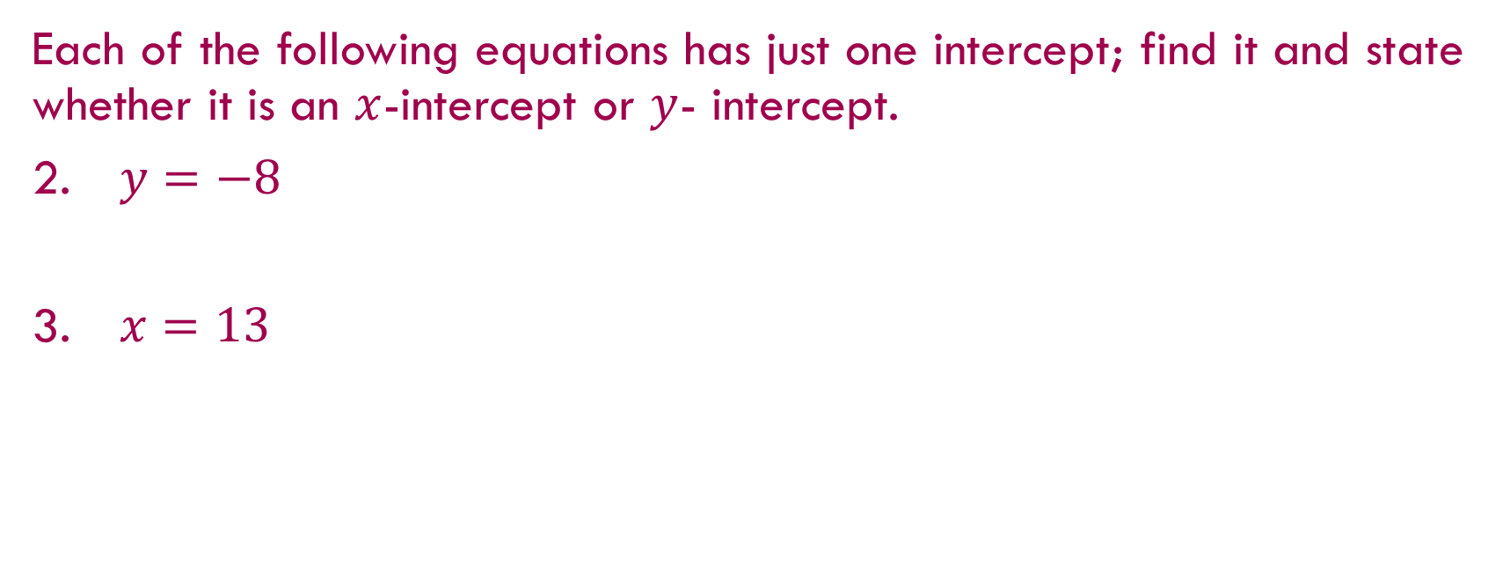
Each of the following equations has just one intercept; find it and state whether it is an $x$-intercept or $y$- intercept.
$y=−8$
$x=13$

