Slide 1
Lesson 1:
Transformers: Shifty y’s
Structures of Quadratic Expressions

Slide 2
Find patterns in the equations and graphs of quadratic functions.

Slide 3
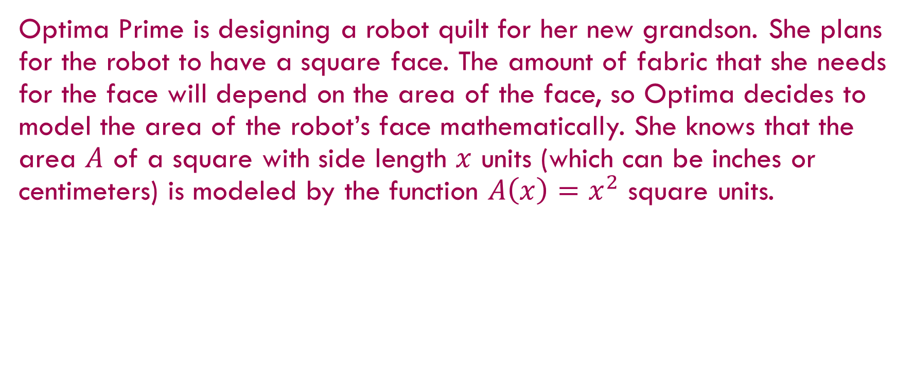
Transformers: Shifty y’s
Optima Prime is designing a robot quilt for her new grandson. She plans for the robot to have a square face. The amount of fabric that she needs for the face will depend on the area of the face, so Optima decides to model the area of the robot’s face mathematically. She knows that the area $A$ of a square with side length $x$ units (which can be inches or centimeters) is modeled by the function $A\left(x\right)=x^{2}$ square units.

Slide 4
Transformers: Shifty y’s
Independently, begin working through problems 1-4.
Notes:
Give students 2 minutes of independent think time.

Slide 5
Transformers: Shifty y’s
With a partner, continue working through problems 1-4.
Notes:
Give students 5 minutes to work in pairs.

Slide 6

She knows that the area $A$ of a square with side length $x$ units (which can be inches or centimeters) is modeled by the function $A\left(x\right)=x^{2}$ square units.
1. What is the domain of the function $A\left(x\right)$ in this context?
Notes:
Have students use the context to think about the answers to problems 1 and 2, encouraging the use of drawings to show how changing a parameter changes the square represented by the expression. Give students three or four minutes to work on their own, and then discuss each of the answers, sharing reasoning about whether the change is to the length of the side or directly to area.

Slide 7
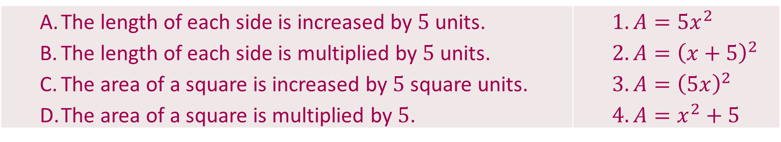
2. Match each statement about the area to the function that models it.
The length of each side is increased by $5$ units. The length of each side is multiplied by $5$ units. The area of a square is increased by $5$ square units. The area of a square is multiplied by $5$. | $A=5x^{2}$ $A={\left(x+5\right)}^{2}$ $A={\left(5x\right)}^{2}$ $A=x^{2}+5$
Notes:
Have students use the context to think about the answers to problems 1 and 2, encouraging the use of drawings to show how changing a parameter changes the square represented by the expression. Give students three or four minutes to work on their own, and then discuss each of the answers, sharing reasoning about whether the change is to the length of the side or directly to area.

Slide 8

3. Optima started thinking about the graph of $y=x^{2}$ (in the domain of all real numbers). Make a table that contains both negative and positive values of $x$, and graph the function. What features do you notice?
Link to Desmos Display
Notes:
Have students make a table and graph y=x^2 for problem 3. Use technology to display the graph for the class. Ask students for their observations about the graph.

Slide 9
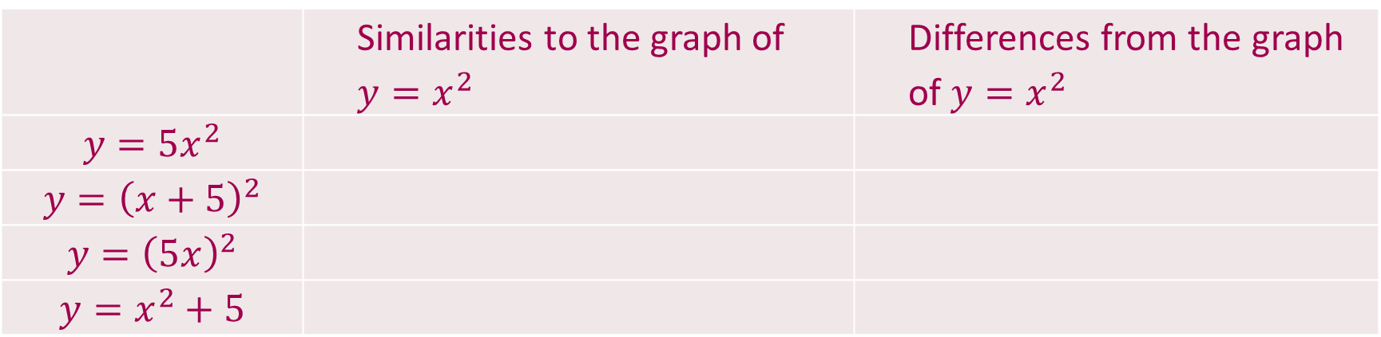

4. Make your own predictions of how the graphs of each of the following equations will be the same or different from the graph of $y=x^{2}$.
 | Similarities to the graph of $y=x^{2}$ | Differences from the graph of $y=x^{2}$
$$y=5x^{2}$$
$$y={\left(x+5\right)}^{2}$$
$$y={\left(5x\right)}^{2}$$
$$y=x^{2}+5$$

Slide 10
Recording Definitions
Pause and Record
Vertex –
Line of Symmetry –
Notes:
Pause and Record — Teacher Notes
Define the vertex and the line of symmetry, and ask students to record the definitions in their notes. Label the vertex and line of symmetry on the graph of in problem 3, and have students add the labels to their graphs. Tell students that the vertex and line of symmetry are two features for describing parabolas that they will be using throughout the unit.
Pause and Record – Adding Notation, Vocabulary, and Conventions
Vertex – The maximum or minimum point on a parabola.
Line of Symmetry – A vertical line through the vertex that divides the parabola into two congruent parts.

Slide 11
Transformers: Shifty y’s
Independently, begin working through problems 5-9.
Notes:
As students are working individually, make a quick check to see that all students can use the technology to graph the functions with appropriate viewing windows. After most students have finished problems 5 and 6, ask them to share their conclusions with a partner and then complete the task working with a partner or small group.

Slide 12
Transformers: Shifty y’s
With a partner, begin working through problems 5-9.
Notes:
After most students have finished problems 5 and 6, ask them to share their conclusions with a partner and then complete the task working with a partner or small group.

Slide 13
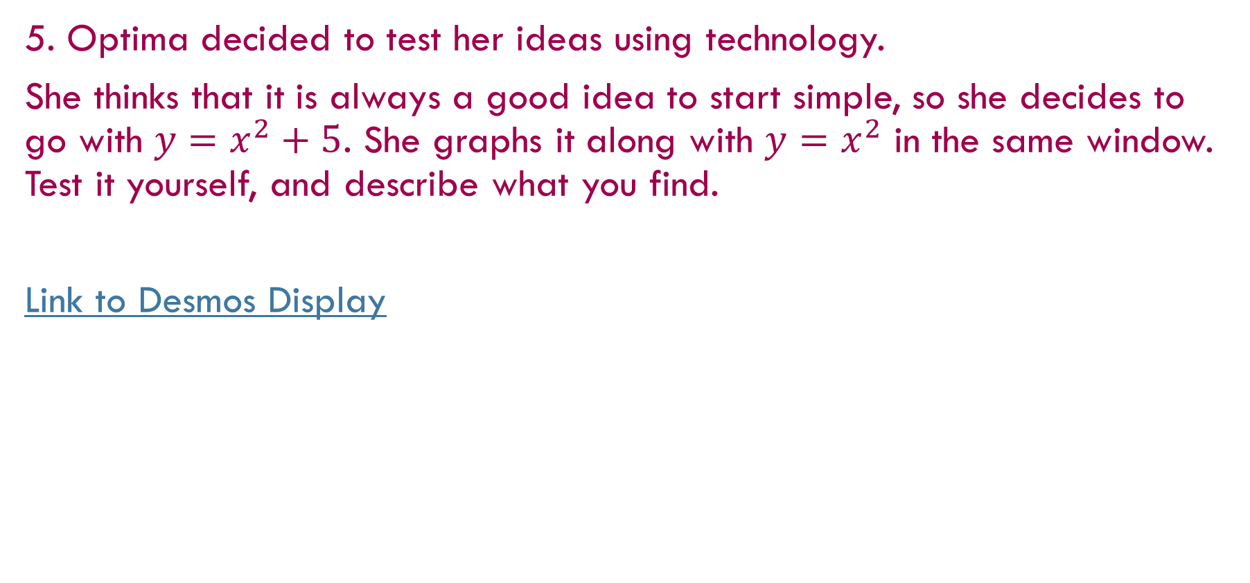
5. Optima decided to test her ideas using technology.
She thinks that it is always a good idea to start simple, so she decides to go with $y=x^{2}+5$. She graphs it along with $y=x^{2}$ in the same window. Test it yourself, and describe what you find.
Link to Desmos Display
Notes:
Ask students to relate their tables to the graphs and explain why their conclusions make sense in each case.
Problems 5 and 6: Use the context to bring out the idea that the area (or the result of squaring) is the y-value or height of the graph. It should make sense that adding a number, k, to each area (or y-value) will shift the graph up k units. Ask students what happens if k is negative.

Slide 14
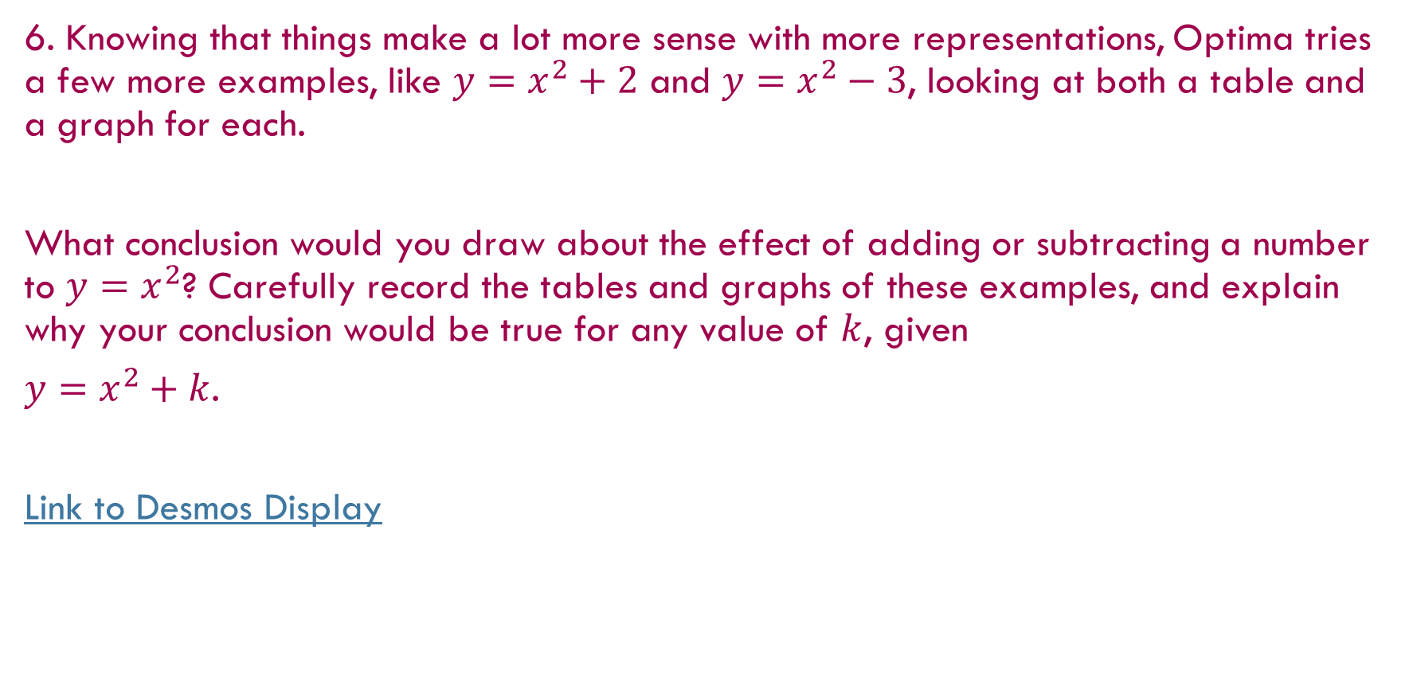
6. Knowing that things make a lot more sense with more representations, Optima tries a few more examples, like $y=x^{2}+2$ and $y=x^{2}−3$, looking at both a table and a graph for each.
What conclusion would you draw about the effect of adding or subtracting a number to $y=x^{2}$? Carefully record the tables and graphs of these examples, and explain why your conclusion would be true for any value of $k$, given
$y=x^{2}+k$.
Link to Desmos Display
Notes:
Ask students to relate their tables to the graphs and explain why their conclusions make sense in each case.
Problems 5 and 6: Use the context to bring out the idea that the area (or the result of squaring) is the y-value or height of the graph. It should make sense that adding a number, k, to each area (or y-value) will shift the graph up k units. Ask students what happens if k is negative.

Slide 15
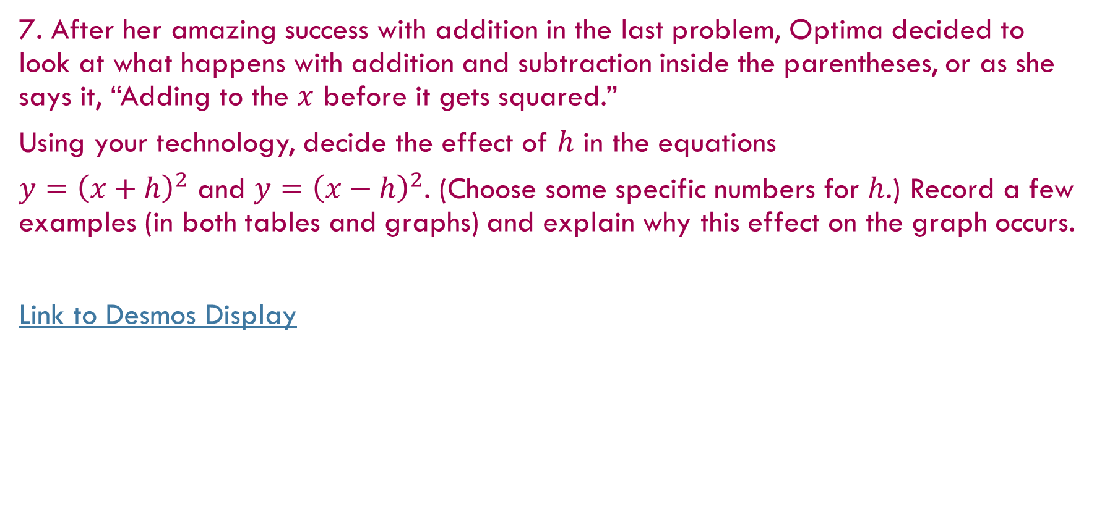
7. After her amazing success with addition in the last problem, Optima decided to look at what happens with addition and subtraction inside the parentheses, or as she says it, “Adding to the $x$ before it gets squared.”
Using your technology, decide the effect of $h$ in the equations
$y={\left(x+h\right)}^{2}$ and $y={\left(x−h\right)}^{2}$. (Choose some specific numbers for $h$.) Record a few examples (in both tables and graphs) and explain why this effect on the graph occurs.
Link to Desmos Display
Notes:
Ask students to relate their tables to the graphs and explain why their conclusions make sense in each case.
Problems 5 and 6: Use the context to bring out the idea that the area (or the result of squaring) is the y-value or height of the graph. It should make sense that adding a number, k, to each area (or y-value) will shift the graph up k units. Ask students what happens if is negative.

Slide 16
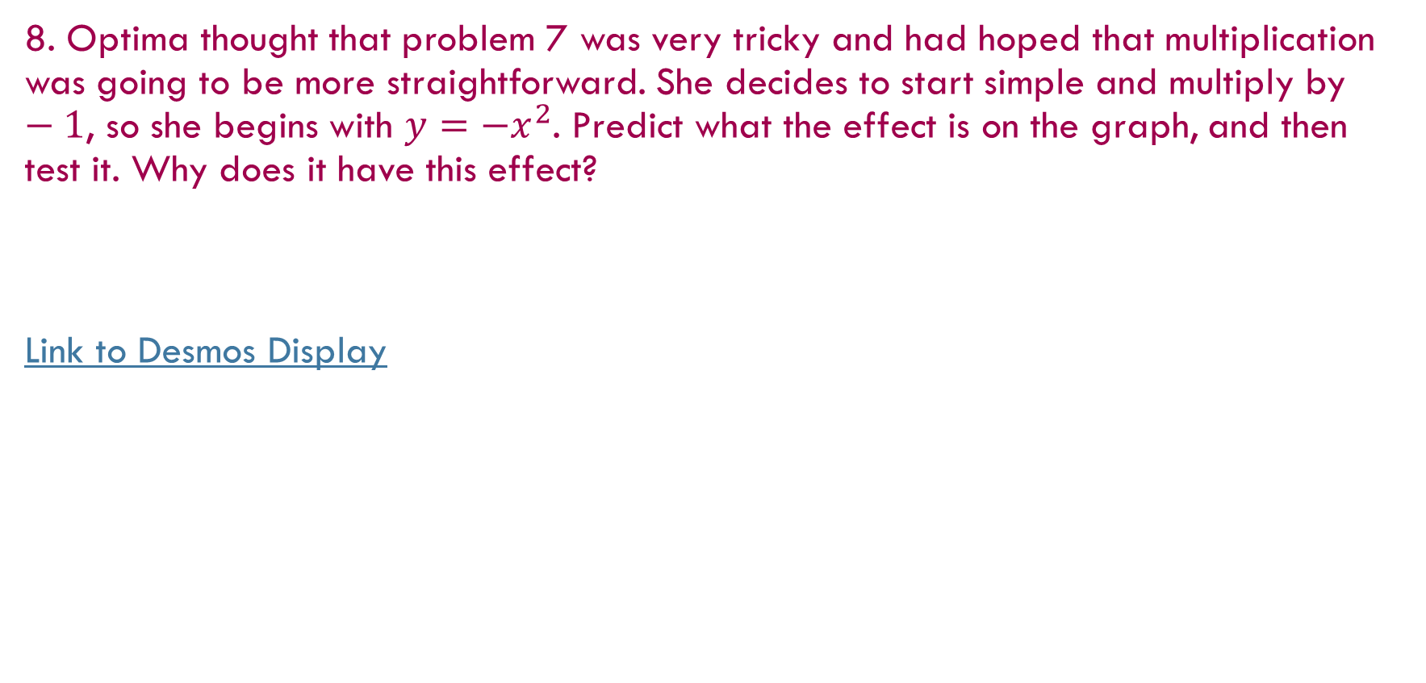
8. Optima thought that problem 7 was very tricky and had hoped that multiplication was going to be more straightforward. She decides to start simple and multiply by $−1$, so she begins with $y=−x^{2}$. Predict what the effect is on the graph, and then test it. Why does it have this effect?
Link to Desmos Display
Notes:
Problem 8: This one can be explained based on either the table or the context. If the sign of every output is changed (or multiplied by -1), it will create a maximum where the minimum was previously and change the intervals that were increasing to decreasing and vice versa.

Slide 17
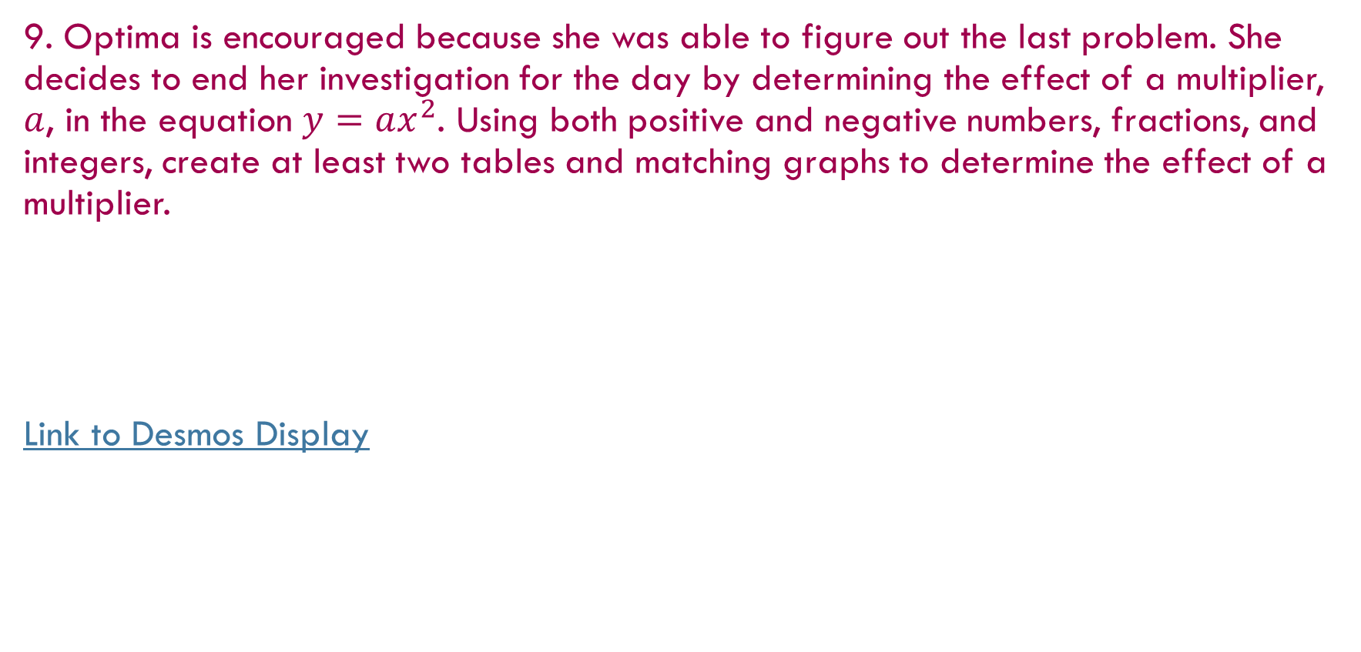
9. Optima is encouraged because she was able to figure out the last problem. She decides to end her investigation for the day by determining the effect of a multiplier, $a$, in the equation $y=ax^{2}$. Using both positive and negative numbers, fractions, and integers, create at least two tables and matching graphs to determine the effect of a multiplier.
Link to Desmos Display
Notes:
Problem 9: Students will probably notice that multiplying by a whole number appears to make the parabola narrower and multiplying by a fraction appears to make the parabola wider. The graphs are not actually narrower or wider, as students will see when they explore parabolas from a geometric perspective. This may seem a little counterintuitive until they connect to the tables and think that a multiplier of 3 multiplies each output, making the curve decrease and increase three times faster.

Slide 18

Use technology to explore the behavior of the line $y=x.$ If the point $\left(0,0\right)$ is used as an anchor point, much like $\left(0,0\right)$ is used on the graph of the parabola, will the transformations discovered for the parabola work for a line? Why or why not?

Slide 19
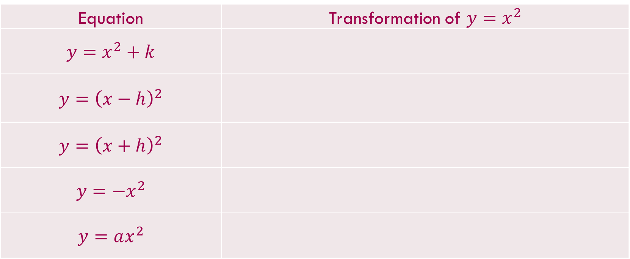
Equation | Transformation of $y=x^{2}$
$$y=x^{2}+k$$
$$y={\left(x−h\right)}^{2}$$
$$y={\left(x+h\right)}^{2}$$
$$y=−x^{2}$$
$$y=ax^{2}$$

Slide 20
Adding Notation, Vocabulary, & Conventions
Pause and Record
Vertex –
Line of Symmetry –

Slide 21
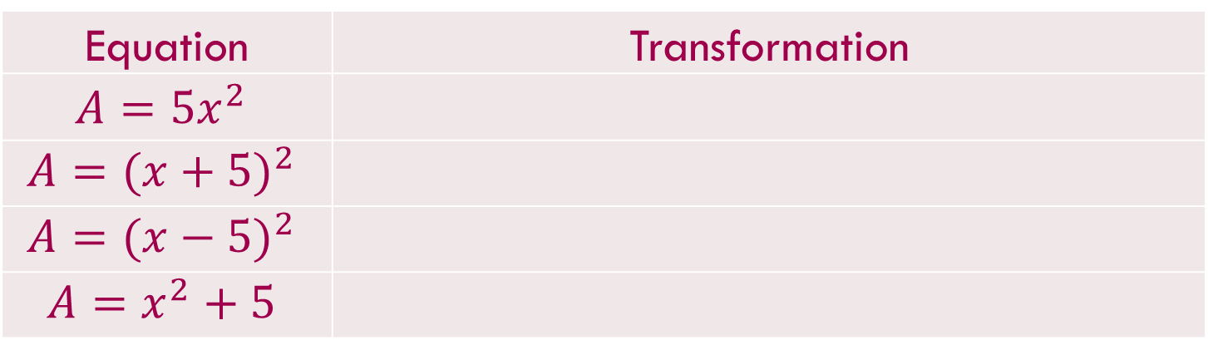

Based upon what you learned today, what transformations of the graph of $y=x^{2}$ occur in each of the following functions:
Equation | Transformation
$$A={5x}^{2}$$
$$A={(x+5)}^{2}$$
$$A={(x−5)}^{2}$$
$$A=x^{2}+5$$

Slide 22
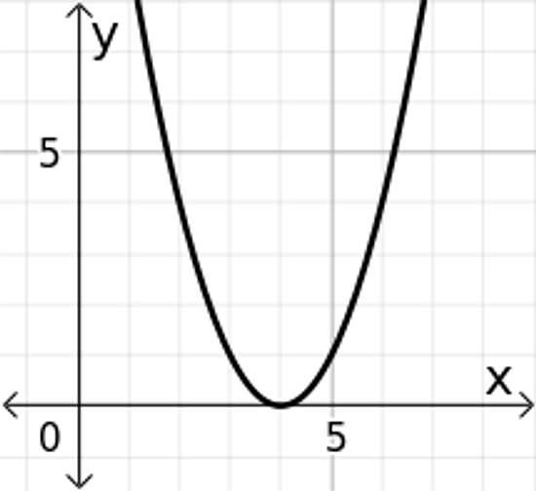
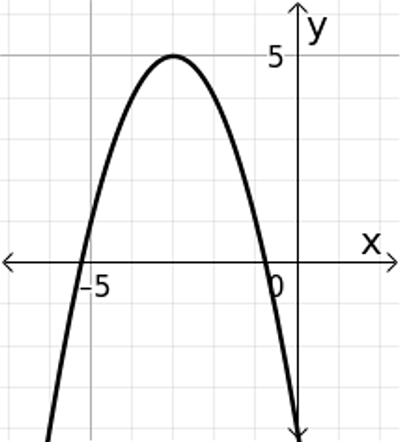
Draw a line of symmetry for the graph, state whether the graph has a maximum point or a minimum point, and provide the coordinates for that point.
1. 2.

Slide 23


Graph the linear equations, and explain your strategy.
3. $f\left(x\right)=−4\left(x+3\right)+7$

Slide 24

Graph the linear equations, and explain your strategy.
4. $3x−4y=24$

