Slide 1
Lesson 1: Something to Talk About
Quadratic Functions
Notes:
This lesson introduces quadratic functions by examining the growth of a geometric pattern. We will begin with modeling patterns and identifying the growth as it appears in tables, graphs, and equations. In this lesson, students will find that the table has a constant second difference, which is the identifying feature of a quadratic function. As with previous grades, students will have multiple opportunities in this unit to consider different features of quadratic functions that occur in different contexts, and to compare the growth of quadratic functions to linear and exponential functions. This unit is about developing a conceptual understanding of quadratic functions, algebraic operations to change forms of quadratic functions, and solving quadratic equations with real solutions.

Slide 2
Which One Doesn’t Belong and Why?
$f\left(x\right)=3\left(x−1\right)$
B. $f\left(n\right)=f\left(n−1\right)+2, f\left(0\right)=7$
C.
$x$ | $f\left(x\right)$
$0$ | $8$
$1$ | $1$
$2$ | $−6$
$3$ | $−13$
$4$ | $−20$
D.
E.
$x$ | $f\left(x\right)$
$0$ | $5$
$1$ | $6$
$2$ | $9$
$3$ | $14$
$4$ | $21$
Notes:
The purpose of this Jump Start is to activate students’ background knowledge of linear functions and their representations. Students are given five functions with different representations and asked to determine which function is different. They must justify their choice with mathematical reasoning. Allow students a few minutes to work individually to determine their choices, then ask students to share their answers with a partner. As student share their reasons, ask question to bring out the following ideas about each function. For instance, students may select A as the only explicit equation. If this is the case, ask what type of function the equation represents and how they know.
The only increasing linear function with an explicit equation. (Slope of 3)
The only increasing linear function with a recursive equation. (Slope of 2)
The only linear function represented with a diagram. (Slope of 3)
The only decreasing linear function (Slope of -7)
The only function that is not linear or exponential because it does not have a constant rate of change.

Slide 3
Model a growing pattern with tables, graphs, and equations.
Analyze the type of growth exhibited by a pattern.

Slide 4
Something to Talk About
1. Let’s start with a little “Notice and Wonder.” Given the following pattern, what do you notice? What do you wonder?
Notes:
Project the pattern shown on the task without describing the context or making additional comments. Tell students to write at least two things that they notice about the sequence of figures and at least one thing that they wonder about the sequence of figures. Allow students some time to work individually, before sharing with the class. Look for students to notice things like:
I see the pattern changing with a new diagonal in each figure
I see the pattern changing with a new row on the bottom of each figure
I see the pattern changing with a new column on the right side of the figure
I see the previous figure filling in the empty space on the next figure to make a square
Students may also wonder things such as:
Will the pattern continue this way?
Is each figure half of a square?
Is each figure a triangle?

Slide 5
Something to Talk About
Independently, consider the following:
Assuming the pattern continues, draw the next figure in the sequence.
How many blocks will be in figure 10?
Examine the sequence of figures and find a rule or formula for the number of tiles in any figure number.
Notes:
Let students work individually using their own way of seeing the diagram until most students have marked the diagram and started to work on problem 3.
Monitor Student Thinking: As students work, watch for ways students are keeping track of the growth of the pattern and find the number of blocks in Figure 10. Listen for students who are using reasoning about the pattern to predict Figure 10. Some students may be writing various equations based upon the way they see the pattern growing. If they are noticing the part that is added onto the pattern each time, they may write a recursive equation. Since this is an important representation for the discussion, encourage this thinking even if the notation is not entirely correct. If students are paying attention to the relationship between the figure number and the number of blocks in the figure, they may try to write an explicit equation for the pattern. Students may also think about the “empty space” or the squares that could be used to complete a rectangle. This could lead to some students noticing that if the figure is copied and rotated, it can fit on top of itself to form a rectangle. This reasoning may also help them to find the explicit formula for the pattern.

Slide 6
Something to Talk About
With a partner, discuss problems 2, 3, and 4.
Assuming the pattern continues, draw the next figure in the sequence.
How many blocks will be in figure 10?
Examine the sequence of figures and find a rule or formula for the number of tiles in any figure number.
Notes:
Then ask students to share their work with a partner and complete the task working with a partner or small group.
Sequence Student Thinking: As you prepare for the class discussion, identify a student to share a table that has at least the first difference shown so that the class can examine the rate of change. Choose another student who has graphed the function using the values from the table. The context is discrete, but this is not an emphasis in this task, so if any student has connected the points to show the shape of the graph, this is useful. Identify a student who has a recursive equation that they can connect to how they saw the pattern growing in the diagram. Find at least one student who found an explicit equation using the diagram. If you have another student with an interesting way of using the diagram to write an explicit equation, plan to have two students share their explicit equations.

Slide 7
Something to Talk About
Cell phones often indicate the strength of the phone’s signal with a series of bars. The image shows how this might look for various levels of service.
2. Assuming the pattern continues, draw the next figure in the sequence.
Notes:
Connect Student Thinking: Now that students have had an opportunity to work on the problems, bring the class together and begin a discussion by having the students you identified on the last slide speak in the order you identified them:
Table: Ask students what patterns they see in the table. Ask how those same patterns show up in the figures. One important pattern to notice is the first difference, or the change in outputs on each line of the table.
Graph: Ask students what they know about the relation based on the table and graph. Possible relations are shown here:
The relation is a function
The relation is discrete
The domain and range of the function are both the set of natural numbers
The function is not linear because it does not have a constant rate of change
The function is not exponential because it does not have a constant ratio between terms
The function is always increasing
The minimum value of the function is (1,1)
Recursive: You might start with a student who had a recursive thought process, but didn’t quite make it to the equation or put it in correct function notation. The idea is that the function starts at 1 and the nth term can be found by taking the previous term and adding n. Ask students to relate this to the table and the graph.
Explicit: This is significantly more difficult to get to, but the example of the rectangle actually helps immensely here. You might draw this out for the students to help them see it. The rectangle ends up being n units high and n+1 units wide. The area of this rectangle will be n(n+1), but since the actual figure is only half the rectangle, you’re going to need to cut this value in half, resulting in the explicit equation: f(n)=1/2 n(n+1).

Slide 8
Something to Talk About
Examine the sequence of figures and find a rule or formula for the number of tiles in any figure number.
Notes:
Connect Student Thinking: Now that students have had an opportunity to work on the problems, bring the class together and begin a discussion by having the students you identified on the last slide speak in the order you identified them:
Table: Ask students what patterns they see in the table. Ask how those same patterns show up in the figures. One important pattern to notice is the first difference, or the change in outputs on each line of the table.
Graph: Ask students what they know about the relation based on the table and graph. Possible relations are shown here:
The relation is a function
The relation is discrete
The domain and range of the function are both the set of natural numbers
The function is not linear because it does not have a constant rate of change
The function is not exponential because it does not have a constant ratio between terms
The function is always increasing
The minimum value of the function is (1,1)
Recursive: You might start with a student who had a recursive thought process, but didn’t quite make it to the equation or put it in correct function notation. The idea is that the function starts at 1 and the nth term can be found by taking the previous term and adding n. Ask students to relate this to the table and the graph.
Explicit: This is significantly more difficult to get to, but the example of the rectangle actually helps immensely here. You might draw this out for the students to help them see it. The rectangle ends up being n units high and n+1 units wide. The area of this rectangle will be n(n+1), but since the actual figure is only half the rectangle, you’re going to need to cut this value in half, resulting in the explicit equation: f(n)=1/2 n(n+1).

Slide 9
Using the same sequence of figures, model the relationship between the perimeter of a figure and the figure number with a table, an explicit equation, and a recursive equation.
Table:
Explicit Equation:
Recursive Equation:

Slide 10
Quadratic Function
Table:
Graph:
Recursive equation:
Next:
Explicit Equation:
Notes:
Table: constant second difference
Graph: curve with a minimum value
Recursive equation: f(1) = 1, f(n) = f(n-1)+n
Next: Previous + rate of change
Explicit Equation: $f\left(n\right)=\frac{1}{2}n\left(n+1\right)$ or $f\left(n\right)=\frac{1}{2}n^{2}+\frac{1}{2}n$

Slide 11
Which table(s) represents a quadratic function? Explain your answer.
A. B. C.
n | f(n)
1 | 1
2 | 3
3 | 7
4 | 15
5 | 31
n | f(n)
0 | 2
1 | 3
2 | 6
3 | 11
4 | 18
n | f(n)
0 | -5
1 | -2
2 | 1
3 | 4
4 | 7
Notes:
This Exit Ticket checks to see if students can recognize one of the defining features of quadratic functions, a constant second difference. This is the first step in understanding quadratic functions. Students will be refining their understanding of rate of change and learning more about distinguishing between quadratic and other function types throughout the unit.

Slide 12
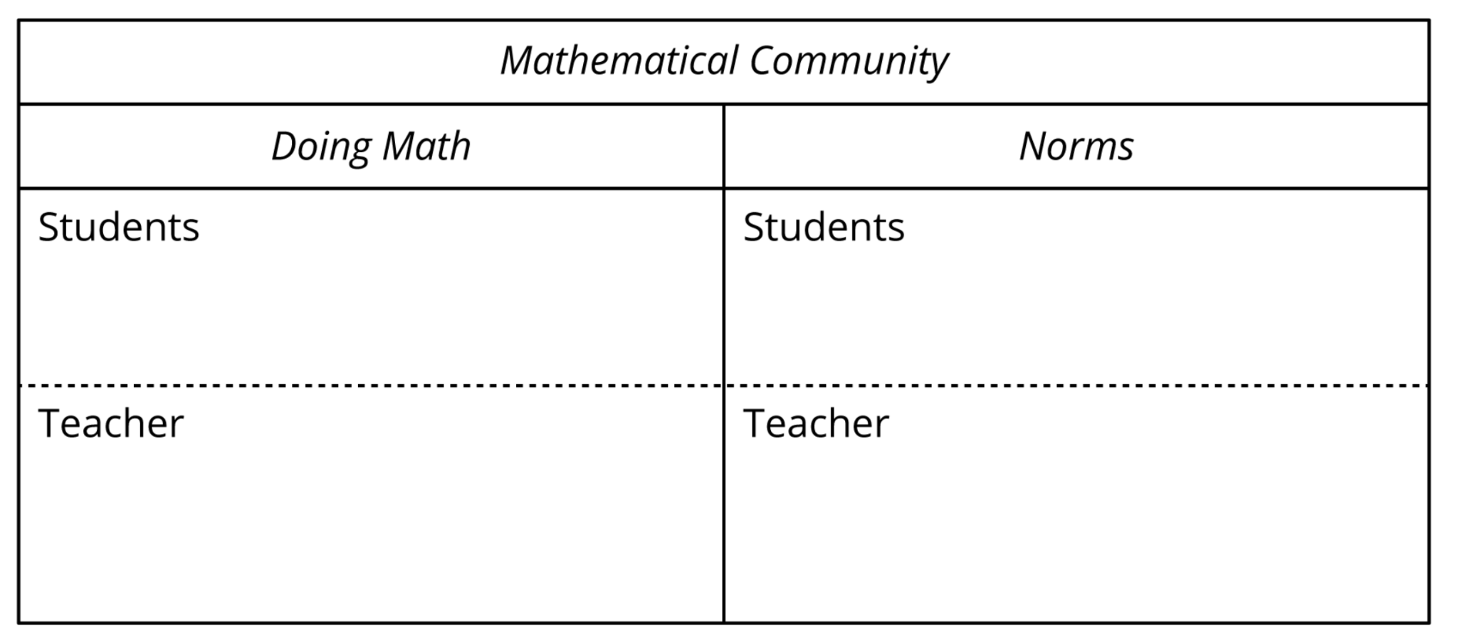
Building a Math Learning Community
Pair
Examine the Mathematical Community lists we created during our first lesson.
Discuss with a partner
What are some actions we did that need to be added to the lists?
What are some norms we might need to add to our list?
Notes:
Give 1 minute of time to examine the list.
2-3 minutes for partner discussion. Walk around and listen for ideas that need to be added. Select students to share those ideas during whole class share-out and add those to the Chart. Class will revisit the chart next day.

Slide 13
Rewrite the following expressions using the distributive property.
1. $5\left(3x−2\right)$
2. $2x\left(6x+5\right)$
3. $\frac{2x}{3}\left(9x+6\right)$
Notes:
These problems provide students with an opportunity to review the distributive property and identify the rate of change of linear functions from different representations. The distributive property is foundational for work with quadratics in this unit and the next unit. Identifying rates of change for linear relationships will support students in understanding the nature of the change for a quadratic function. Ask students to work the problems individually and then have students share their solutions to each problem with a partner. Monitor the individual and partner work to see if there is a need to discuss either of these problems as a whole class. If so, have successful students share their solution processes for each problem, as needed.

Slide 14
Identify the rate of change in each representation of a linear function.
4. $f\left(n\right)=f\left(n−1\right)−8, f\left(1\right)=13$. 6.
Notes:
Identifying rates of linear change are going to support student understanding of the linear first difference in a quadratic function as we move forward. Have students work solo and then share their responses in small groups to bounce ideas off of one another.

